Slide 1
Use and evaluation of ECMWF forecasts with focus on extremes
Linus Magnusson , Evaluation section, Forecast Department

Slide 2
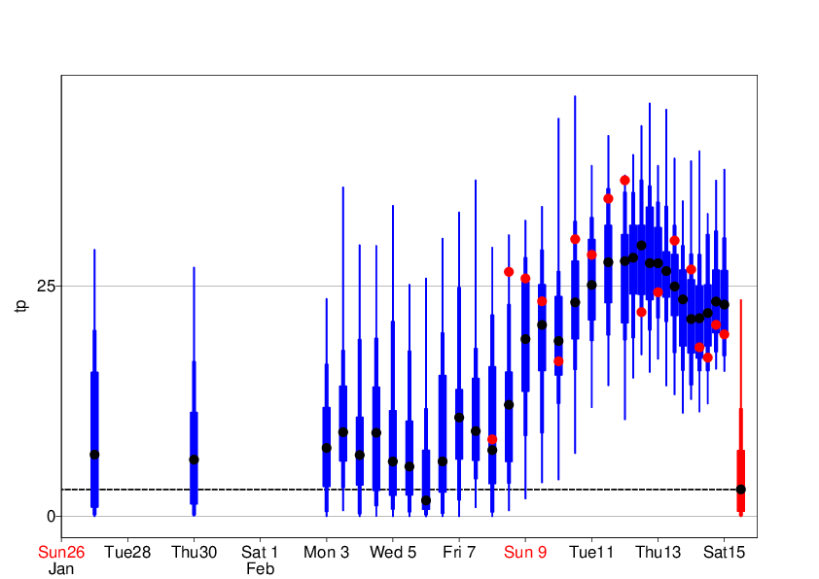
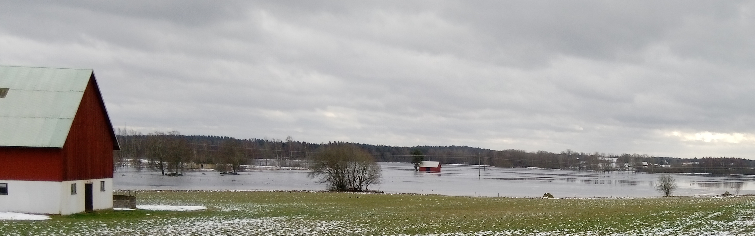
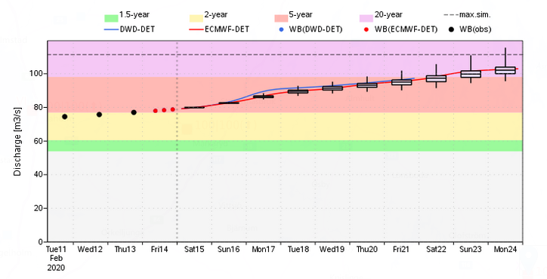
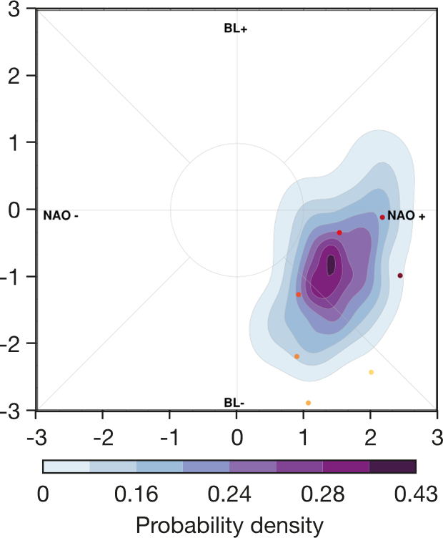
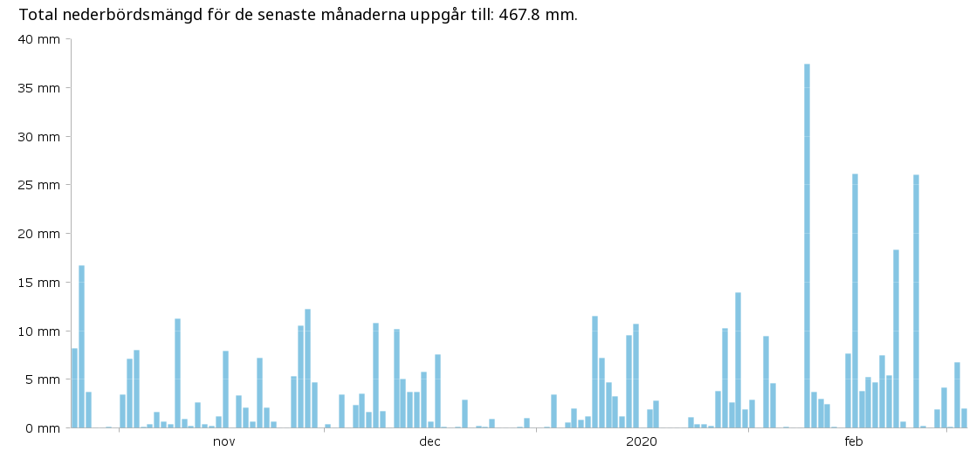
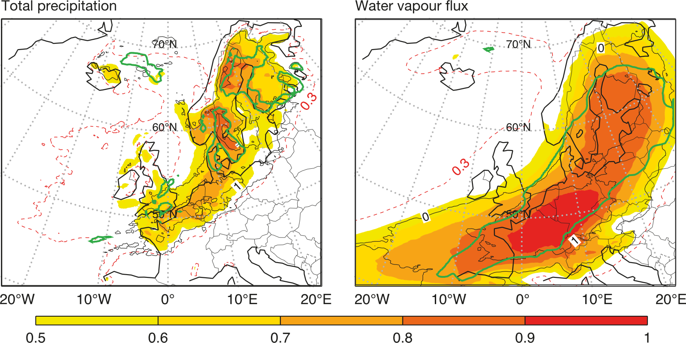
Multi-scale prediction of extremes: Flooding in southern Sweden in 2020
Forecast evolution of precipitation in southern Sweden during Storm Dennis
Forecast of river discharge in Mörrumsån
Early prediction of positive NAO+
3 week forecast
One of several events
Precipitation in Växjö
Strong atmospheric river for Storm Dennis
6-day forecast
Storm Dennis

Slide 3
Basic motivations for forecast evaluation
Measure the skill of the forecast products – inform users
Monitor the evolution of forecast performance – inform management
Evaluate new model versions – avoid future problems
Scout for error – direct future improvements
Quickly understand reported errors – firefighting
Learn about the forecast performance in general – preparedness for future questions
For this one need a wide range of diagnostic tools, verification metrics and a broad understanding of the forecasting system

Slide 4
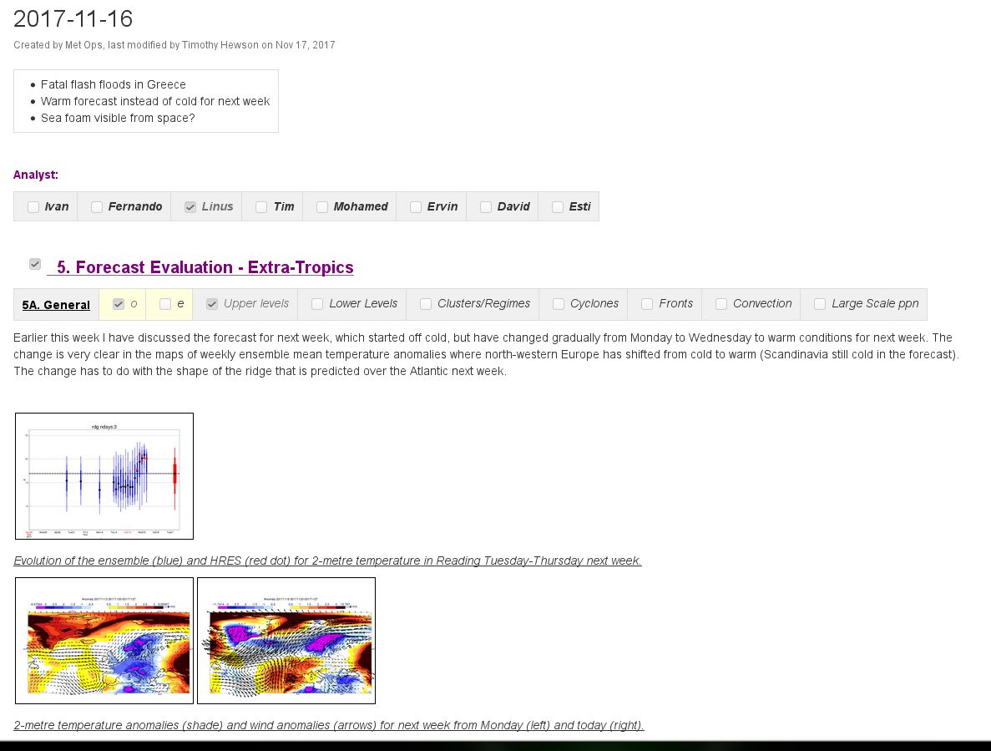
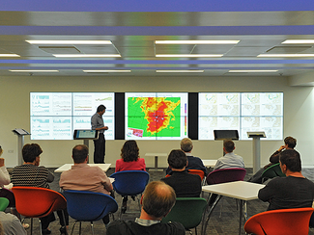

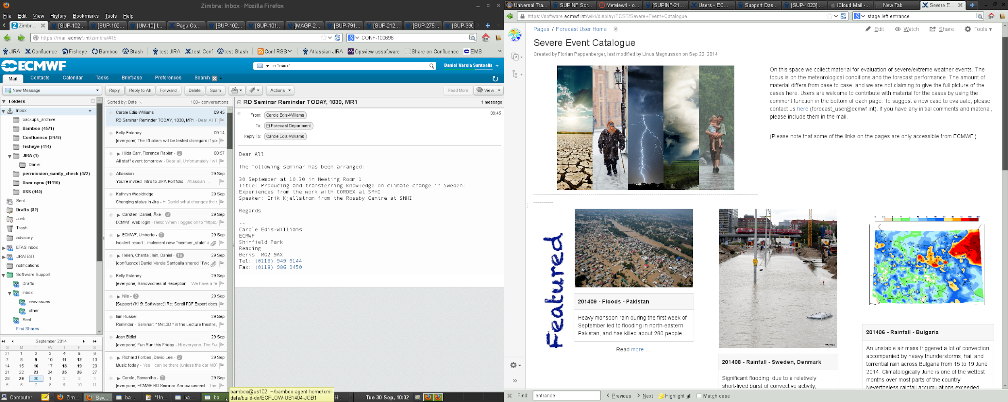
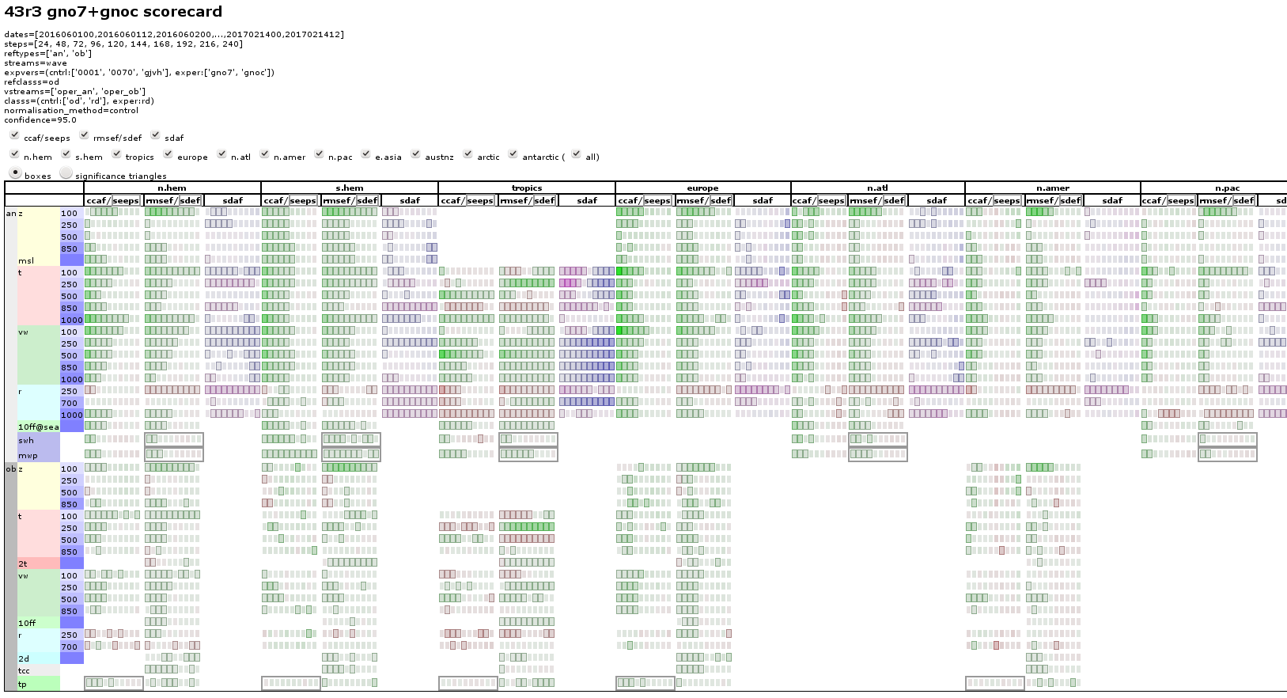
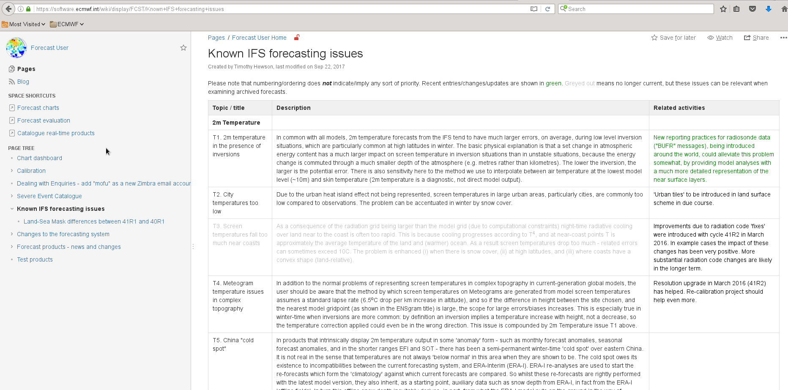
Forecast quality monitoring at ECMWF
Questions from users
Daily report
Weekly weather discussions
Quarterly evaluation and development meeting
Research activities
Known forecast issues
Severe event catalogue
New model cycles

Slide 5
What can we learn from case studies?
Severe event catalogue (~150 cases since 2013):
https://software.ecmwf.int/wiki/display/FCST/Severe+Event+Catalogue
List of ECMWF Newsletter articles on severe events:
139 - Windstorms in northwest Europe in late 2013
140 - Forecasting the severe flooding in the Balkans
141 - Recent cases of severe convective storms in Europe
142 - Forecasts for a fatal blizzard in Nepal in October 2014
143 - Forecasts for US east coast snow storm in January 2015
144 - ECMWF forecasts for tropical cyclone Pam
145 - Predicting this year’s European heat wave
146 - Forecasting flash floods in Italy
147 - Wind and wave forecasts during Storm Gertrude/Tor
148 - Forecasts showed Paris flood risk well in advance
149 - Predicting heavy rainfall in China
150 - Flash floods over Greece in early September 2016
151 - The cold spell in eastern Europe in January 2017
152 - ECMWF supports flood disaster response in Peru
153 – Predictions of tropical cyclones Harvey and Irma
154 – Two storm forecasts with very different skill
155 – Predicting extreme snow in the Alps in January 2018
156 – Forecasting convective rain events in late May
157 – Forecasting the 2018 European heatwave
158 – Predicting multiple weather hazards over Italy
159 - Forecasts of freezing rain in Romania
160 - ECMWF works with universities to support response to tropical cyclone Idai
161 - The 2019 western European heatwaves
162 - Challenges in forecasting Hurricane Lorenzo
163 - Forecasting February’s wet and stormy weather in parts of Europe
164 - Warm intrusions into the Arctic in April 2020
165 – Hurricane Laura and its threat to the United States
166 - Windstorm Alex affected large parts of Europe
167 - Unusual snowfall in Madrid in January
168 - Saharan dust events in the spring of 2021
169 - Extreme rain in Germany and Belgium in July 2021
170 - Heavy snowfall in Denmark and Sweden at the start of December
171 - Wind gust predictions for storm Eunice

Slide 6
But first….
Single probabilistic forecasts for life-threating events cannot be verified!
  The true probability distribution function is not known – only the single outcome
  Life-threating events usually rare – return periods often >20 years – too small sample to do a probabilistic verification
  Life-threating events are usually a composite of sub-events and unique in horizontal and temporal scales
    Series of precipitation events leading to river flooding
    Combination of waves, storm surge, tides and precipitation leading to costal flooding
    Length and magnitude of heatwaves
    …..
What can we do:
Statistical verification of less extreme events
Evaluate model climate of extremes
Learn about important aspects from case studies

Slide 7
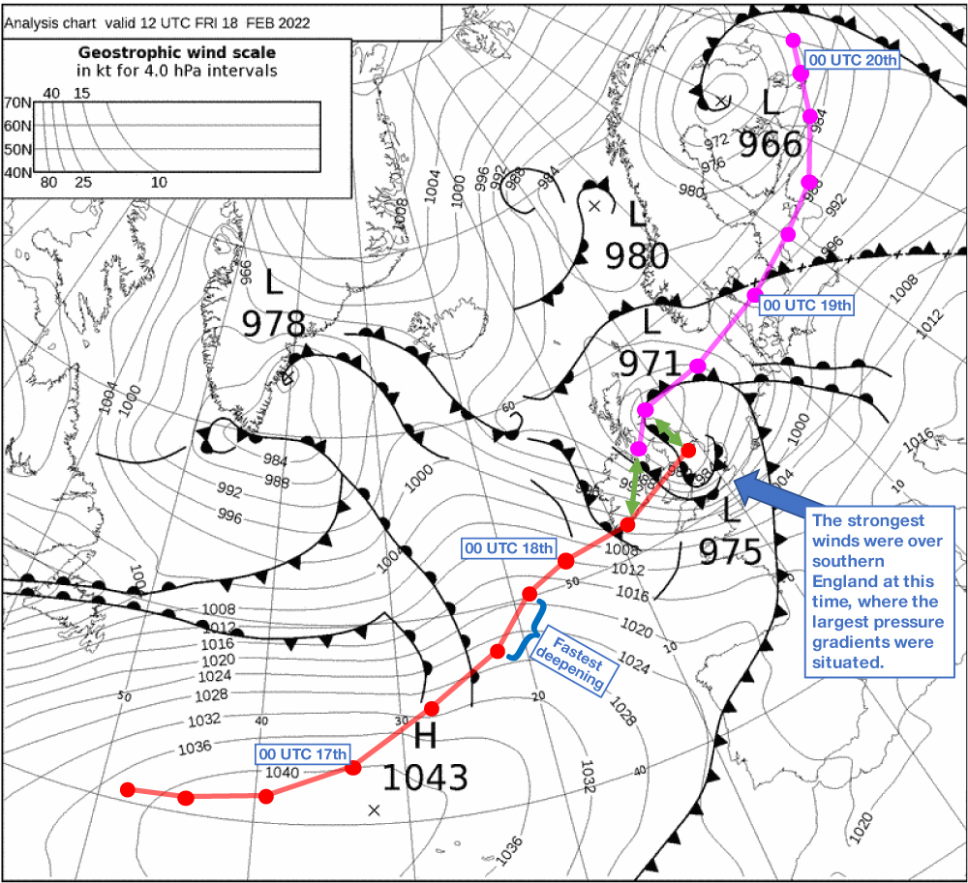
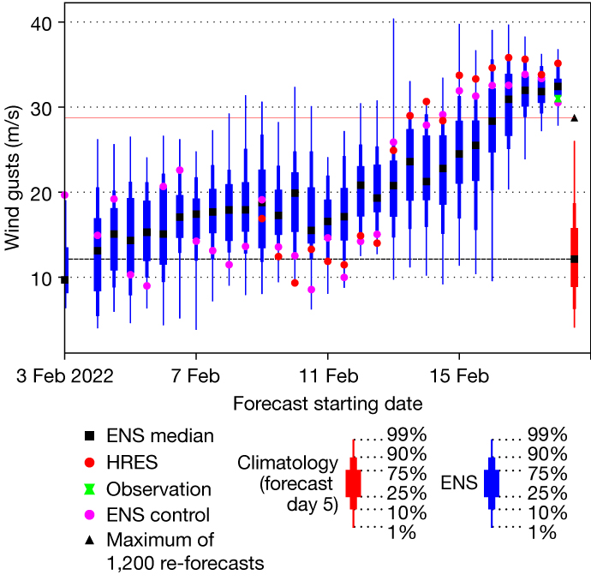
Storm Eunice
ECMWF Newsletter 171
Maximum wind gusts for London-Heathrow

Slide 8

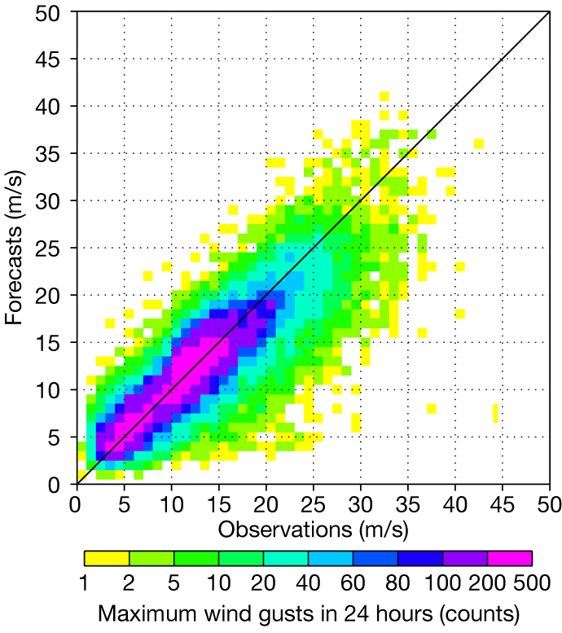
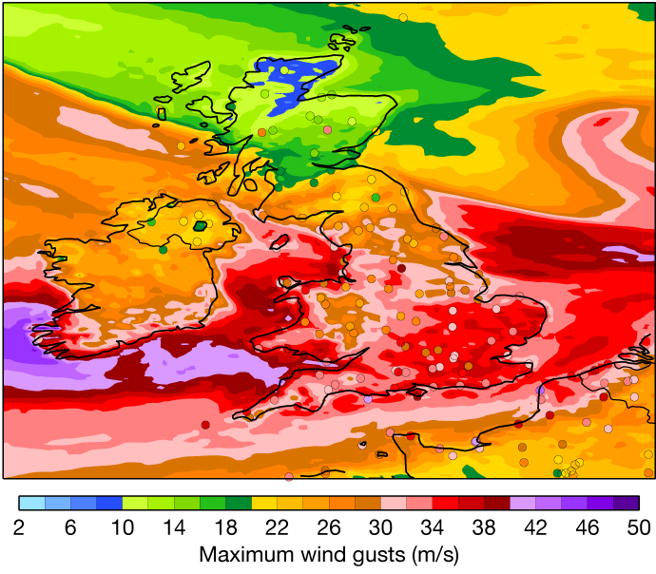
Maximum wind gust predictions
Wind gust statistics for Europe 12-21 Feb 2022
Wind gusts retuned in cycle 47r3

Slide 9
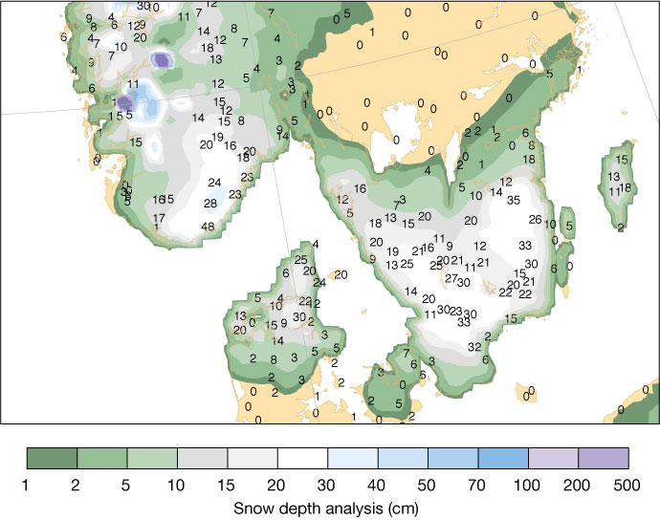
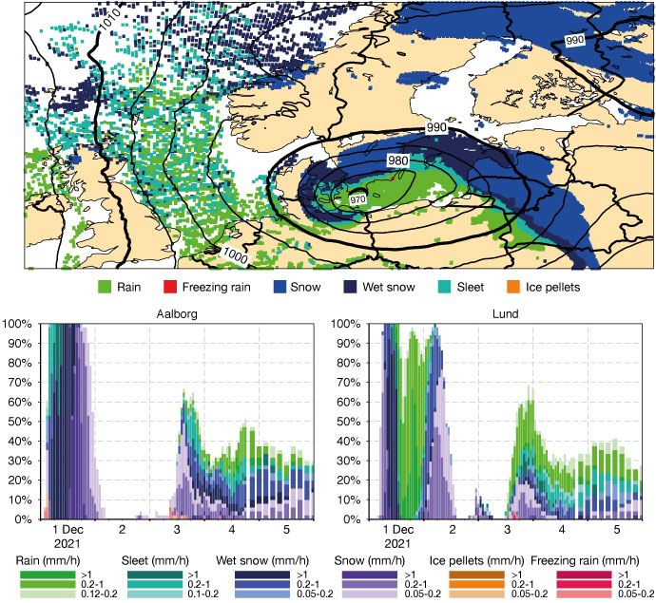
Early snowfall in December 2021
ECMWF Newsletter 170
Snow analysis and observations
Precipitation type forecasts

Slide 10
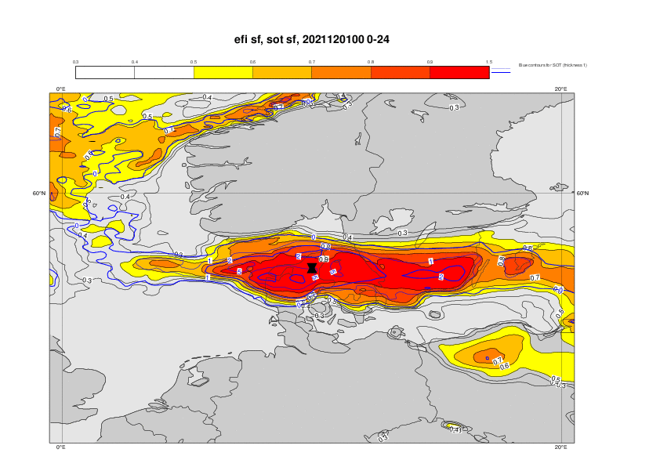
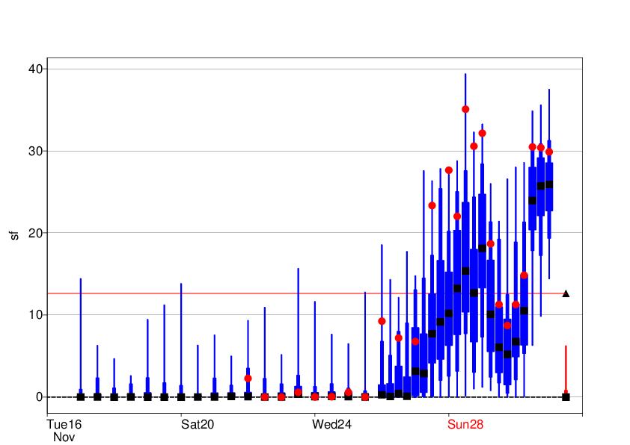
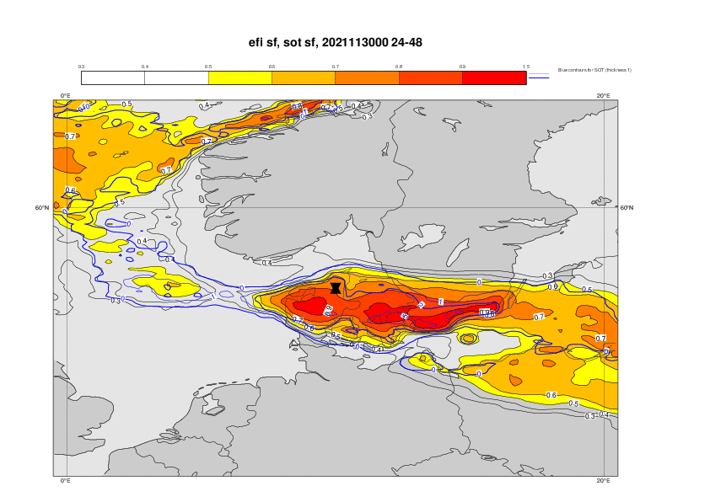
Prediction of the snowfall in Aalborg, Denmark 1 Dec
(mm of water eq.)
1 Dec 00UTC
30 Nov 00UTC
HRES – red dot, ENS – blue, Model climate – red
Max in model climate - triangle

Slide 11
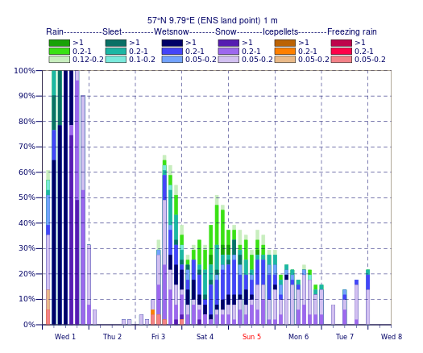
Snow accumulation in Aalborg
Reality
Model
Under-catch?
32 mm total / 30 mm snow water
17 mm
Over-predicted?
10/22/30 cm
16 cm
Correct snow density?
(Snow water / snow density = snow depth)
Representativeness uncertainty

Slide 12
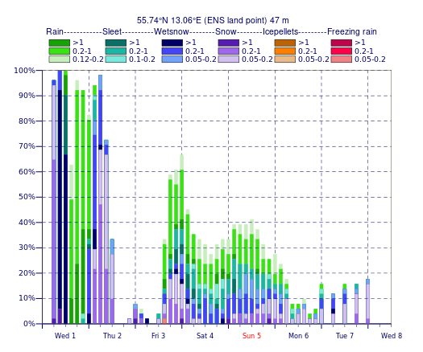
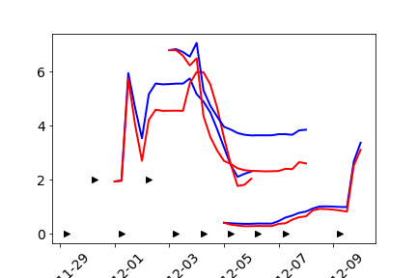
Snow accumulation in Lund
Model
00-12UTC
12-24 UTC
00-12 UTC
+6C
10 cm
Snow depth in:
47r3 (blue)
New snow model (red)
Obs (triangles)
Reality
+7.5C

Slide 13
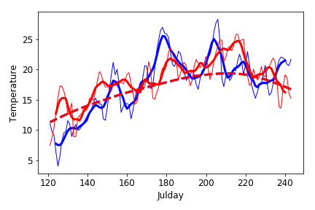
Predictability drivers for 2018 European Heatwave
ECMWF Newsletter 157
Daily mean temperature over France
2018 –red
2019 - blue
Daily values – thin
7-day mean – thick
Climate - dashed
1 May
1 Sept

Slide 14
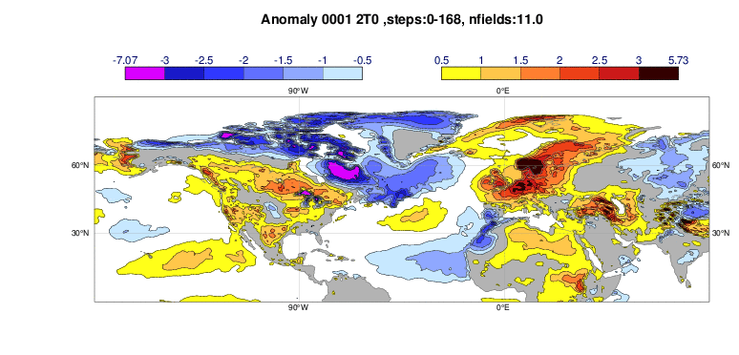
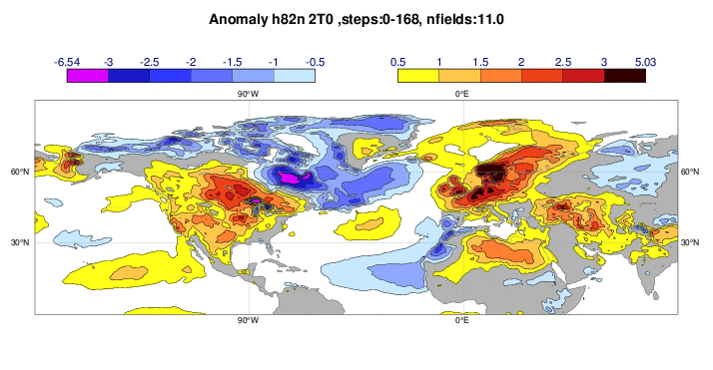
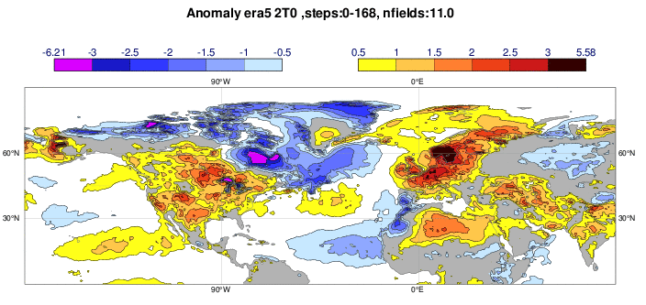
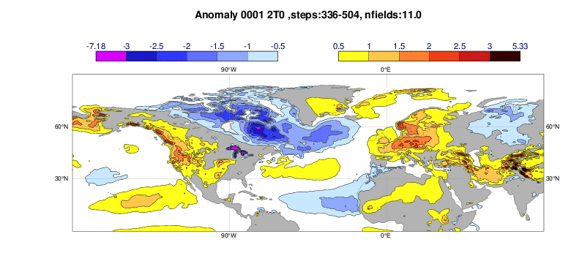
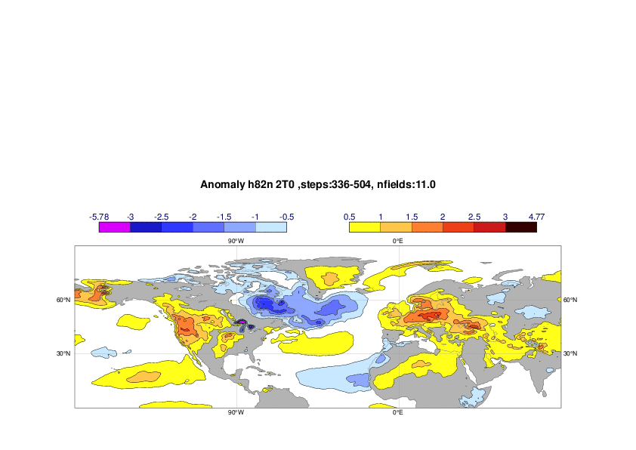
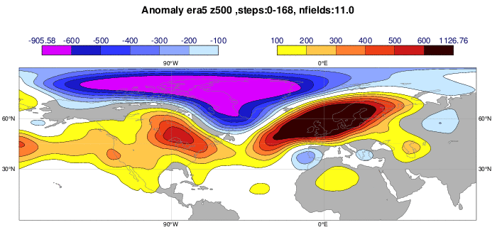
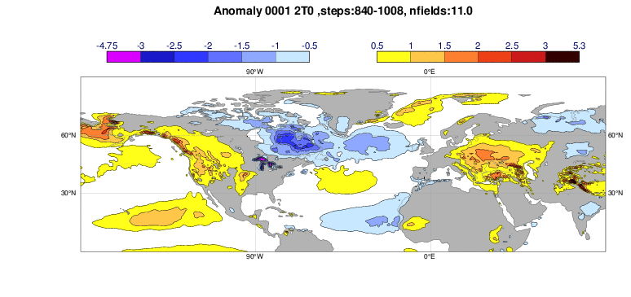
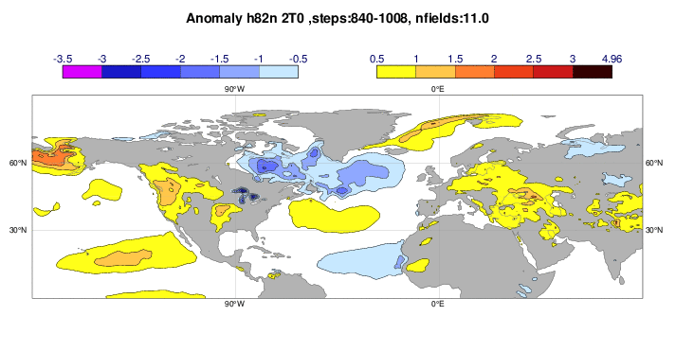
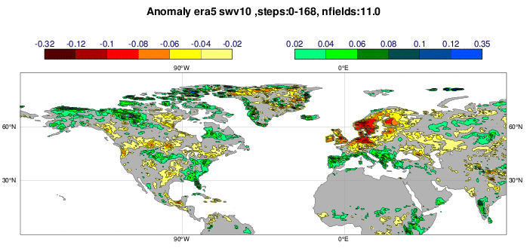
2-metre temperature
Composite anomalies
9 May – 6 August 2018
Operational
Low-reso Experiment
Week 1
Analysis anomalies (ERA-5)
Week 3
Week 6

Slide 15
Swapping of initial conditions (ocean, land)
2018 all
2018 atm, 2018 oc, 2017 land
2018
2018
2018
2017
2018
2018
2017
2018
2018
2018 atm, 2017 oc, 2018 land
2017 atm, 2018 oc, 2018 land
2018
2017
2018
2018
2018
2018
2017
2017

Slide 16
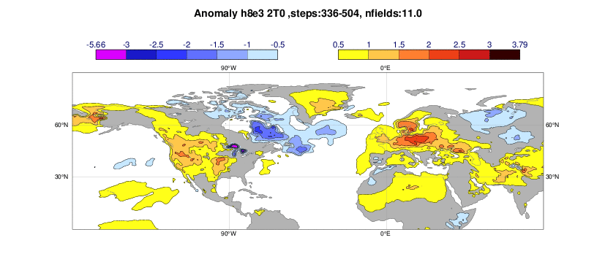
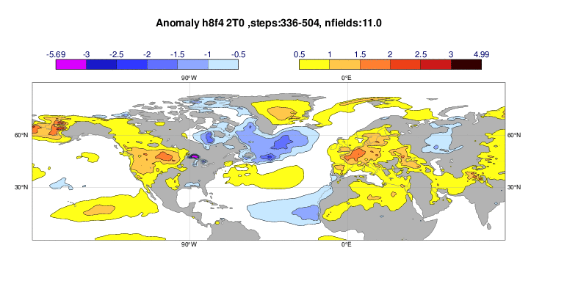
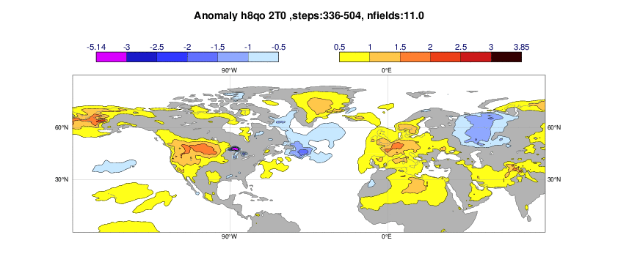
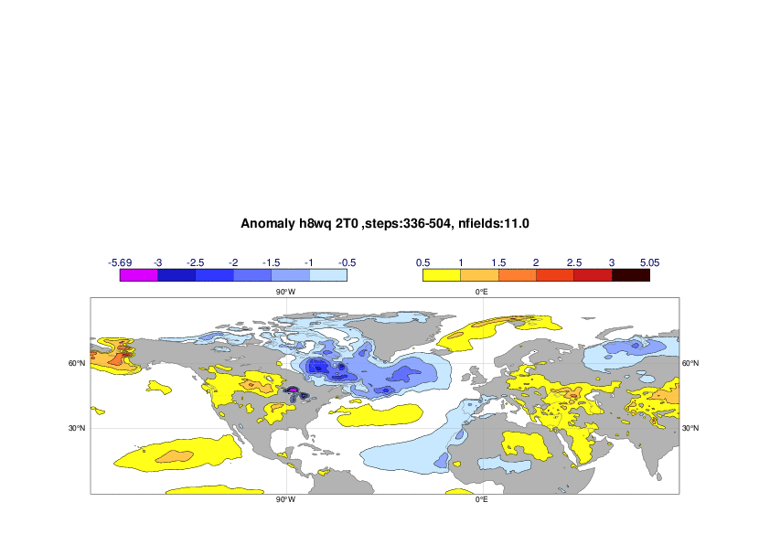
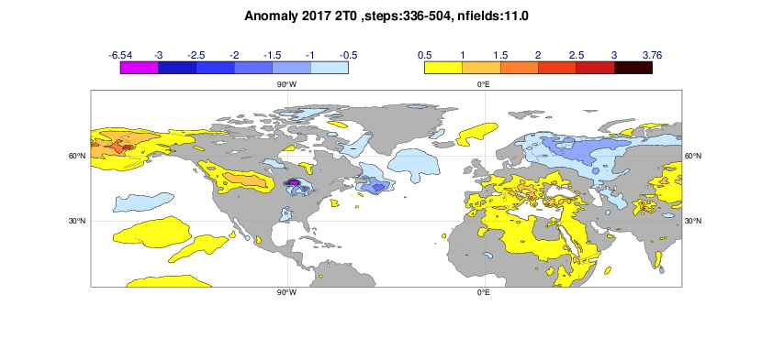
2018 all
2018 atm, 2017 oc, 2018 land
2-metre temperature anomaly week 3
Analysis anomaly
2018 atm, 2018 oc, 2017 land
2018 atm, 2017 oc, 2017 land
2017 atm, 2018 oc, 2018 Land
2017 all

Slide 17
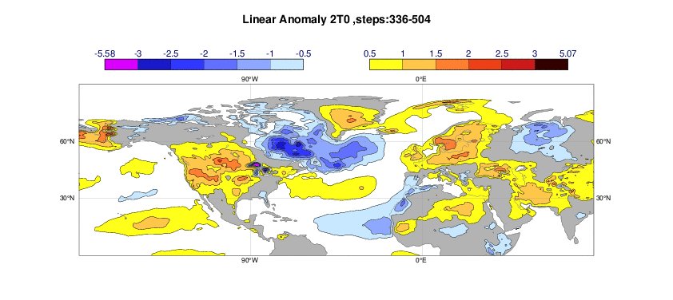
2-metre temperature anomaly week 3
2018 atm, 2017 oc, 2017 land
2017 atm, 2018 oc, 2018 Land
Analysis
2017 all
2018 linear
2018 non-linear
Summary: Non-linear interactions played an important role

Slide 18
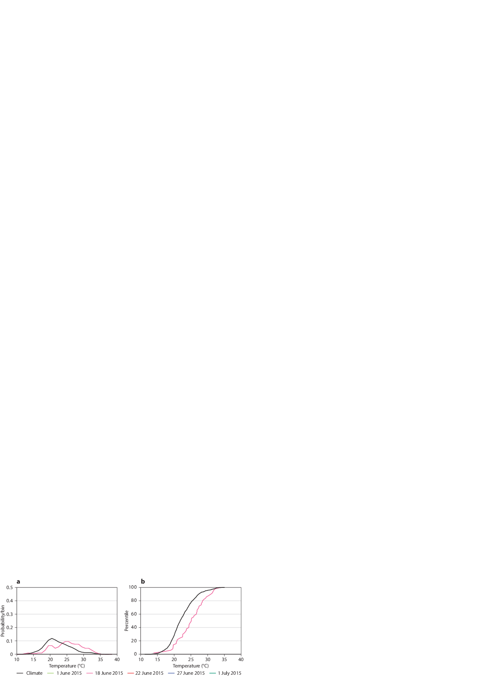
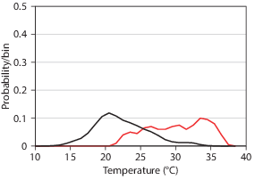
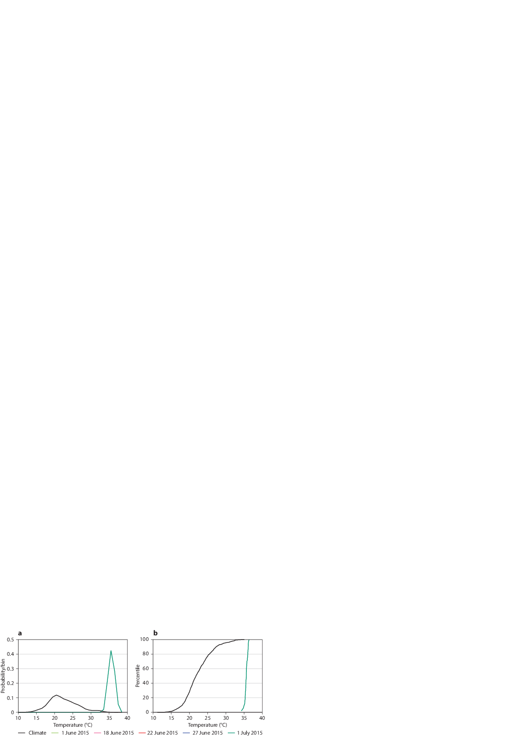
Lessons learn on predictability on different time-scales
ECMWF Tech Memo 851
 | Extended range (2-4 weeks) | Medium range (3-7 days) | Short range (0-3 days)
European heatwave | Soil moisture, SST anomalies | Rossby wave train | Local heating and evaporation
N. European extreme rainfall | North-Atlantic oscillation | Presence of Atmospheric rivers | Exact position of the system, strength of orographic precipitation
N. European windstorm | North-Atlantic oscillation | Jet-stream propagation | Timing of development, wind gust parameterisation
Tropical cyclones | SST, MJO, African easterly waves | Steering flow | Landfall position and intensity
Flash-floods in S. Europe | Predict S. European flow-regimes(?) | Position of trough/cut-off low and Med. Atmospheric rivers | Evaporation + Moisture advection, precipitation processes (orography), runoff into rivers
Severe convection |  | Upper-level troughs, Positions of fronts, CAPE, wind shear | Convective triggering, organisation, life-time, wind gust parameterisation
Eastern Asian rainfall | Monsoon strength (?) | Position of frontal zone (Mei-Yu) | Local pattern of precipitation
Long-lived flow patterns, teleconnections and boundary conditions
Capturing synoptic situation, global DA
DA and model physics suitable for extreme conditions

Slide 19
Examples of error types
Observation related (missing observations, faulty observations)
  Automated alarm systems and quality control
Boundary conditions
  Sea-ice and SST
  Snow
  Soil mositure
  Climate files (land-sea mask, vegetation, ..)
Large synoptic errors
  Medium-range (forecast busts)
Weather parameters
  2-metre temperature, clouds, winds
  Often systematic errors
Severe events
  Missing extremes
Model climate
  Mean
  Variability
Summary
Purpose of forecast evaluation
  Fire fighting (problems that needs immediate action)
  Detect and document systematic errors (to be addressed in research)
  Learn about the behaviour of the forecast system (unpredictable situations, extreme weather, …)

Slide 20
Outreach in focus
🔗 confluence.ecmwf.int/display/FUF
Forecast User Forum
A discussion platform for users of ECMWF forecasts to interact with other users and with ECMWF, on topics related to weather and forecasts, and to provide feedback to ECMWF.
ECMWF will be monitoring discussions, joining conversations and considering comments and feedback in ongoing research and diagnostic work.
3 forum categories:
  Current and Recent Weather
  Featured Feedback Topics
  UEF Events & Training

Slide 21


Slide 22
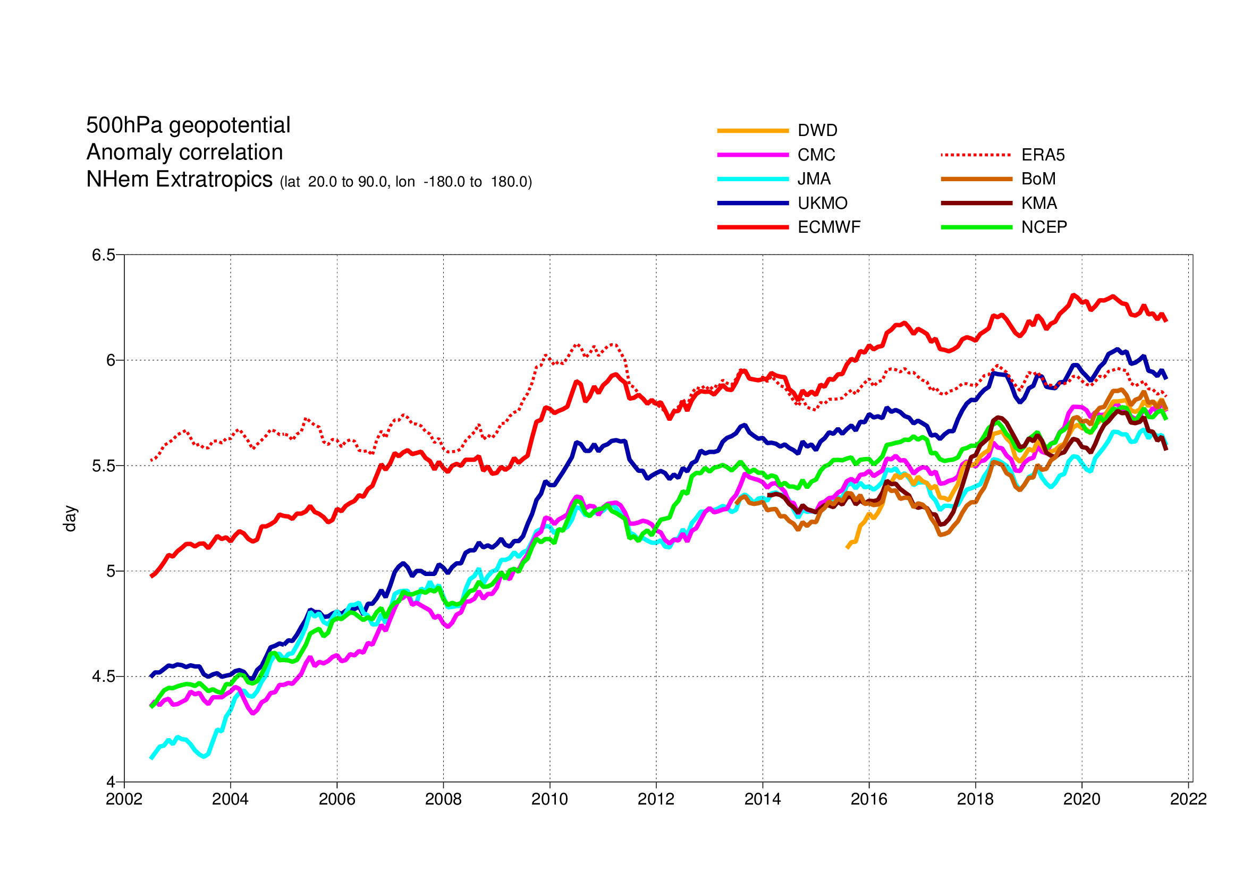
Model performance: comparisons with other centres
Forecast range at which the anomaly correlation drops below 85%
Notes:
500Z for Nhem extratropics

Slide 23
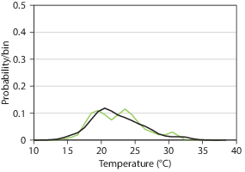
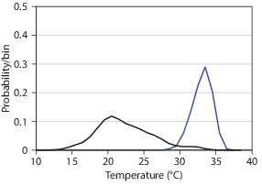
Multi-scale predictability
What are driving the predictability on different scales?

Slide 24
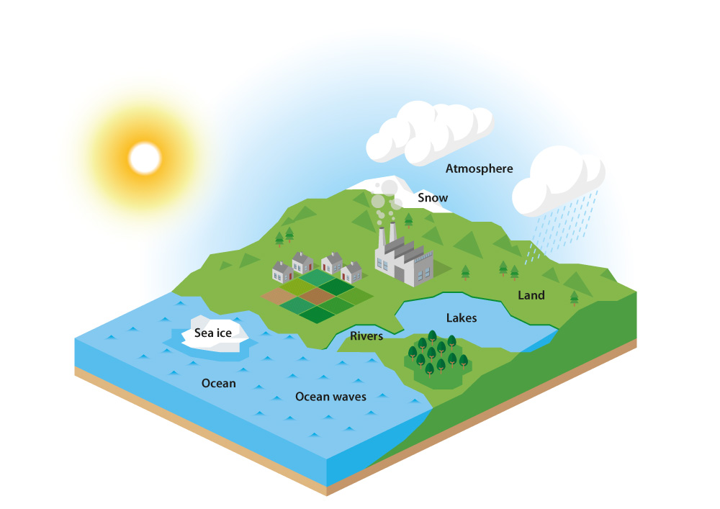
The operational ECMWF forecasting system
High resolution deterministic forecast (HRES) :
  twice per day 9 km, 137 levels, to 10 days ahead
Ensemble forecast (ENS):
  twice per day 51 members, 18 km, 137 levels, to 15 days ahead
  Monday/Thursday 00 UTC extended to 46 days ahead with 36 km
    Reforecast dataset with 11 members for past 20 years
Seasonal forecast: once a month
  51-members, ~35 km 91 levels, to 7 months ahead (~38 years of hindcasts with 25 members)
  sub-set of 15 members is run for 13 months every quarter
Slide 24

Slide 25

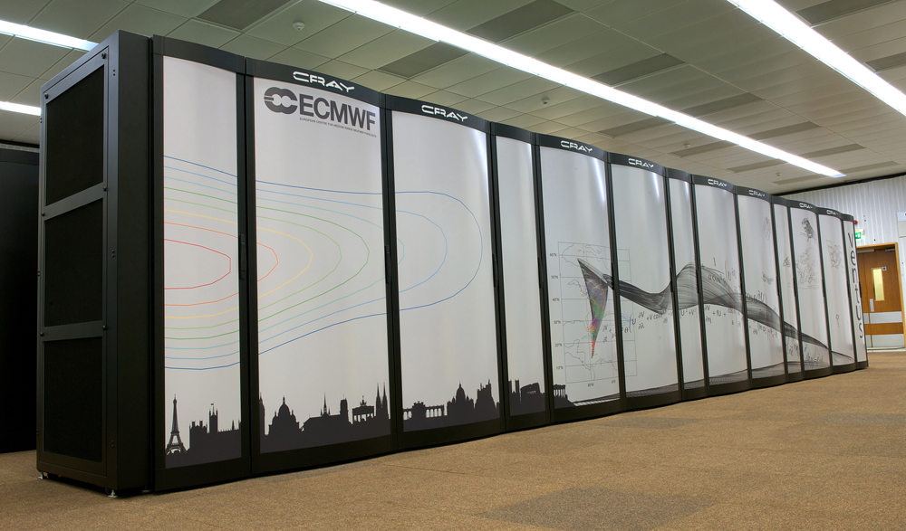
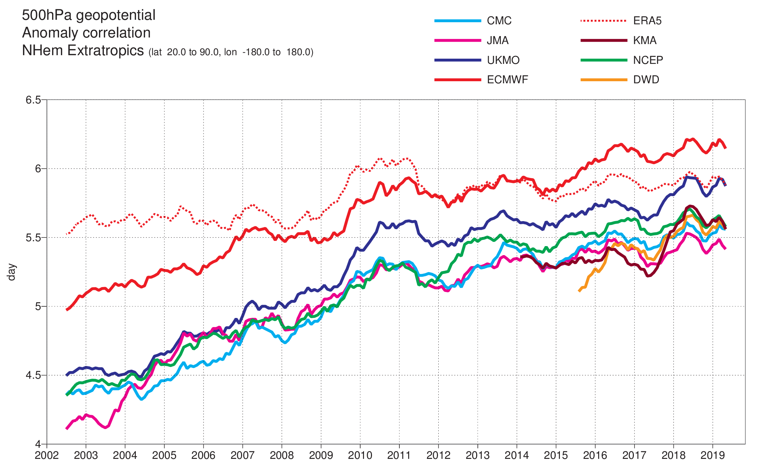
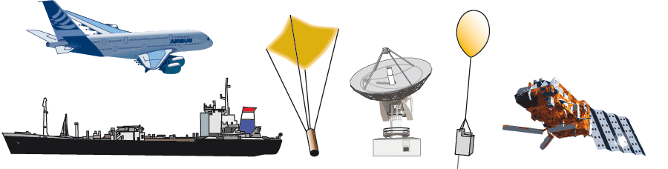
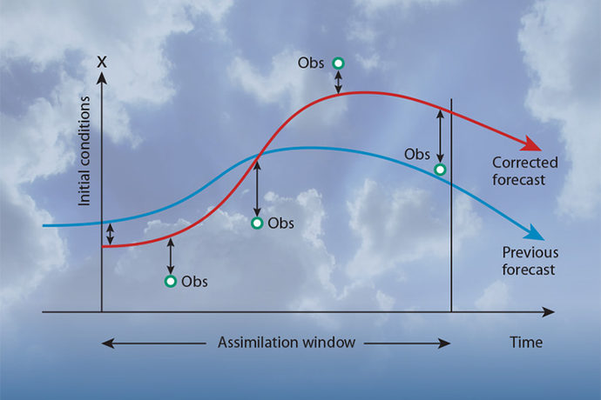
Basic steps in NWP
Observations
Quality control
Data assimilation
Forecast
Dissimilation
Evaluation
Observation types
Conventional
Polar satellites
Geostationary sat.
Common issues
Algorithms
Background error
Observation error
Increments
Model components
Dynamics
Atm. Physics
Surface
Ocean
Reliability
Timeliness
Post-processing
Products
Daily errors
Statistical evaluation
Diagnostics
Current issues

Slide 27


Example tropical cyclone Idai (2019)
Extended-range forecast from 4 March
https://www.ecmwf.int/en/newsletter/160/news/ecmwf-works-universities-support-response-tropical-cyclone-idai

Slide 28


Forecast value chain
Flood forecast from GLOFAS
globalfloods.eu
Tropical cyclone tracks
Extreme forecast index for precipitation
Emerton et al. https://www.sciencedirect.com/science/article/pii/S2212420920313133

Slide 29
Known forecast issues

Slide 31






2018 all
2018 atm, 2017 oc, 2018 land
Soil water level 1 anomaly week 1
2018 atm, 2018 oc, 2017 land
2018 atm, 2017 oc, 2017 land
2017 atm, 2018 oc, 2018 Land
2017 all
Mean change already in week 1 due to atmosphere

Slide 32

Summary 2018 heatwave
Week 3 predictability mainly from atmosphere
Some signal from soil, but is dependent on the atmosphere
Little signal from ocean
To do
  Intra-seasonal variability
  Compare skill with other heatwaves in the reforecast
  …

Slide 33



Relaxation experiment
-λ ( x - x_{ref} )
20 ensemble members
Reduction of ensemble spread
+24h
+72h
+120h

Slide 34


T2m bias DJF 2016-17 00UTC stratified by total cloud cover error
RMSE
RMSE
Weighted contribution to total error
BIAS
BIAS
Average error in each bin
Contribution of each bin to total error

Slide 35


RMSE for z500, Northern hemisphere
1 year sampled every 5th day, Verified against UKMO analysis
RMSE
Difference to fv3ec
Northern Hem.
Southern Hem.
Magnusson et. al. (2019, QJRMS)

Slide 36
Comparison between FV3, GFS and IFS
Initialisation scheme developed at GDFL to initialise FV3 from GFS and IFS initial conditions (Chen et al., AMS Hurricanes 2017)
Create opportunity to compare forecasts with “same” initial conditions but different models: Compare model biases, predictability, etc
 | GFS | FV3, 2018 GFDL version | IFS
Dynamical core | Spectral, Hydrostatic, S-L advection | Finite-volume, Non-hydrostatic, cube-square grid | Spectral, Hydrostatic, S-L advection
Physics | GFS | Modified GFS (GFDL microphysics, YSU PBL scheme, mixed-layer ocean model | IFS
Resolution | 13 km / 64 levels | 13 km / 91 levels | 9 km / 137 levels
Initial conditions | GFS | GFS, IFS | IFS
Same initial condition
Same model
Same initial condition
1-year sample: Initialised every 5th day from 15 August 2015 to 15 August 2016
Hurricane season: Initialised every 12th hour from 1 August to 30 October 2017

Slide 37
RMSE for z500, Northern hemisphere
1 year sampled every 5th day, Verified against UKMO analysis
RMSE
Difference to fv3ec
Northern Hem.
Southern Hem.
Magnusson et. al. (2019, QJRMS)

Slide 38


200 hPa temperature bias
ECMWF has a known cold bias in lower stratosphere in the extra-tropics
(Shepherd et al., ECWMF Technical Memo 824)
Evolution of mean error over N.Hem (in respect to ECMWF analysis)
Mean difference fv3ec-EC after 240 hours

Slide 39


Tropical cyclone track errors, Atlantic, August-October 2017
Total, along and cross track errors
Total error
~1 km/h
Chen et al. (2019, GRL)

Slide 40

RMSE for 6-day z500, Europe 1 February – 1 April
Bust case

Slide 41

Z500 error pattern for bust case
ECMWF initial conditions
2-day error
6-day error
GFS initial conditions
2-day error
6-day error

Slide 42

Correlation of z500 RMSE
Same initial condition
Same model

Slide 43

Forecast differences
6-hour
30-hours
FV3gfs - GFS
FV3ec - EC
FV3gfs – FV3ec

Slide 44

Composite of z500 anomalies in cases of largest difference growth (30h-6h) between FV3ec and EC
1 day before
Middle of growth window
1 day after

Slide 45

Orographic drag in the two models

Slide 46
Conclusions / lessons learnt
Use wide range of scores and metrics to get full picture
Ensure close collaboration in verification between research and operations
Make use of conditional verification
Use special datasets for process understanding
Collaborations between centres help to understand forecasting issues

Slide 47

Correlation of z500 RMSE
Same initial condition
Same model

Slide 48


Accounting for observation uncertainty
IFS Scorecard
Ensemble perturbed approach (Saetra et al. 2004):
recommended when error-corrected scoring rules do not yet exist
consists in adding obs uncertainty on top of the ens uncertainty
Comparison of cycles 43r3 (old cycle) and 45r1 (new cycle)
verification of upper-air variables against radiosondes
obs. error normally distributed (with parameters provided by DA)
ensemble verification without and with observation uncertainty
Need for a general methodology which includes also surface variables!
cycle 45r1 better
-----------------------
cycle 43r3 better

Slide 49

High-impact weather: trends in ensemble forecast performance
Comparison of performance evolution using
different scores (Brier score, Logarithmic score, Diagonal elementary score)
different climatology definitions
Example:
24 h precipitation
95th percentile
Day 5
Highest signal-to-noise ratio
“Monitoring trends in ensemble forecast performance focusing on surface variables and high-impact events”, Ben Bouallegue et al. QJRMS, submitted.

Slide 50

Observation monitoring
Routine monitoring of all available observations
  Provide valuable feedback to data providers and other NWP centres
  Assess model developments and highlight analysis issues
  Safeguard the analysis from poor-quality observations
  Improve observations usage
Automatic alarm system
Participating in the modernisation of WMO’s monitoring, and contributing to the WMO Integrated Global Observing System (WIGOS)
Contributing to EUMETNET’s Obs. Programme
Supporting the migration to BUFR
NEW: monitoring of ocean data
Mean potential temperature (in °C) of the first 5 metres of the ocean as measured by Argo floats over the period 1 February 2017 to 27 March 2017.

Slide 51


Forecast performance
Headline scores
  HRES and ENS upper-air skill
  HRES and ENS precipitation
  Severe weather: TC position and EFI for extreme wind
Comparison with reference systems
Comparison with other centres
Evaluation for severe weather
Additional verification and in-depth diagnostics
See ECMWF web site for latest results
www.ecmwf.int/en/forecasts/quality-our-forecasts

Slide 52


Real-time monitoring of forecast performance
Daily Report of model performance
  Available to all staff on wiki
  Respond to user feedback on model issues
Weekly weather discussion
  In weather room, open to all staff
Quarterly Evaluation and Diagnostics (QED)
  Review of past season
  Discussion of forecast problems
  Plans for future model upgrades

Slide 53

Diagnostics
Diagnostic tools are continuously reviewed and developed:
  EDA variance budgets
  EFI for water vapour transport
  Regime transitions
  Error tracking
  Review of diagnostics work and associated tools
The aim is to improve ECMWF’s abilities to access process-level information for diagnostic studies:
  More spatio-temporal decomposition of forecast variances and errors
  Maintenance and use of non-assimilated/independent data sources
  External collaboration (e.g. with ETH Zurich on the role of “warm conveyor-belts” in the development of downstream forecast error).

Slide 54


Severe event catalogue
https://software.ecmwf.int/wiki/display/FCST/Severe+Event+Catalogue

Slide 55


How has the skill improved over the years?
24-hour
144-hour
1990
2000
2010
HRES
ERAI-I
N.Hem
S.Hem
From Magnusson and Källén (2013, MWR)

Slide 56

Use of super-site observations
Lindenberg, Germany
Useful for process understanding and to constrain parameterizations
Other sites
Sodankylä, FI
Cabauw, NL
Reading, UK
. . .

Slide 57









Examples of diagnostics on different time-scales – Temperature at tropopause level
Drift in 200 hPa temperature
Data assimilation
Forecast mean error
Seasonal scale
Airrep obs dept.
Day 1
Month 1-3
~0.1K
~2K
AMSU-A obs dept.
Day 5
Observation monitoring: 150-300 hPa
~0.5K
Day 10
Analysis increments
~1K
~0.05K

Slide 58


ECMWF: WMO Lead Centre for Deterministic Forecast Verification
Interactive map for surface scores
DWD
UKMO
ECMWF

