Slide 1
Materials: Create your future
Materials for self-printing

Slide 2
Background images
Use a large format to print the background images, ideally A0 format.
The paper needs to be thick enough so that marker pens do not bleed through to the back.
Add a title that describes what the final image will show, e.g. ‘Town adapted for high temperatures in 2073’ or ‘Coastal zone adapted for higher sea level in 2073’.
Two different background images can also be combined on the same large sheet of paper. For example, an image of the town can be combined with an image of the countryside.
The empty spaces in slides 11–16 can be used as they are. The participants create a scenario without preconceptions.
A blank image can also be used to create a digital image of the results from the workshop.

Slide 3
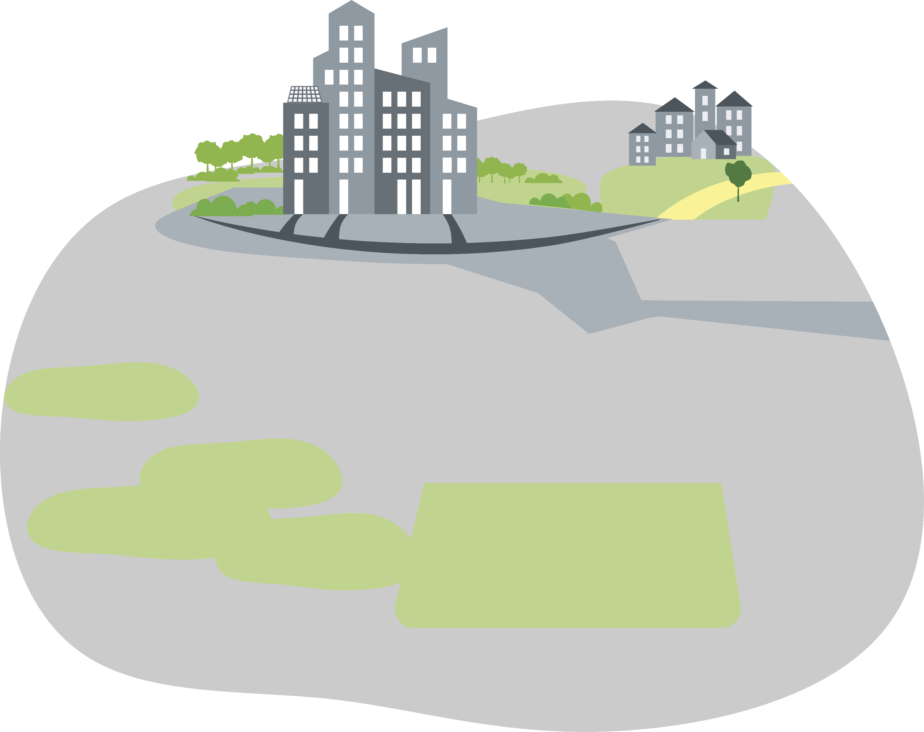
Notes:
Challenge: High temperatures and/or torrential rain

Slide 4
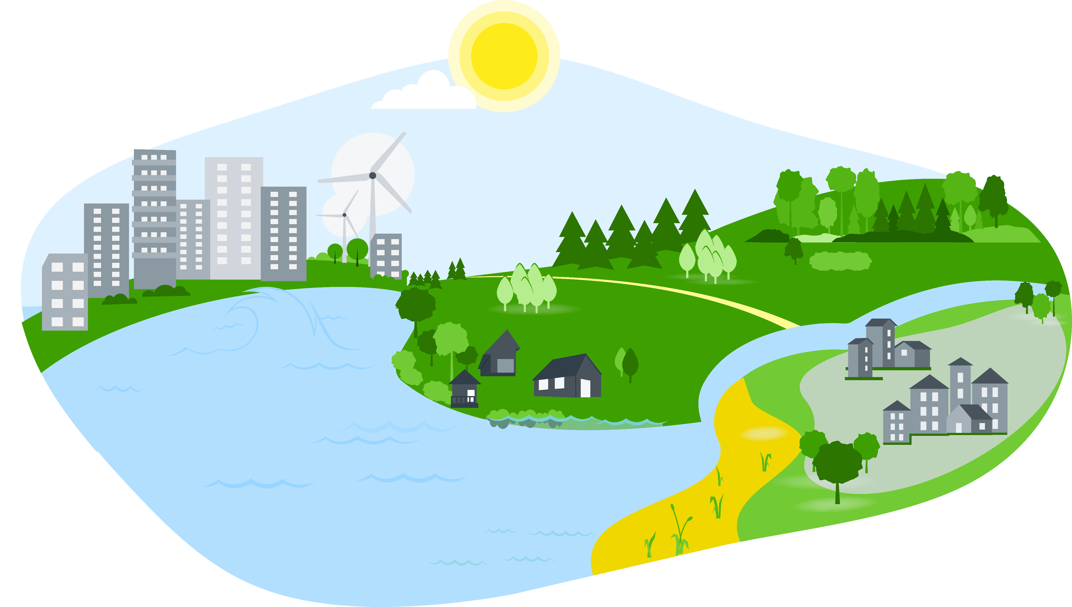
Notes:
Challenge: Flooding and high flows

Slide 5
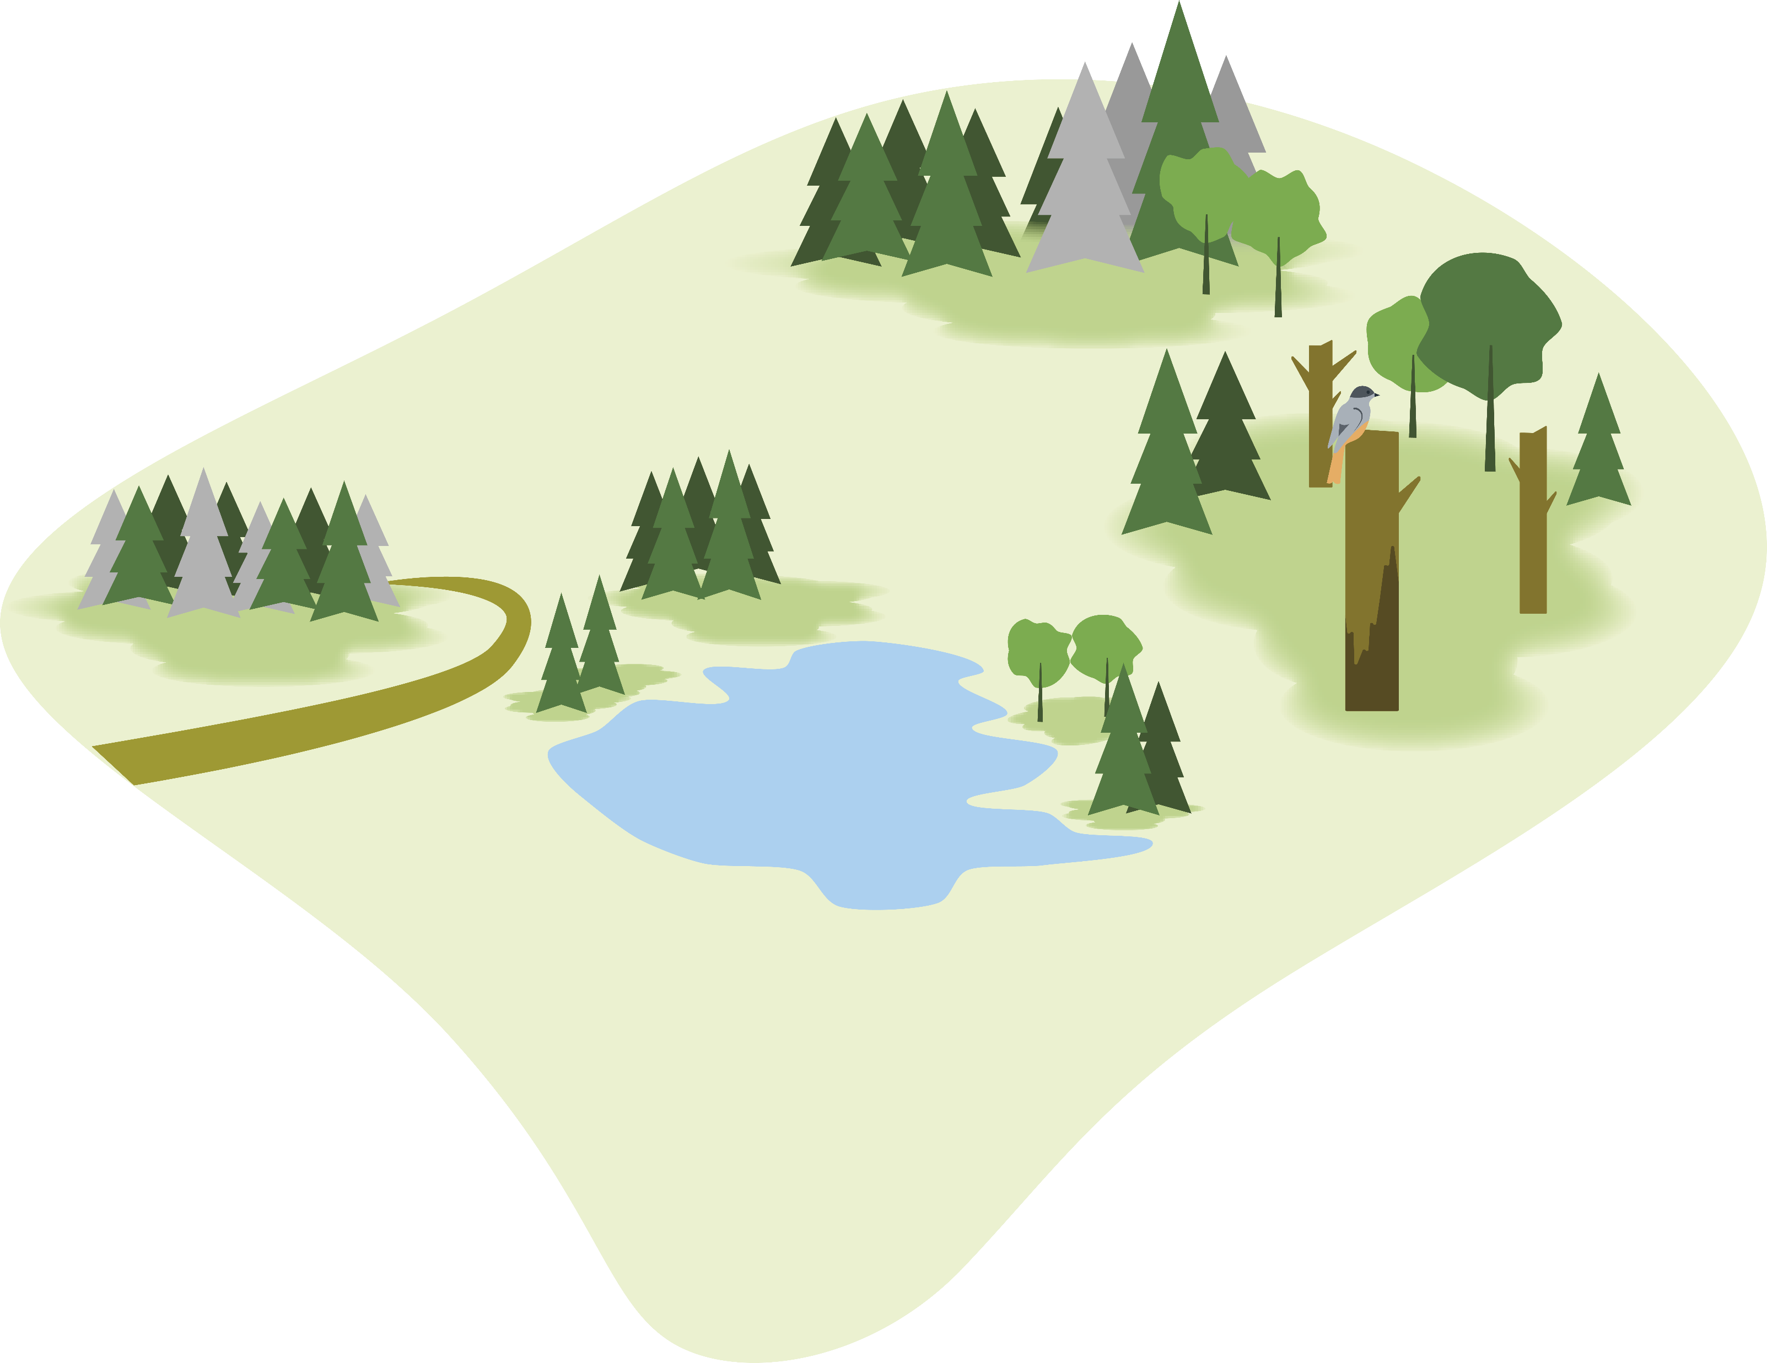
Notes:
Challenge: Increased incidence of pests and diseases

Slide 6
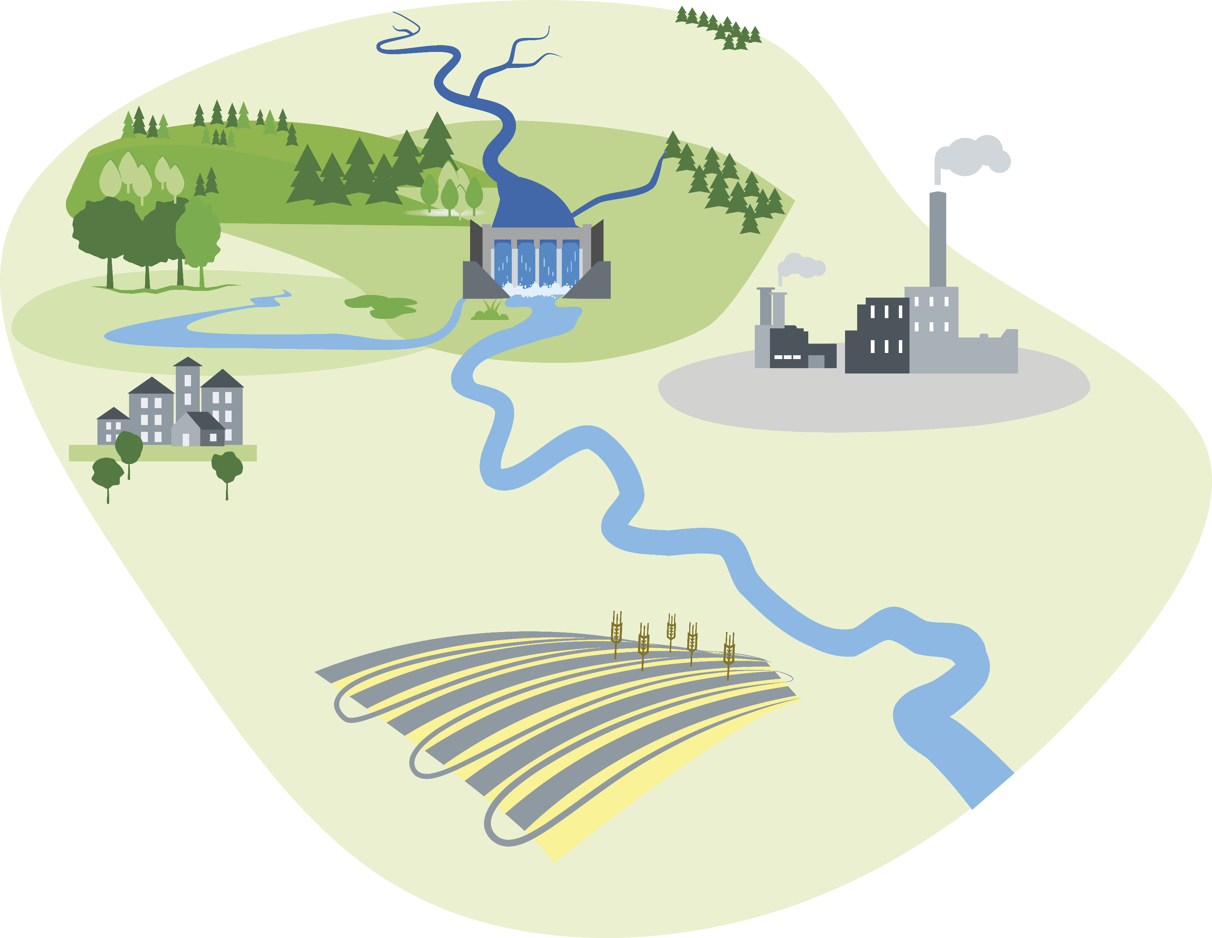
Notes:
Challenge: Water supply shortages

Slide 7
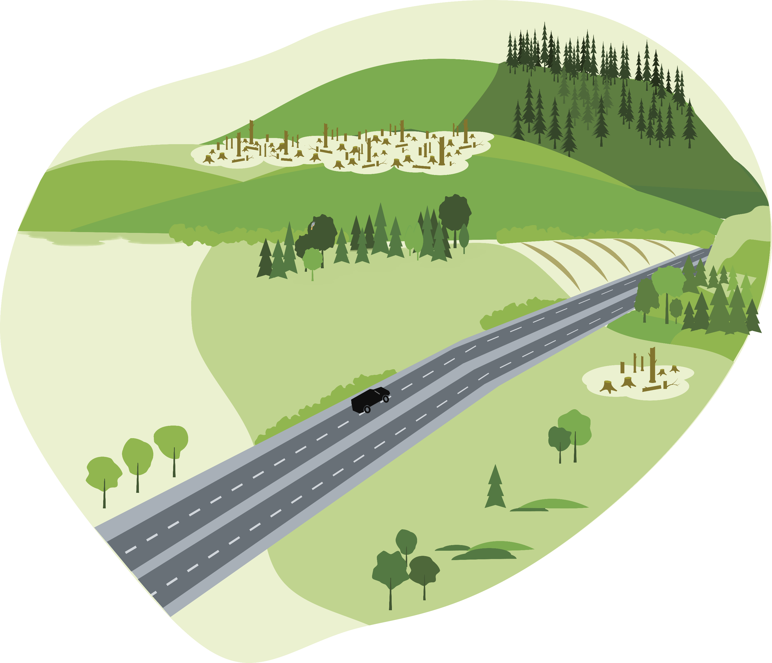
Notes:
Challenge: Biological and ecological effects

Slide 8
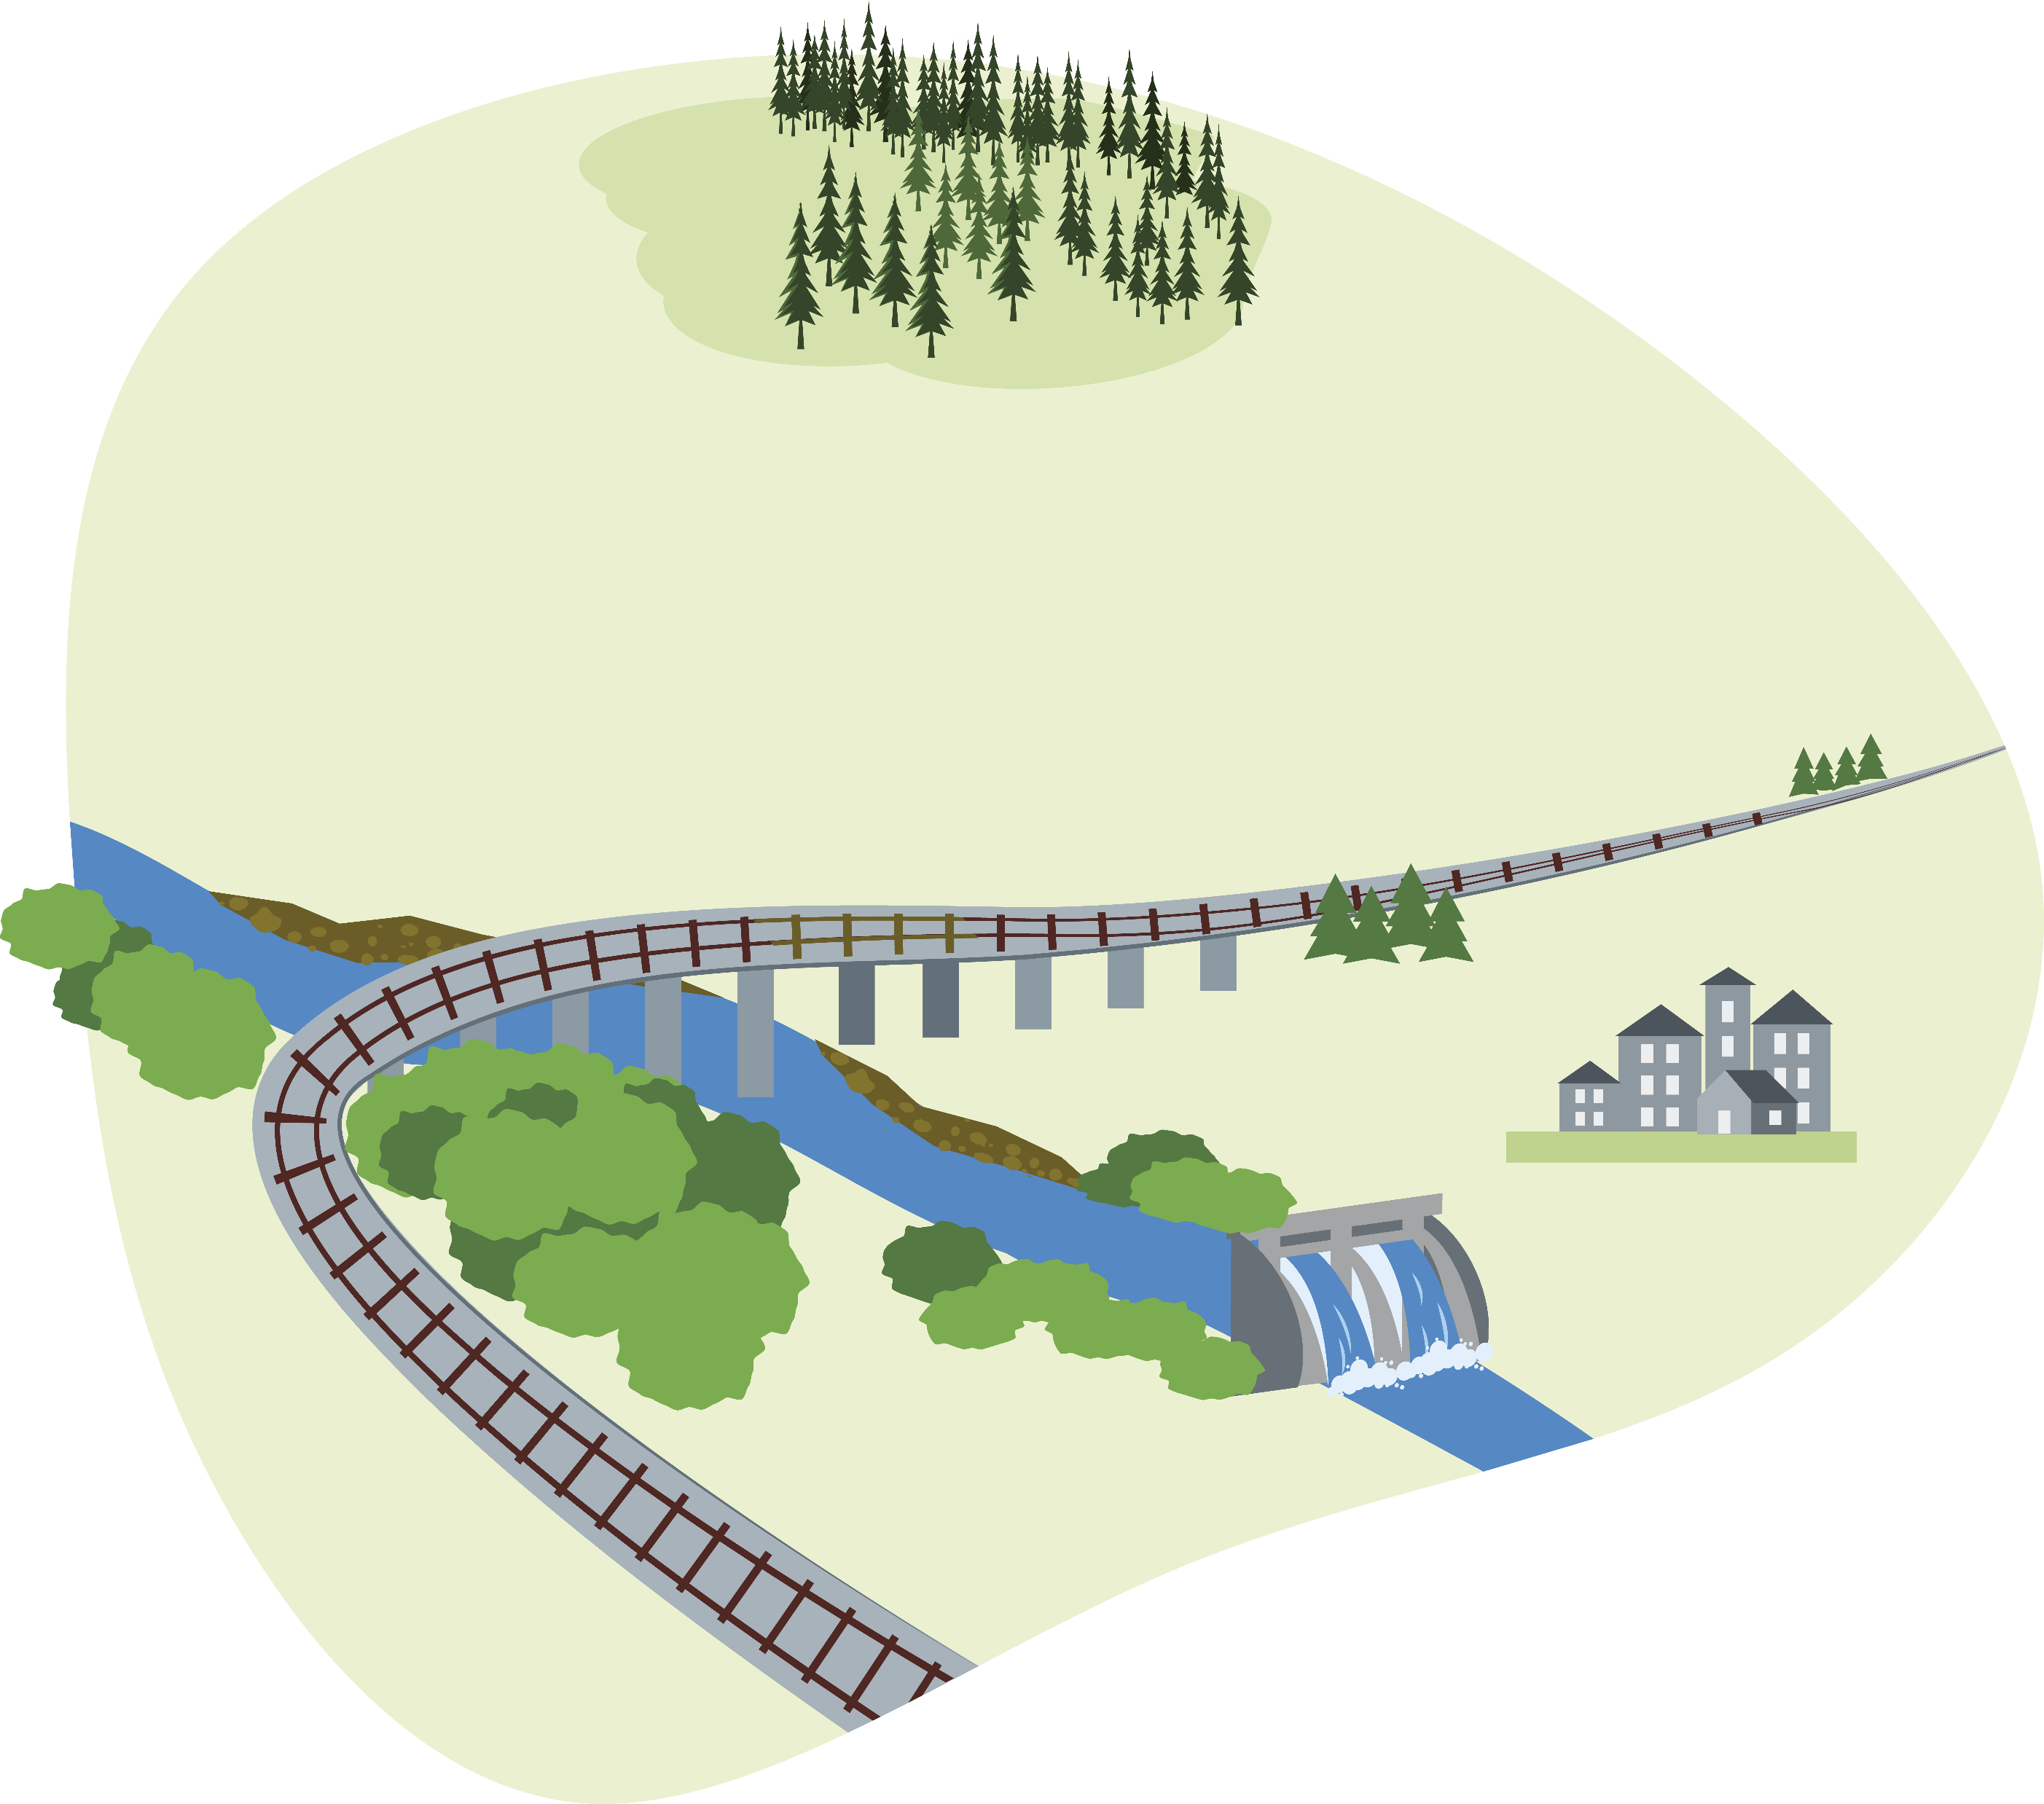
Notes:
Challenge: Increased risk of landslides and erosion

Slide 9
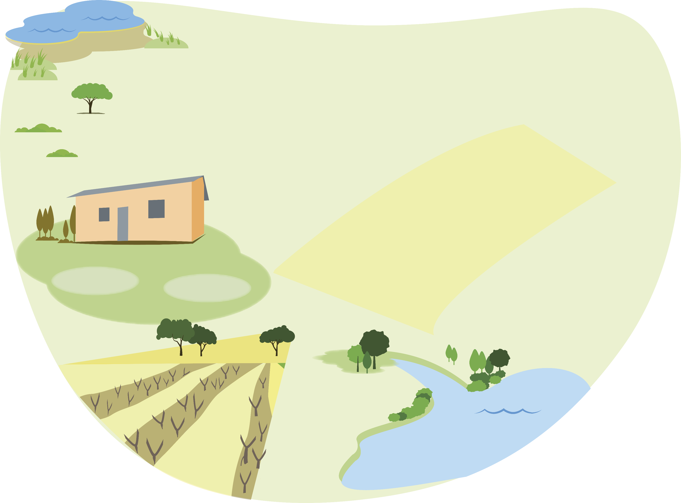
Notes:
Challenge: Impact on domestic and international food production and trade

Slide 10
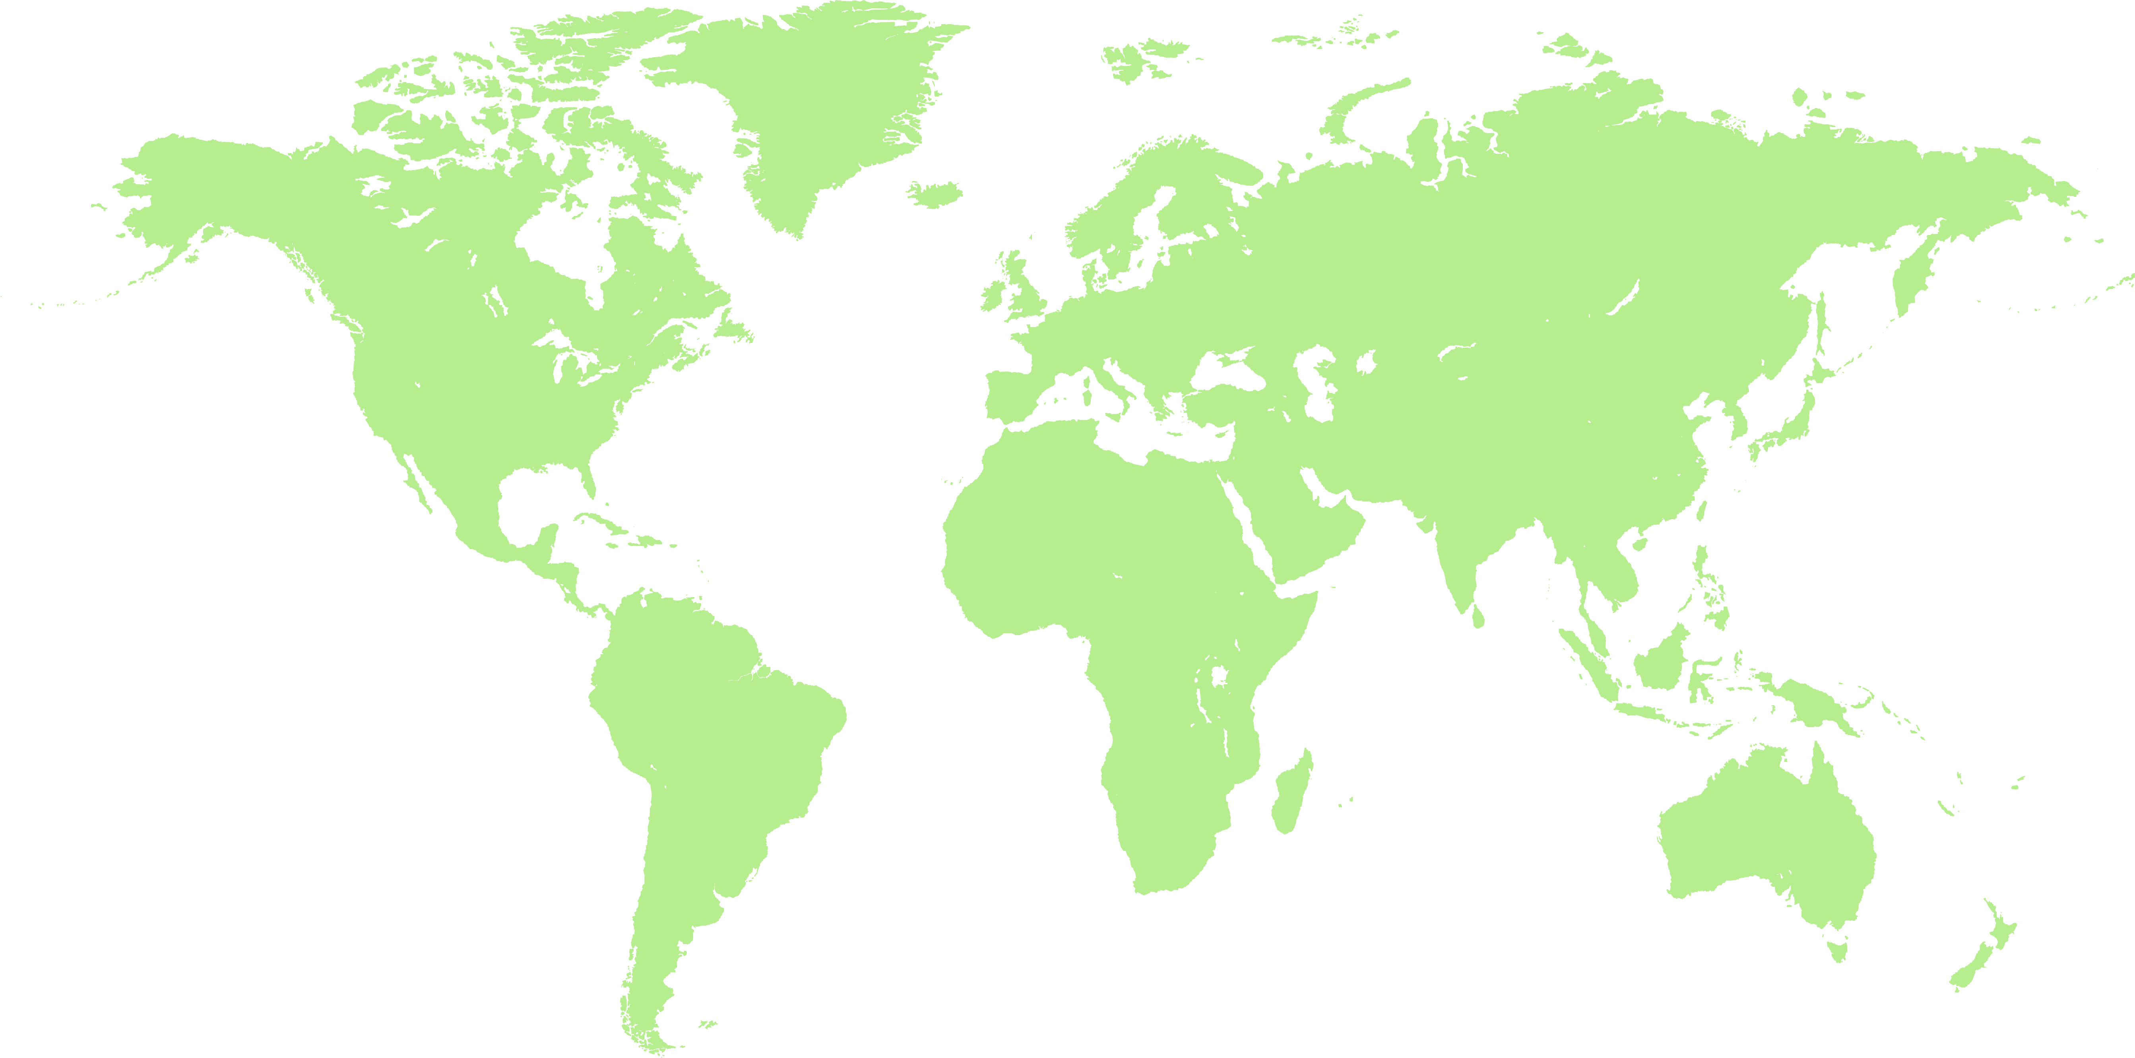
Notes:
Challenge: C

Slide 11
Notes:
Challenge: Impact on domestic and international food production and trade

Slide 12
Notes:
Blank slide coastal zone

Slide 13
Notes:
Blank slide coastal zone

Slide 14
Notes:
Create your own background image or use an empty image

Slide 15
Notes:
Create your own background image or use an empty image

Slide 16
Notes:
Create your own background image or use an empty image

Slide 17
Notes:
Create your own background image or use an empty image

Slide 18
Figures
Figures can be selected one by one, compiled and printed in the appropriate size.
Figures that are between 6 and 10 cm high fit well on an A0 background. Houses can be higher.
Figures can be printed on a regular printer, for example on A3 paper, and then cut out by hand.
Use glue/removable adhesives to attach the figures to the background image.

Slide 19
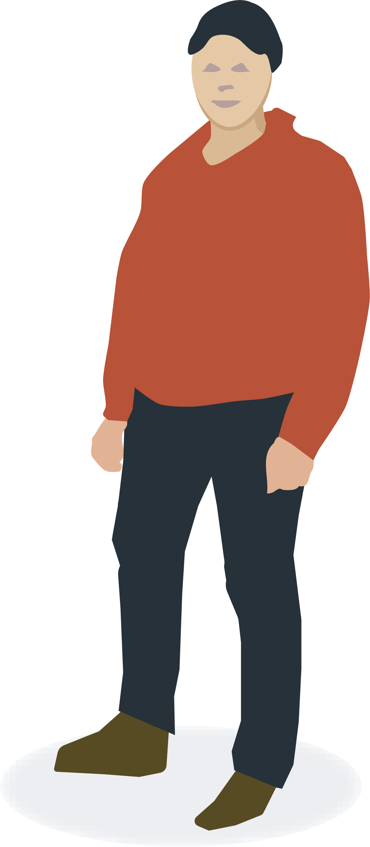
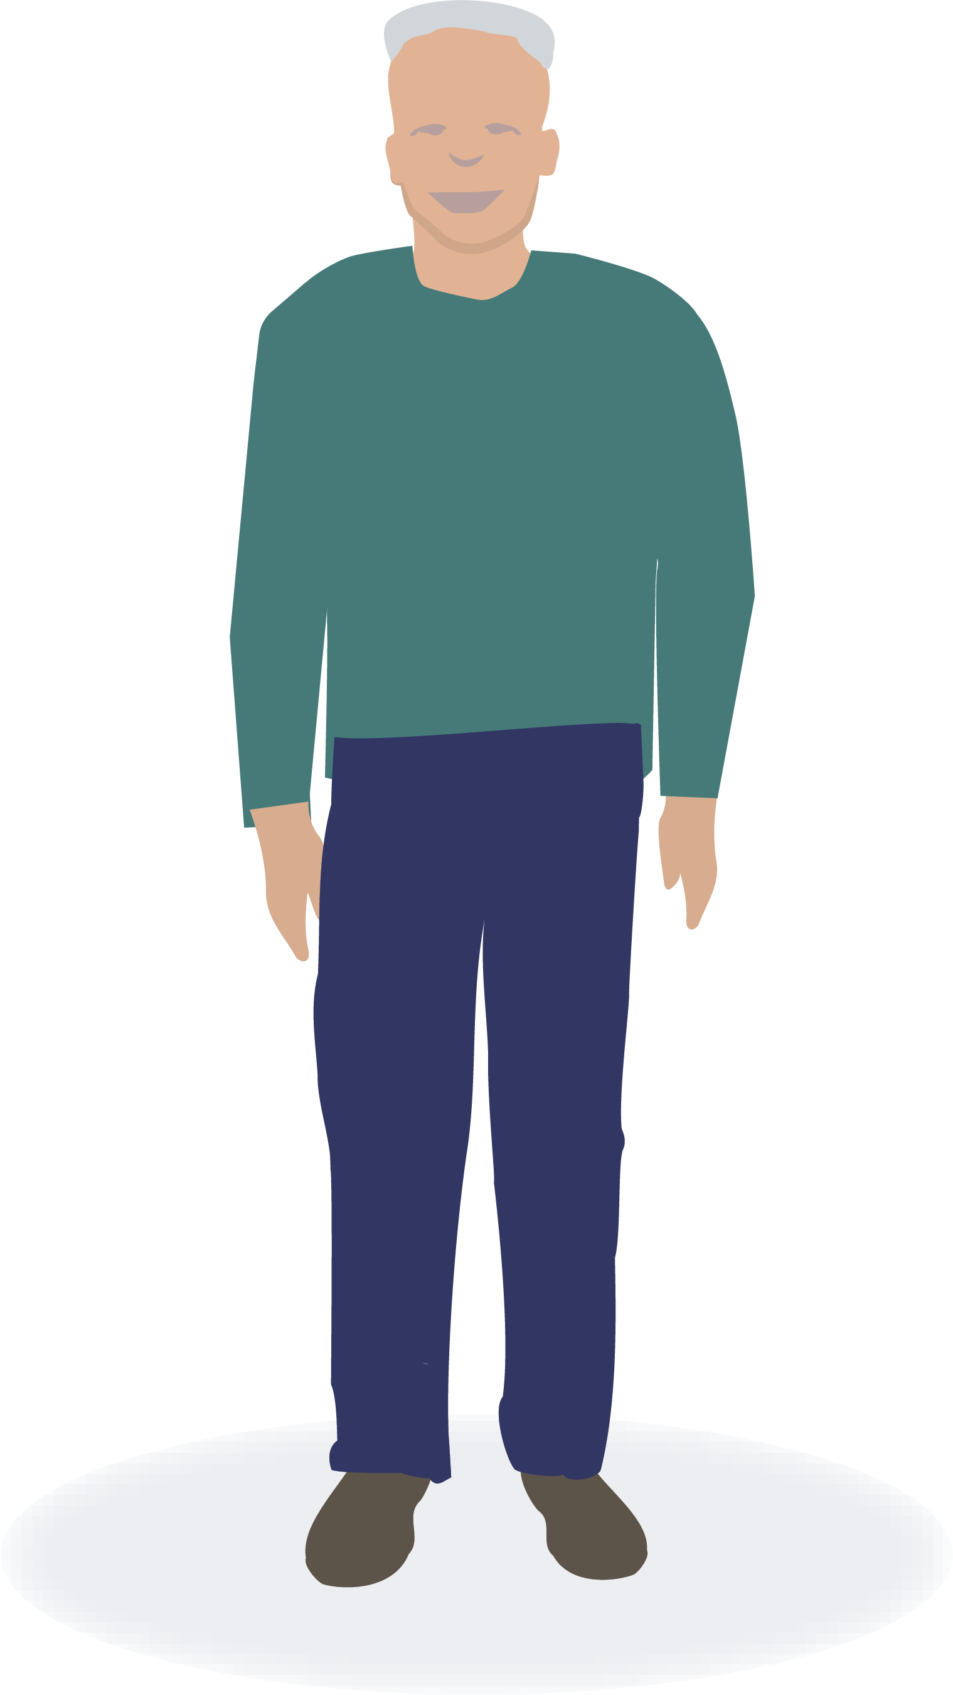
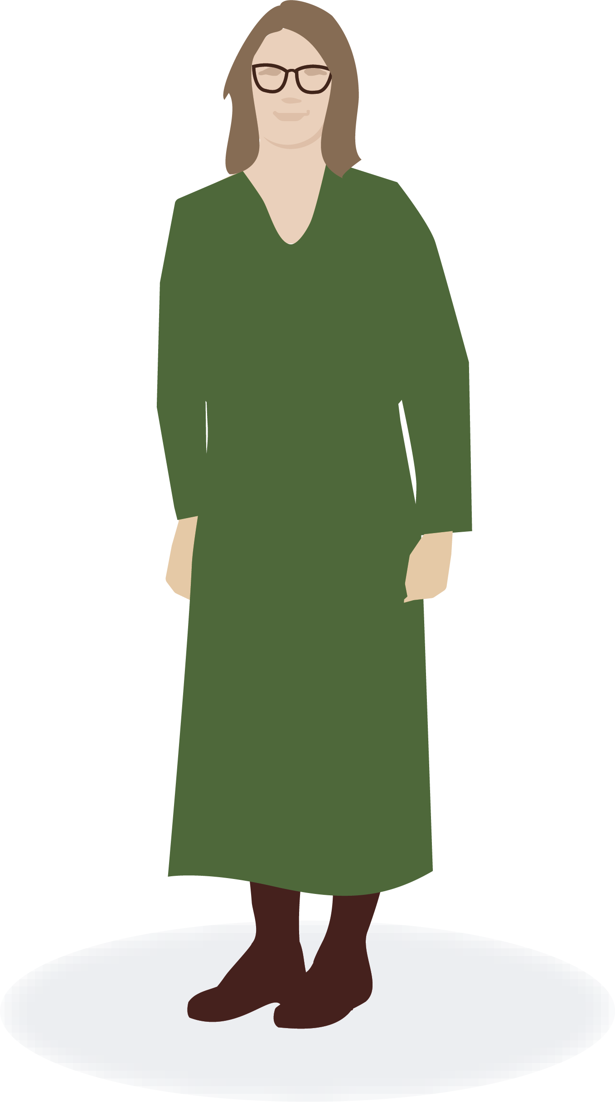
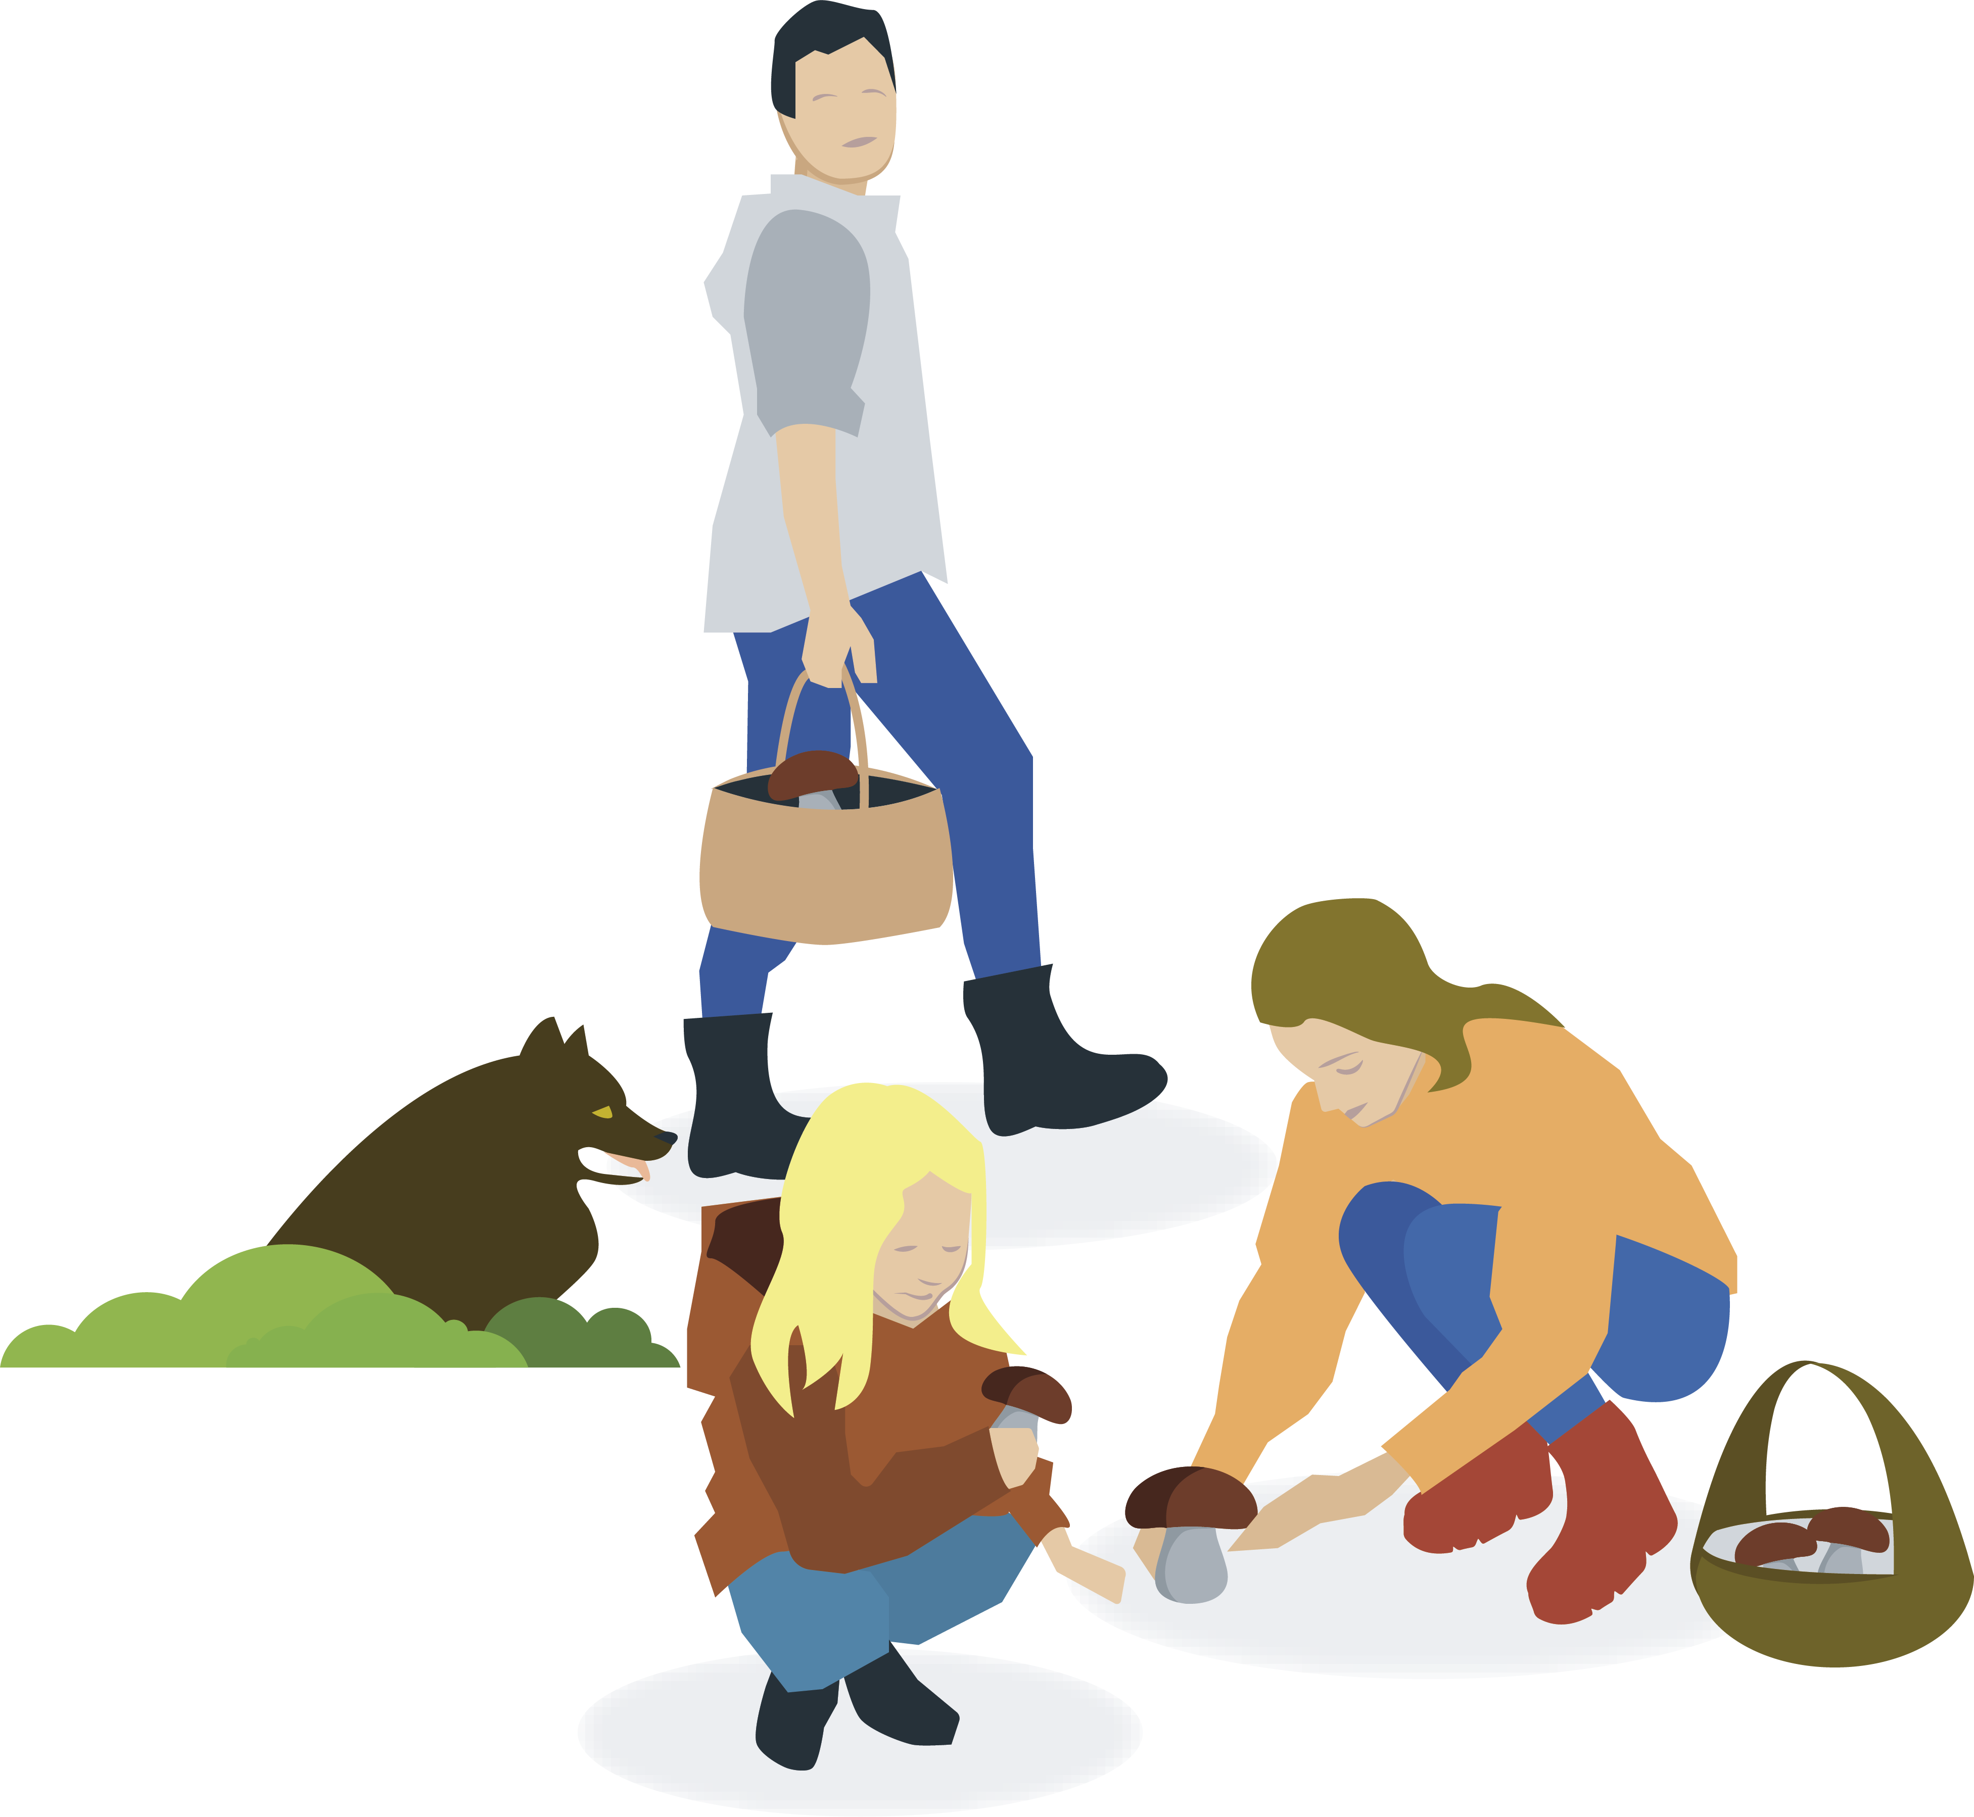
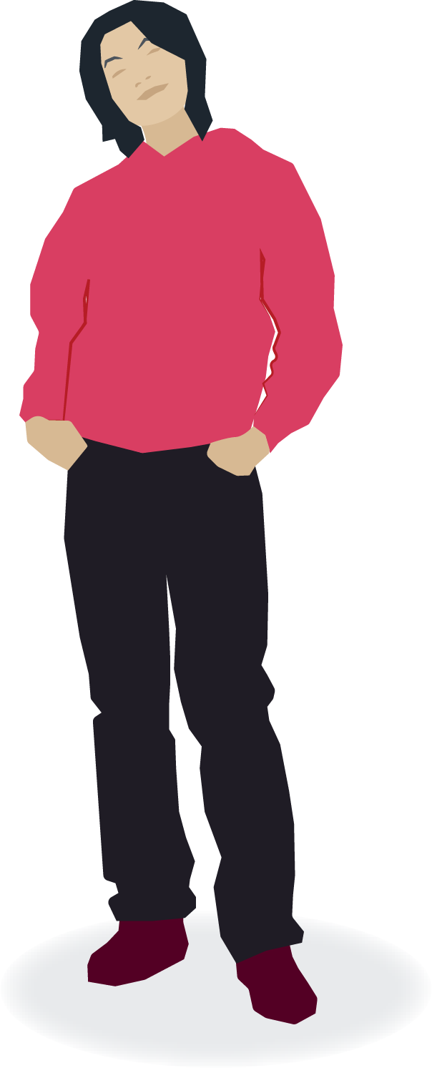
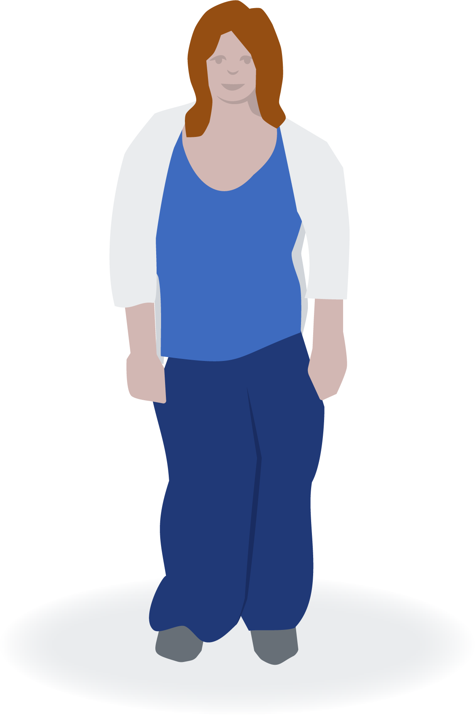
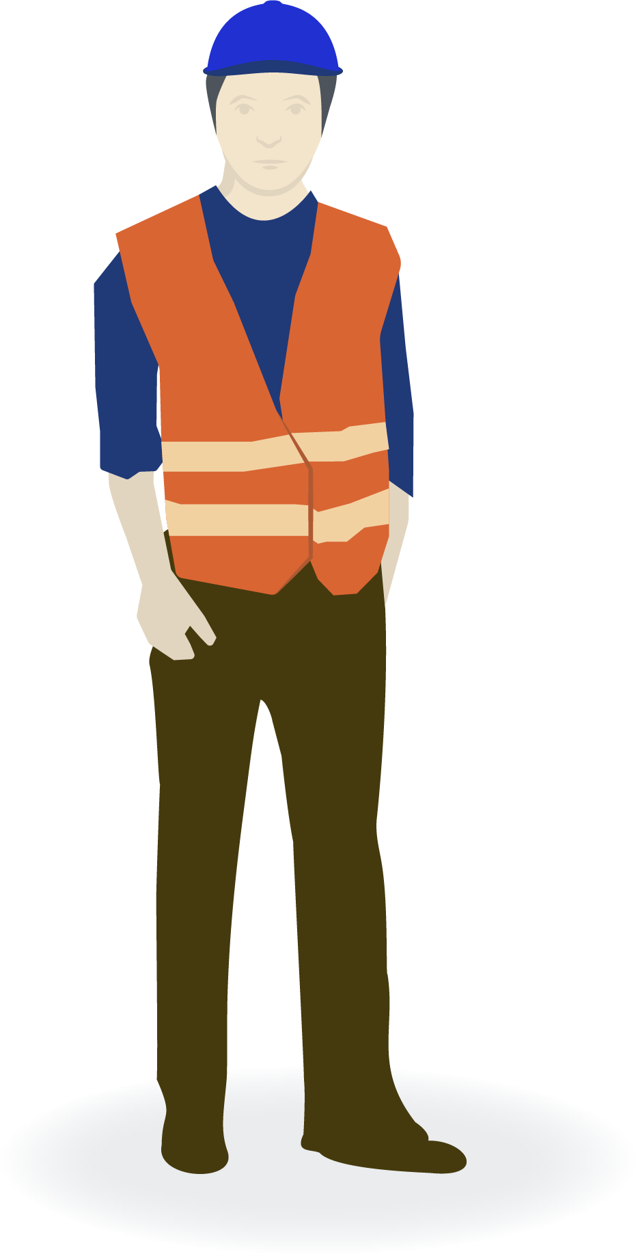
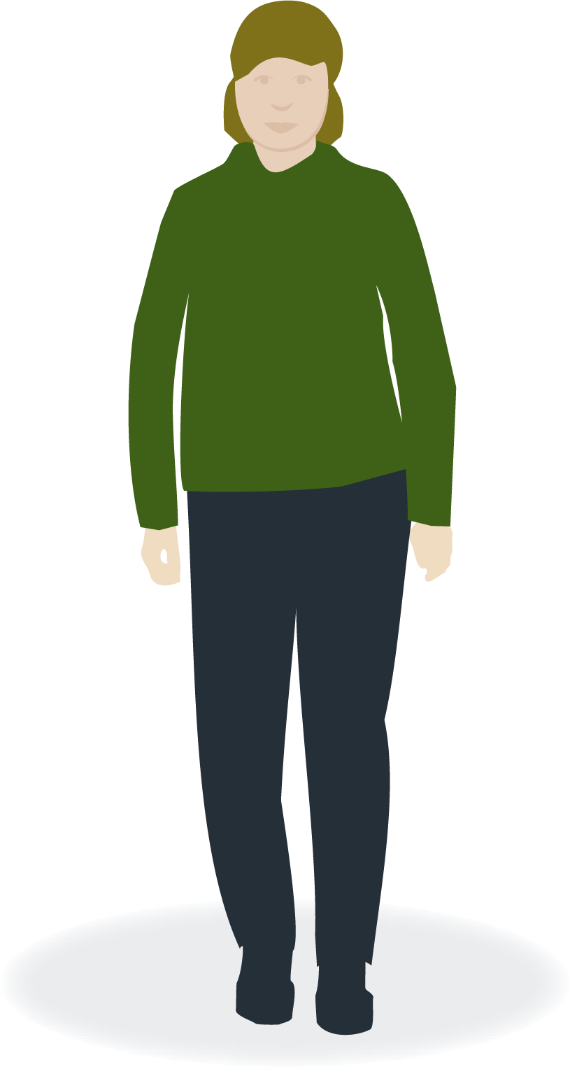
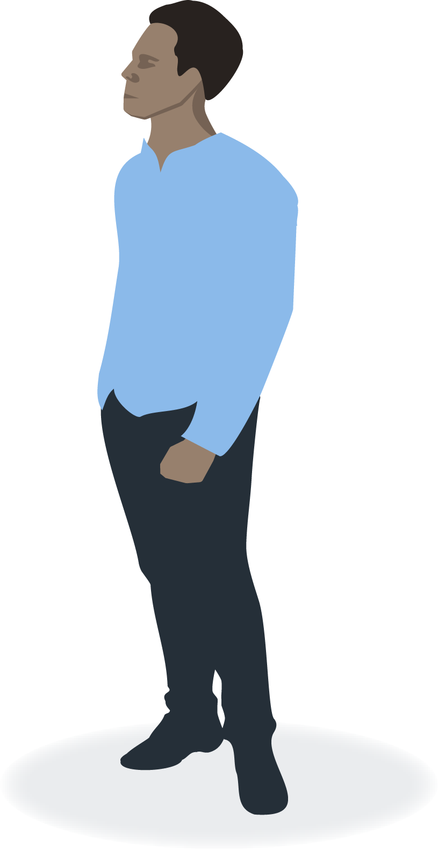
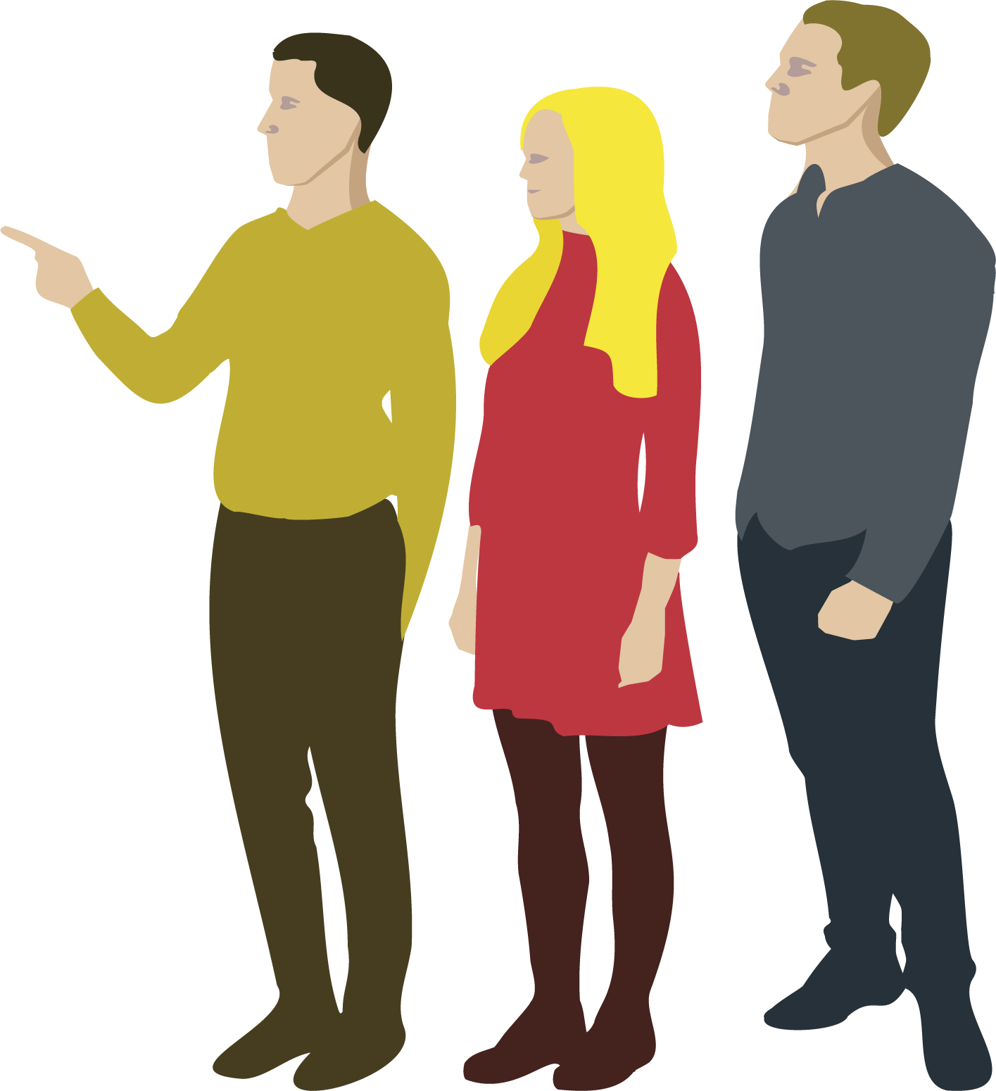
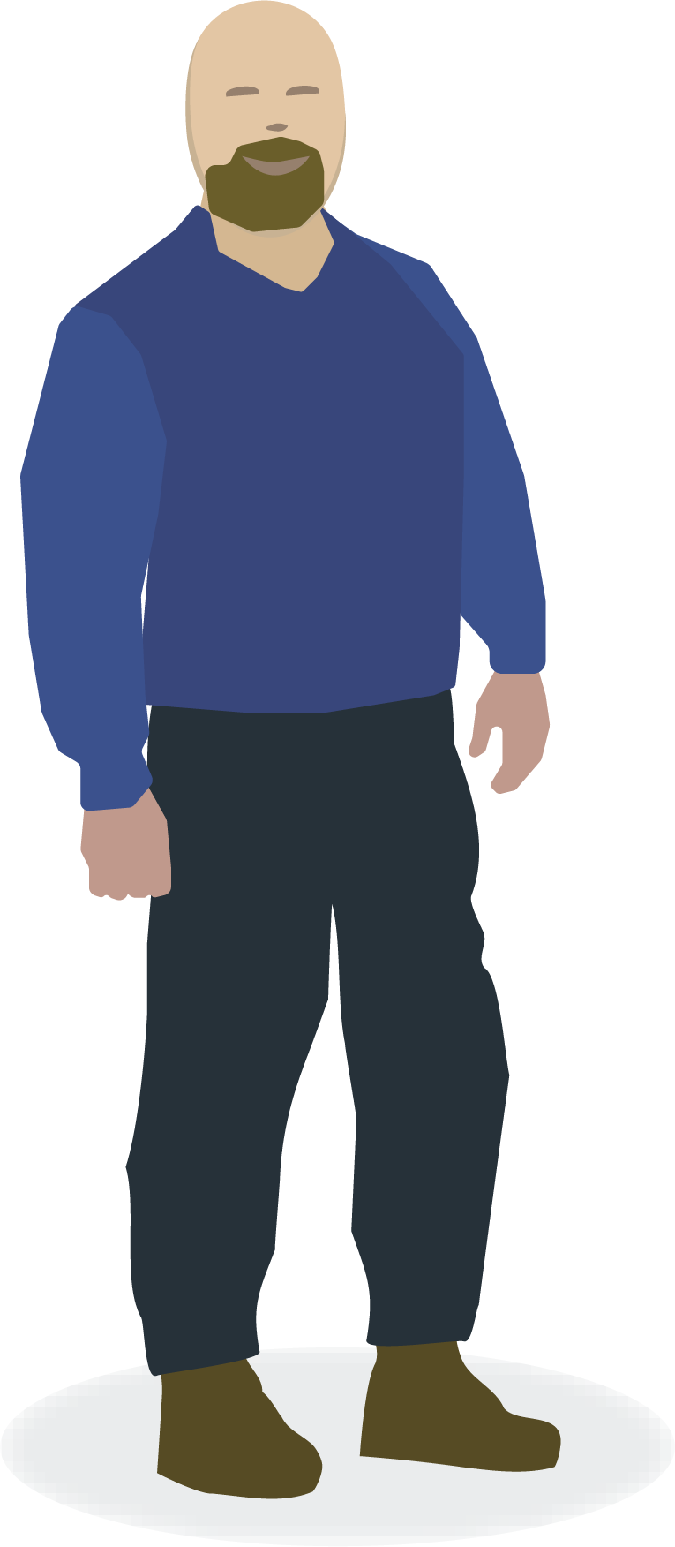
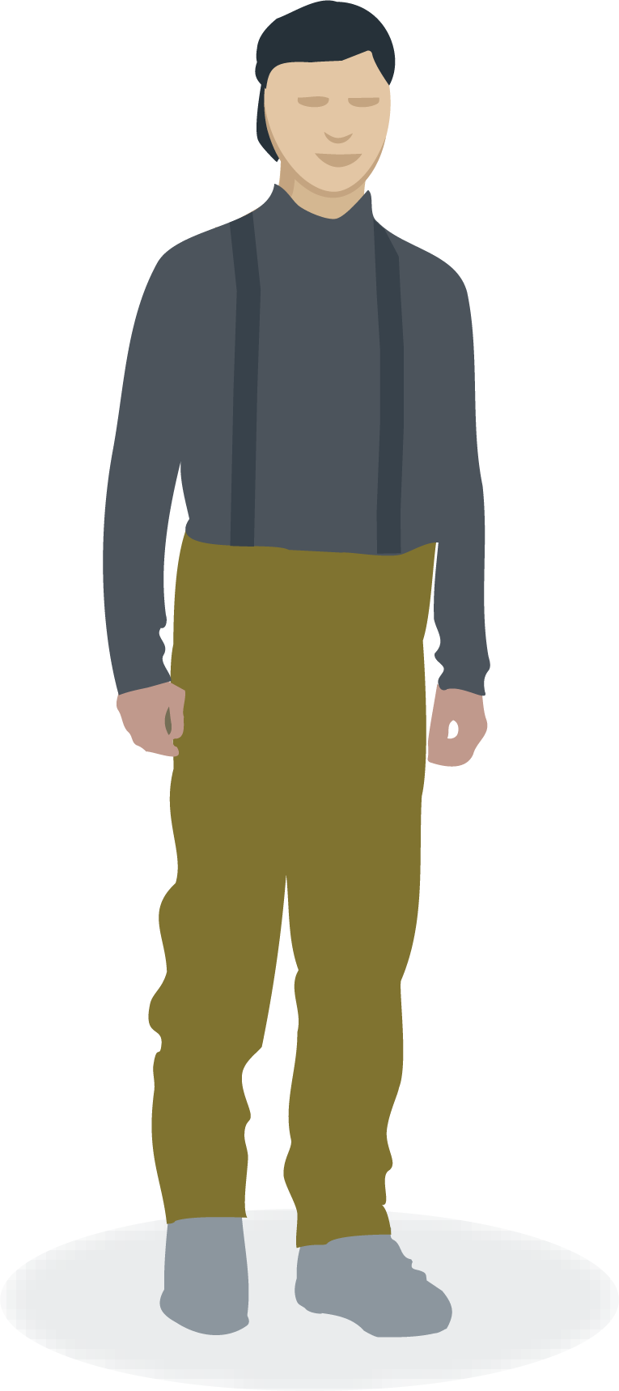
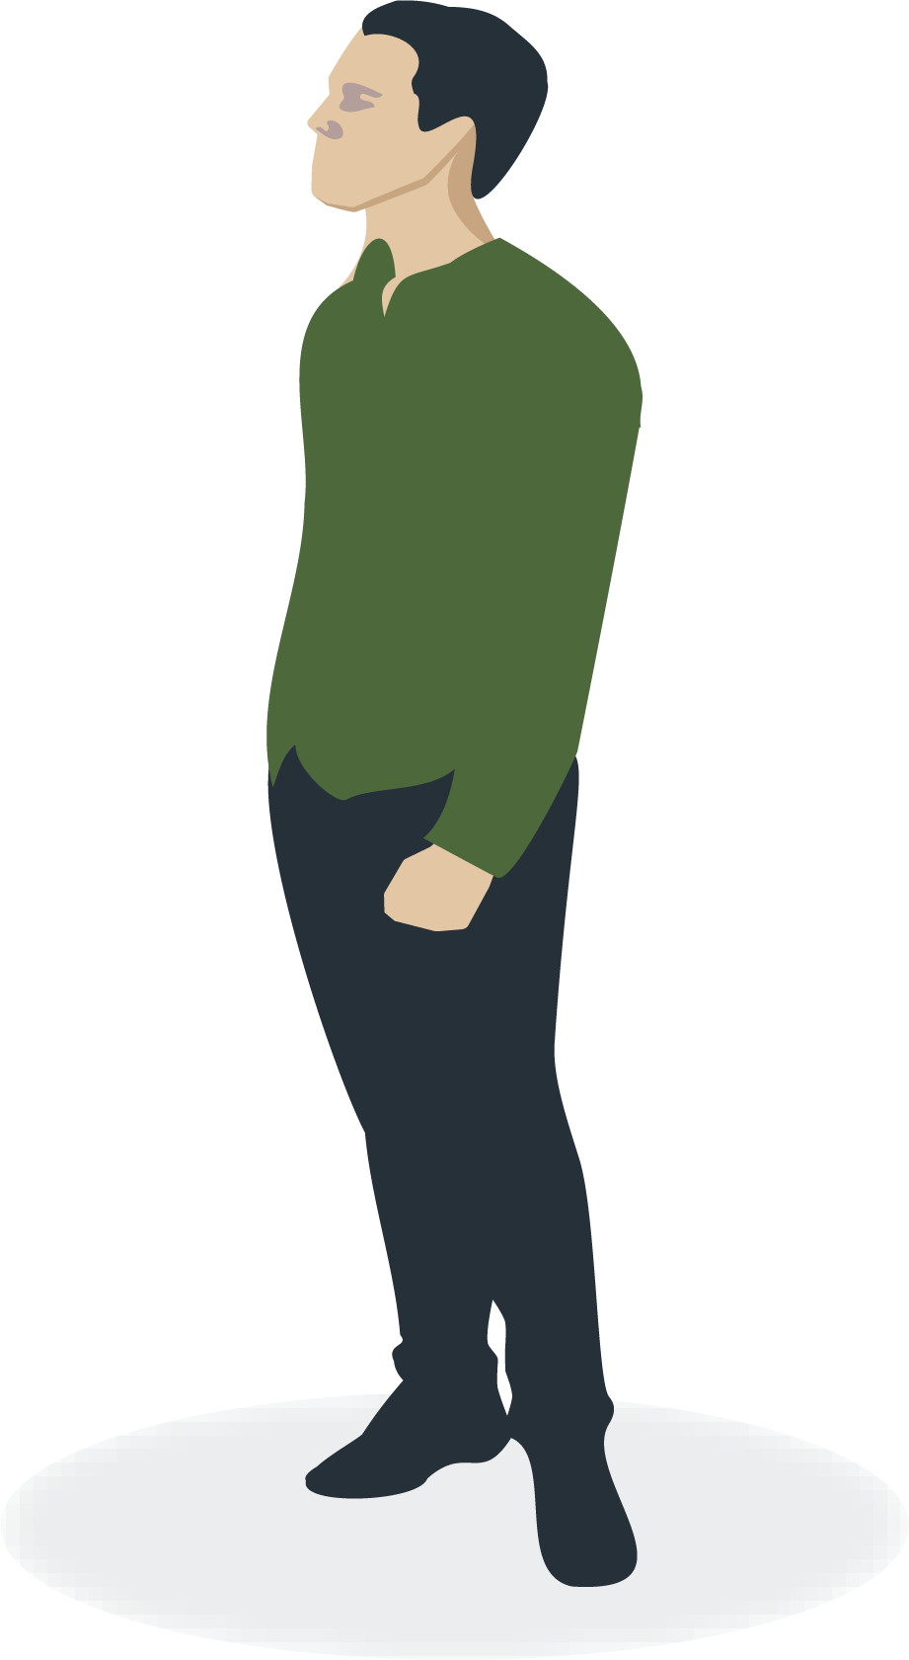
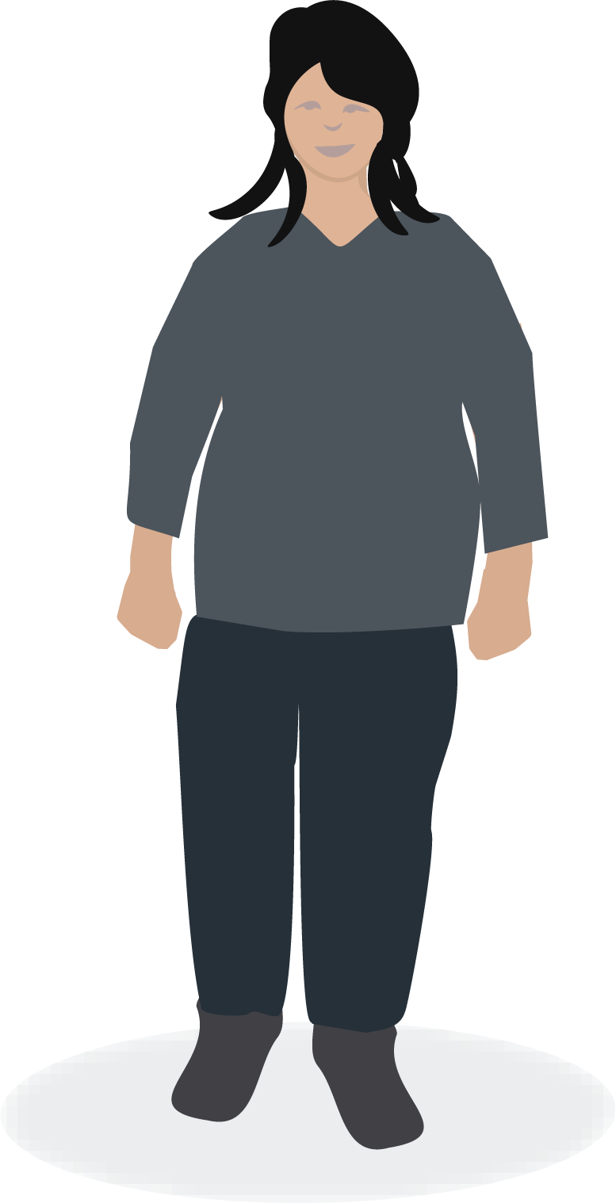
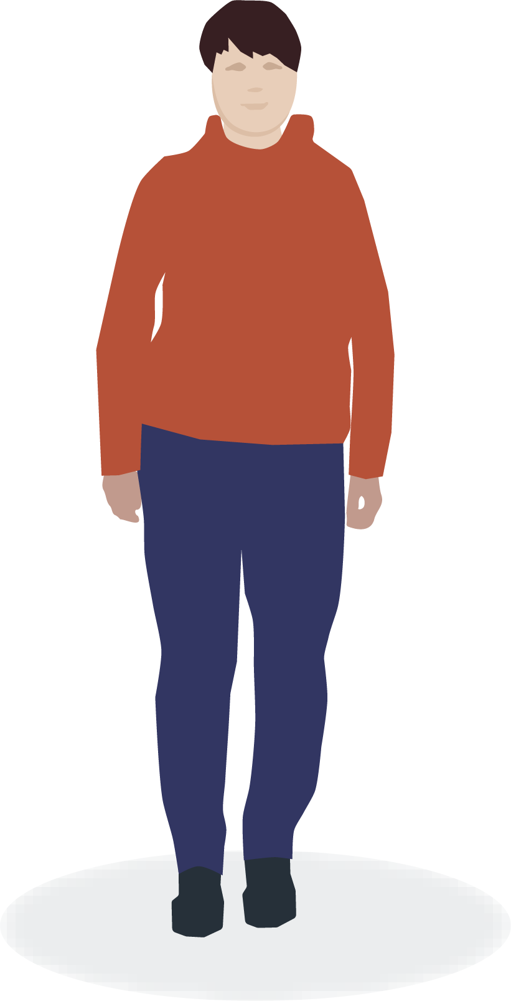
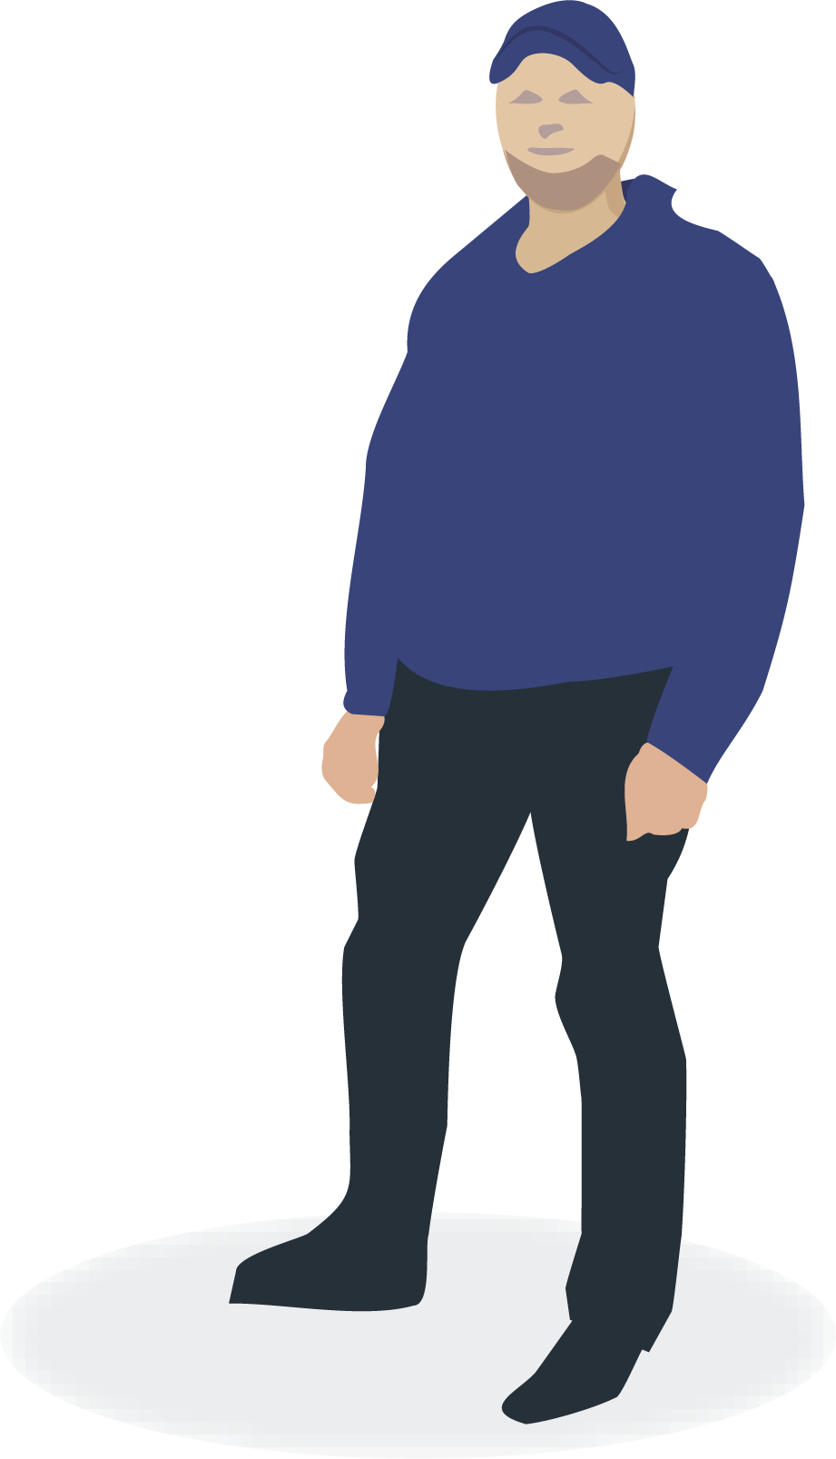
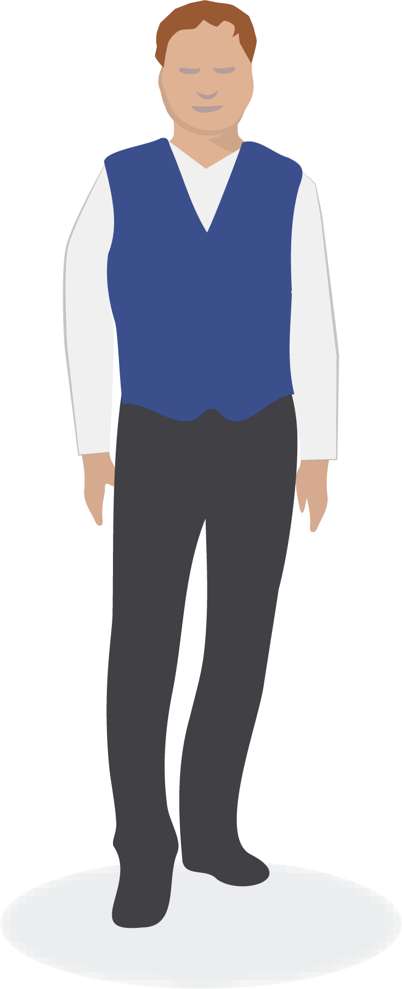
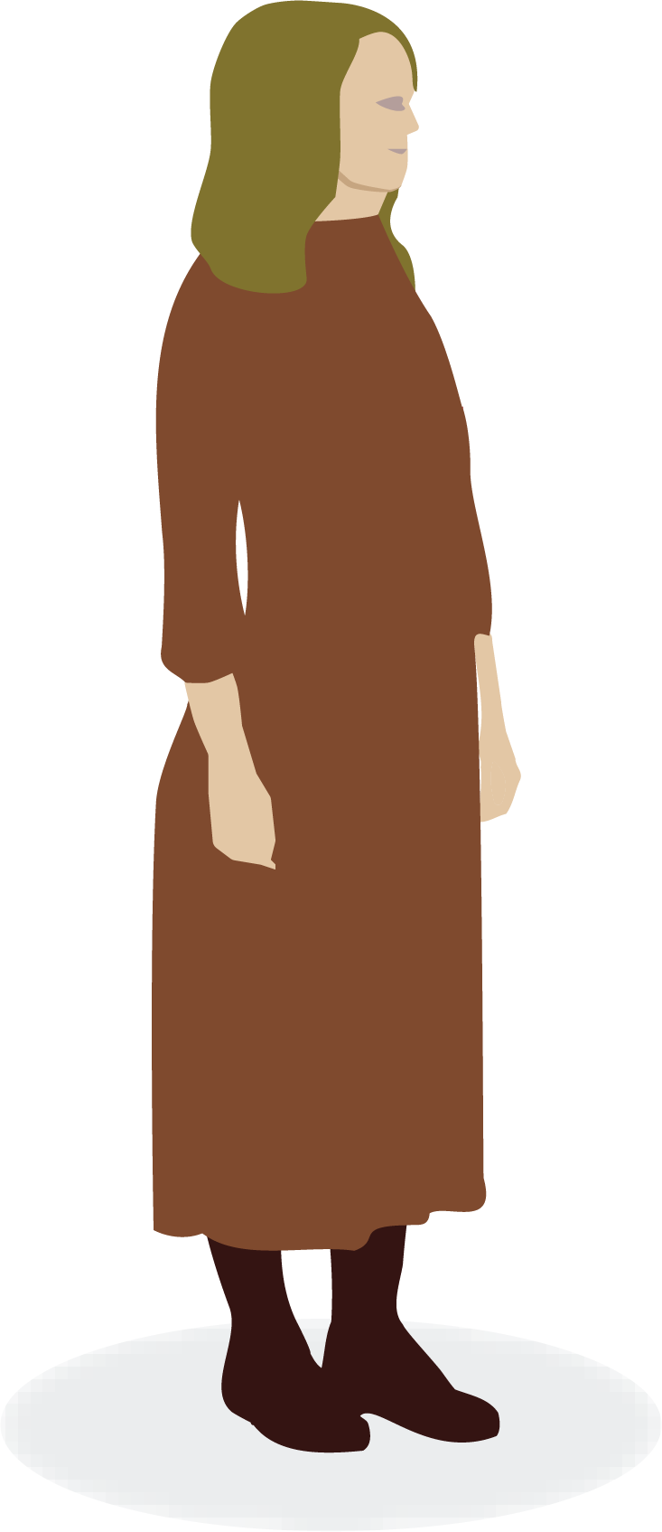
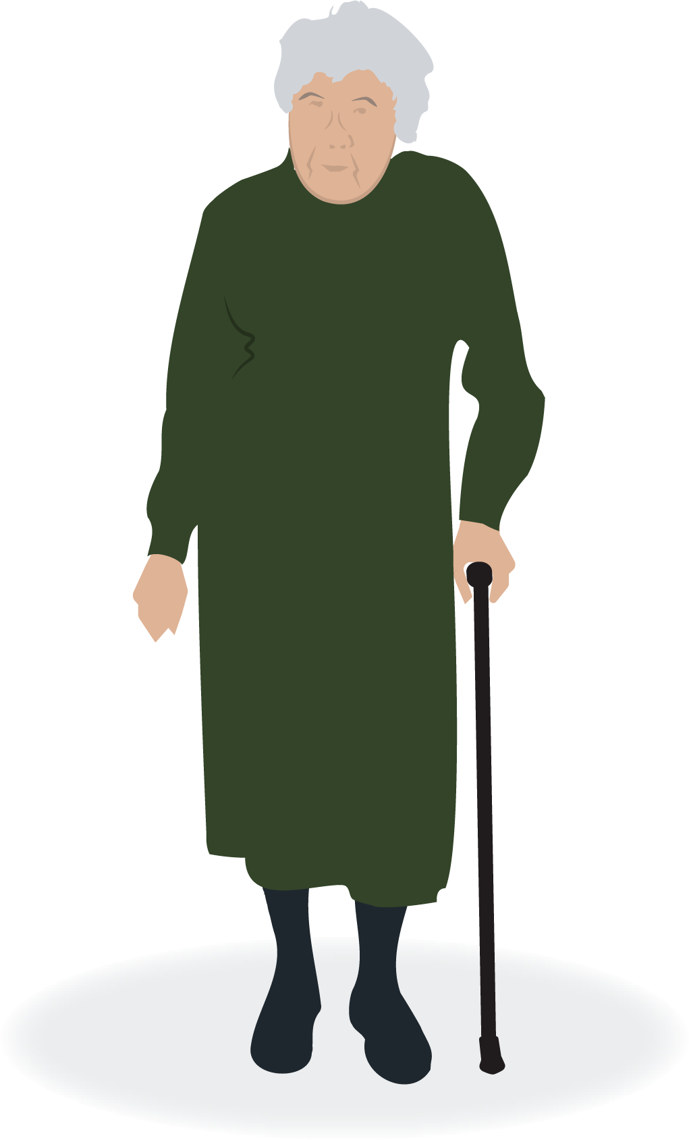
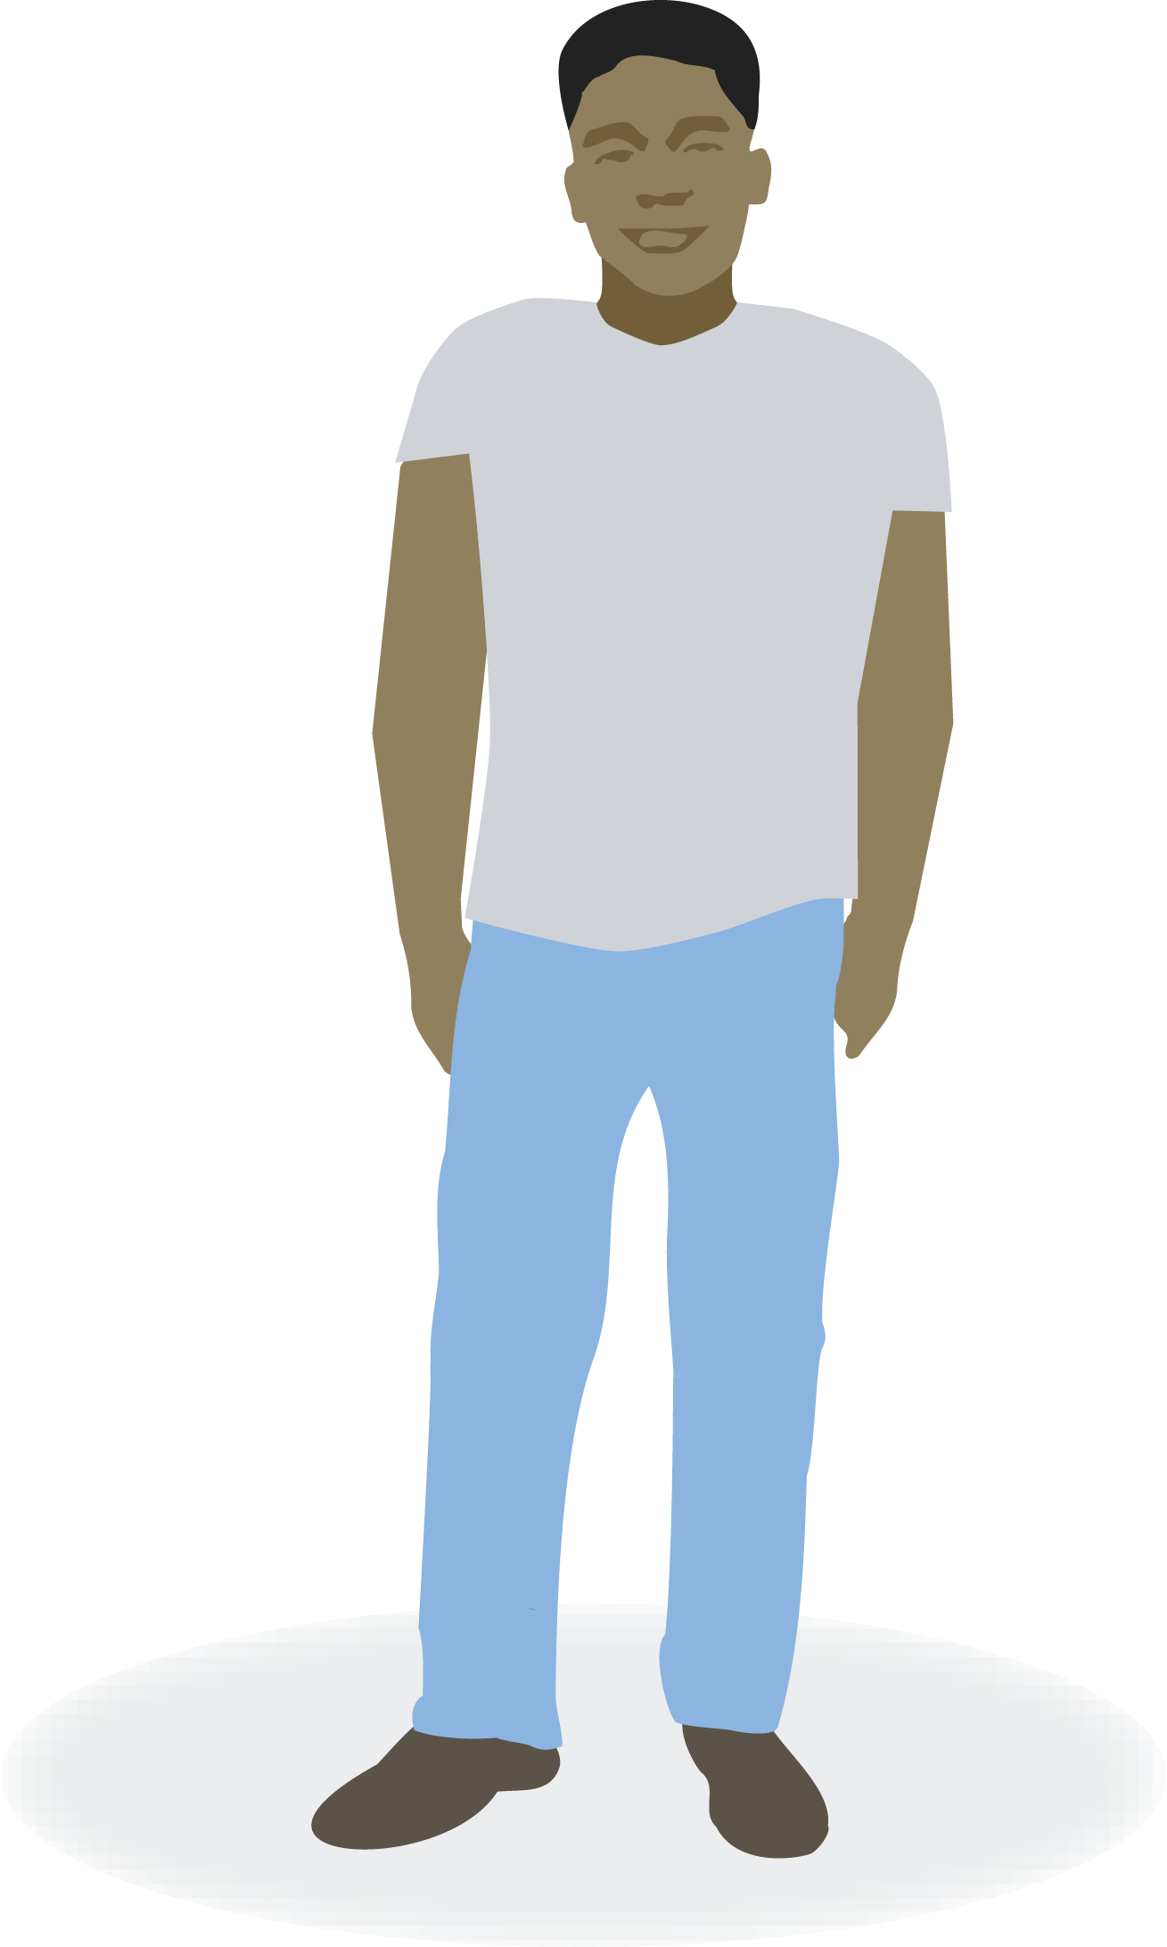
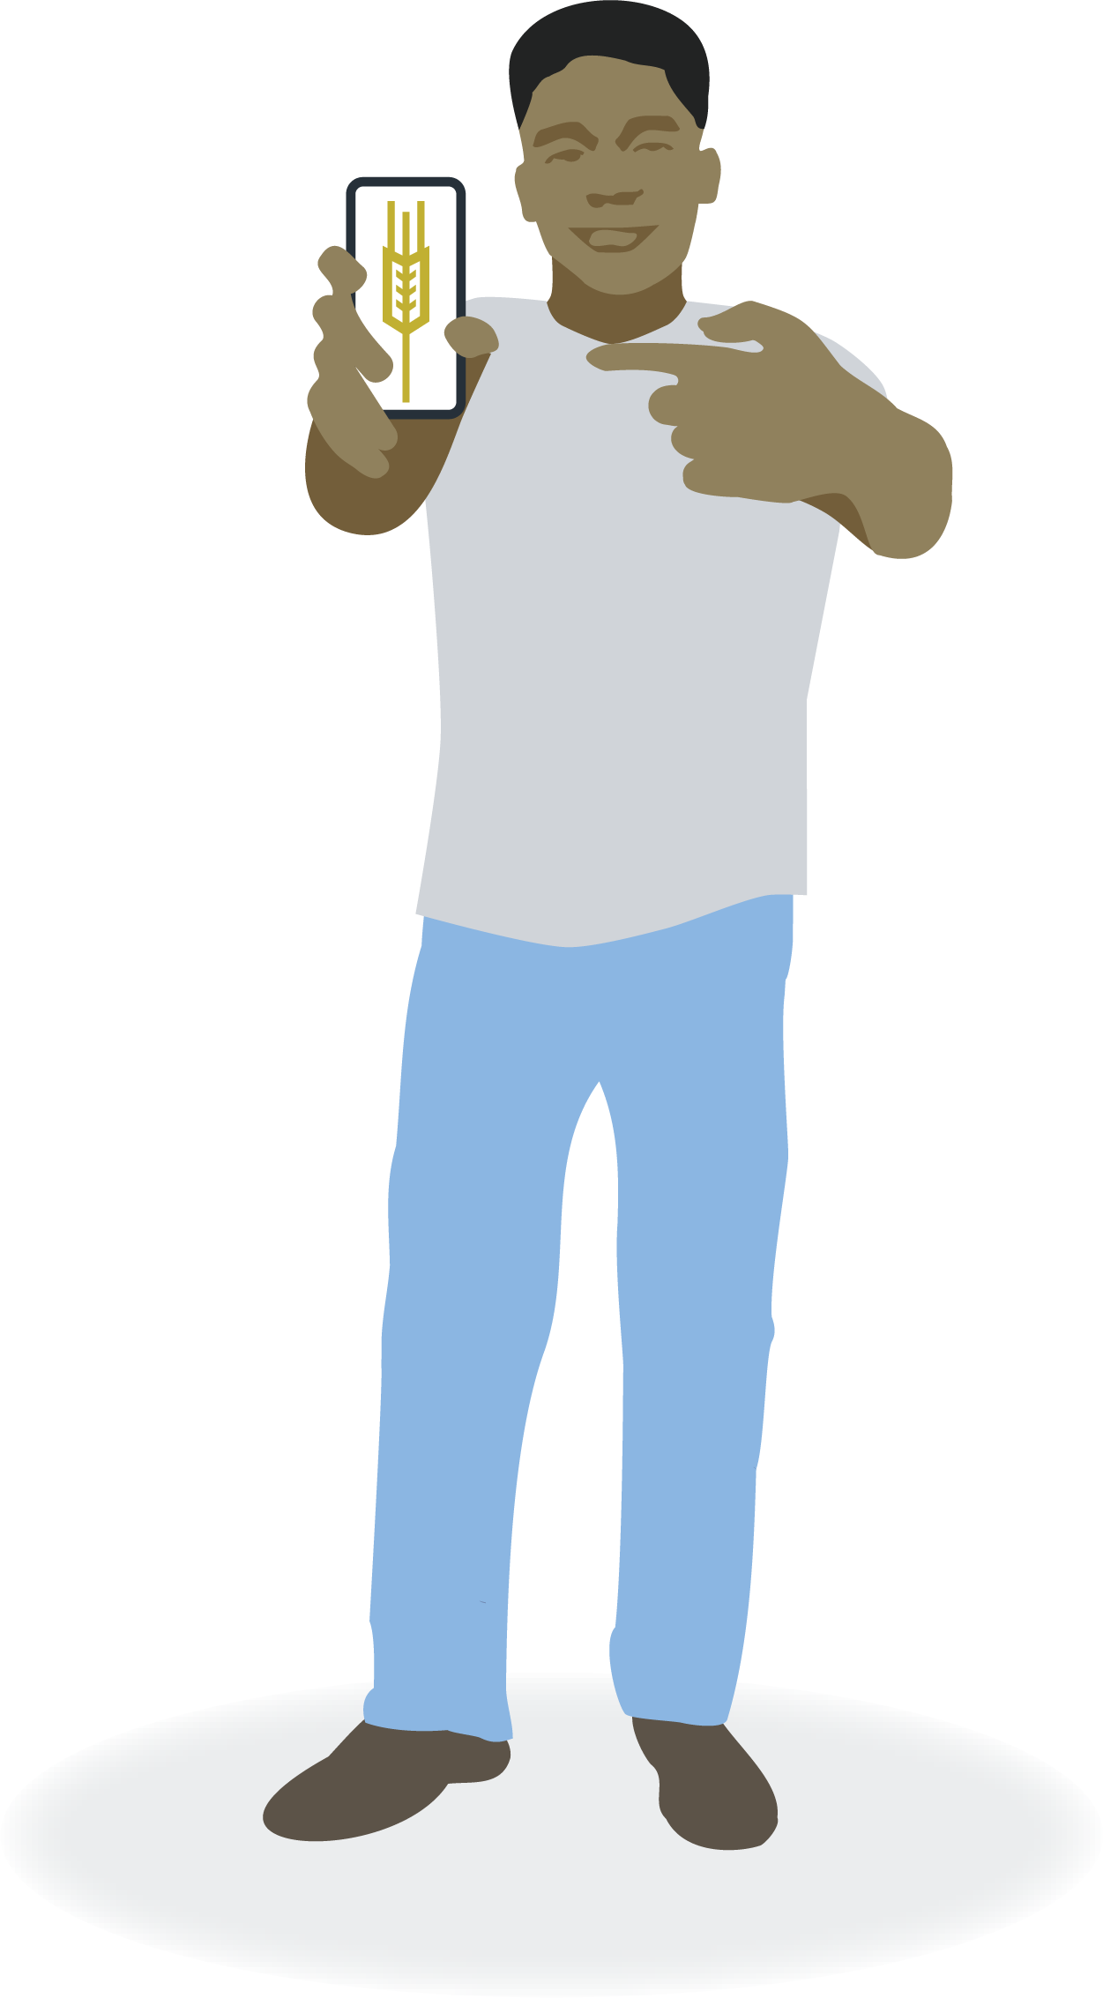
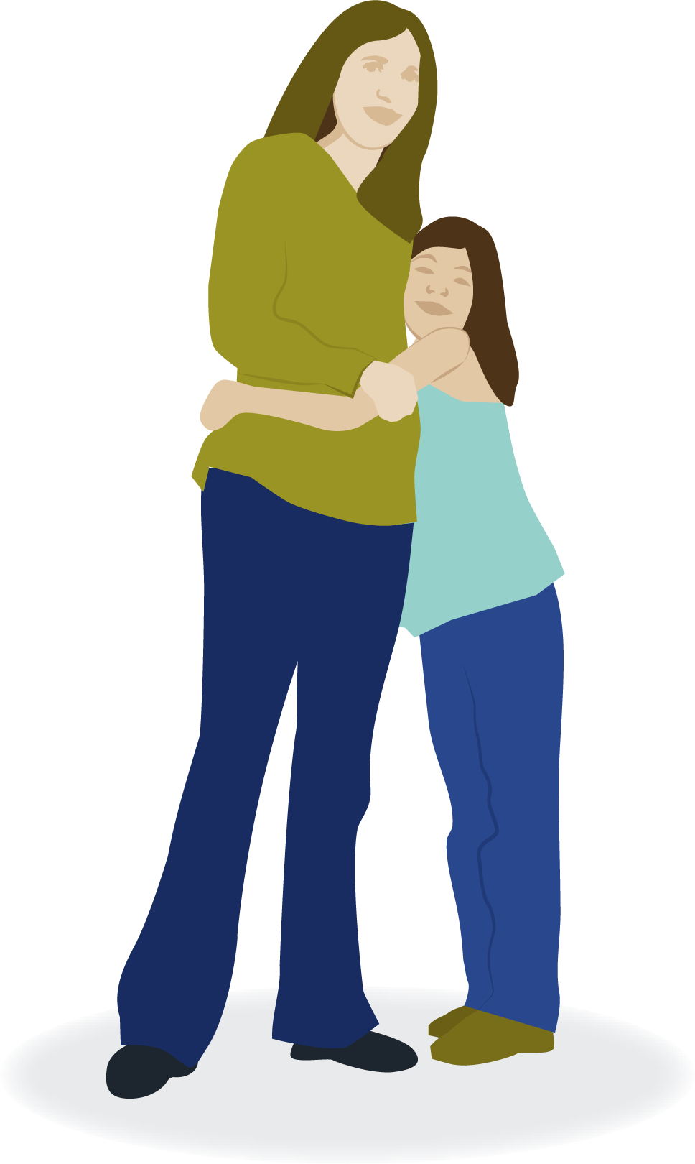
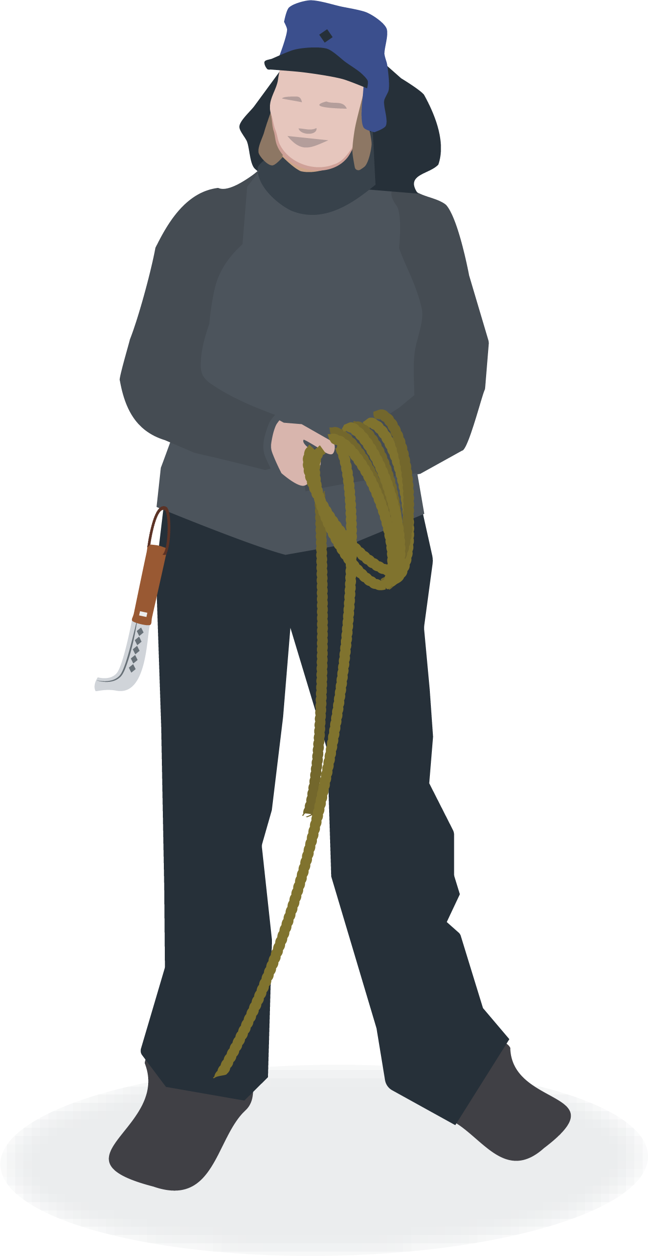
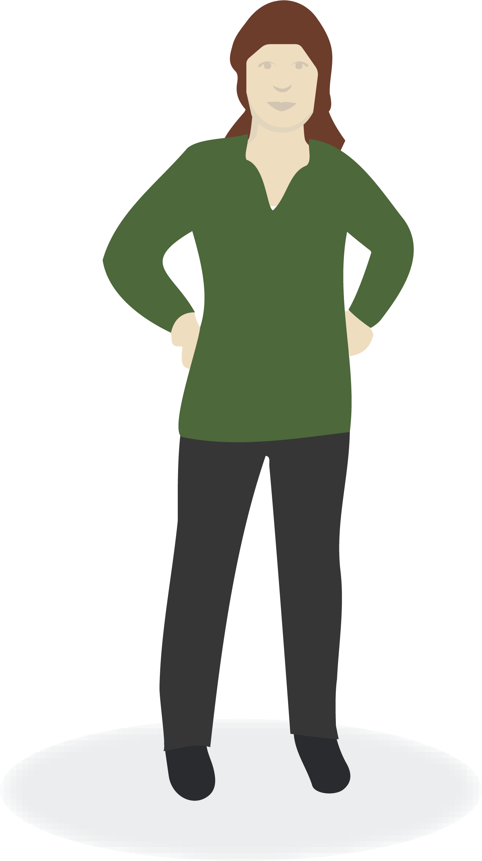
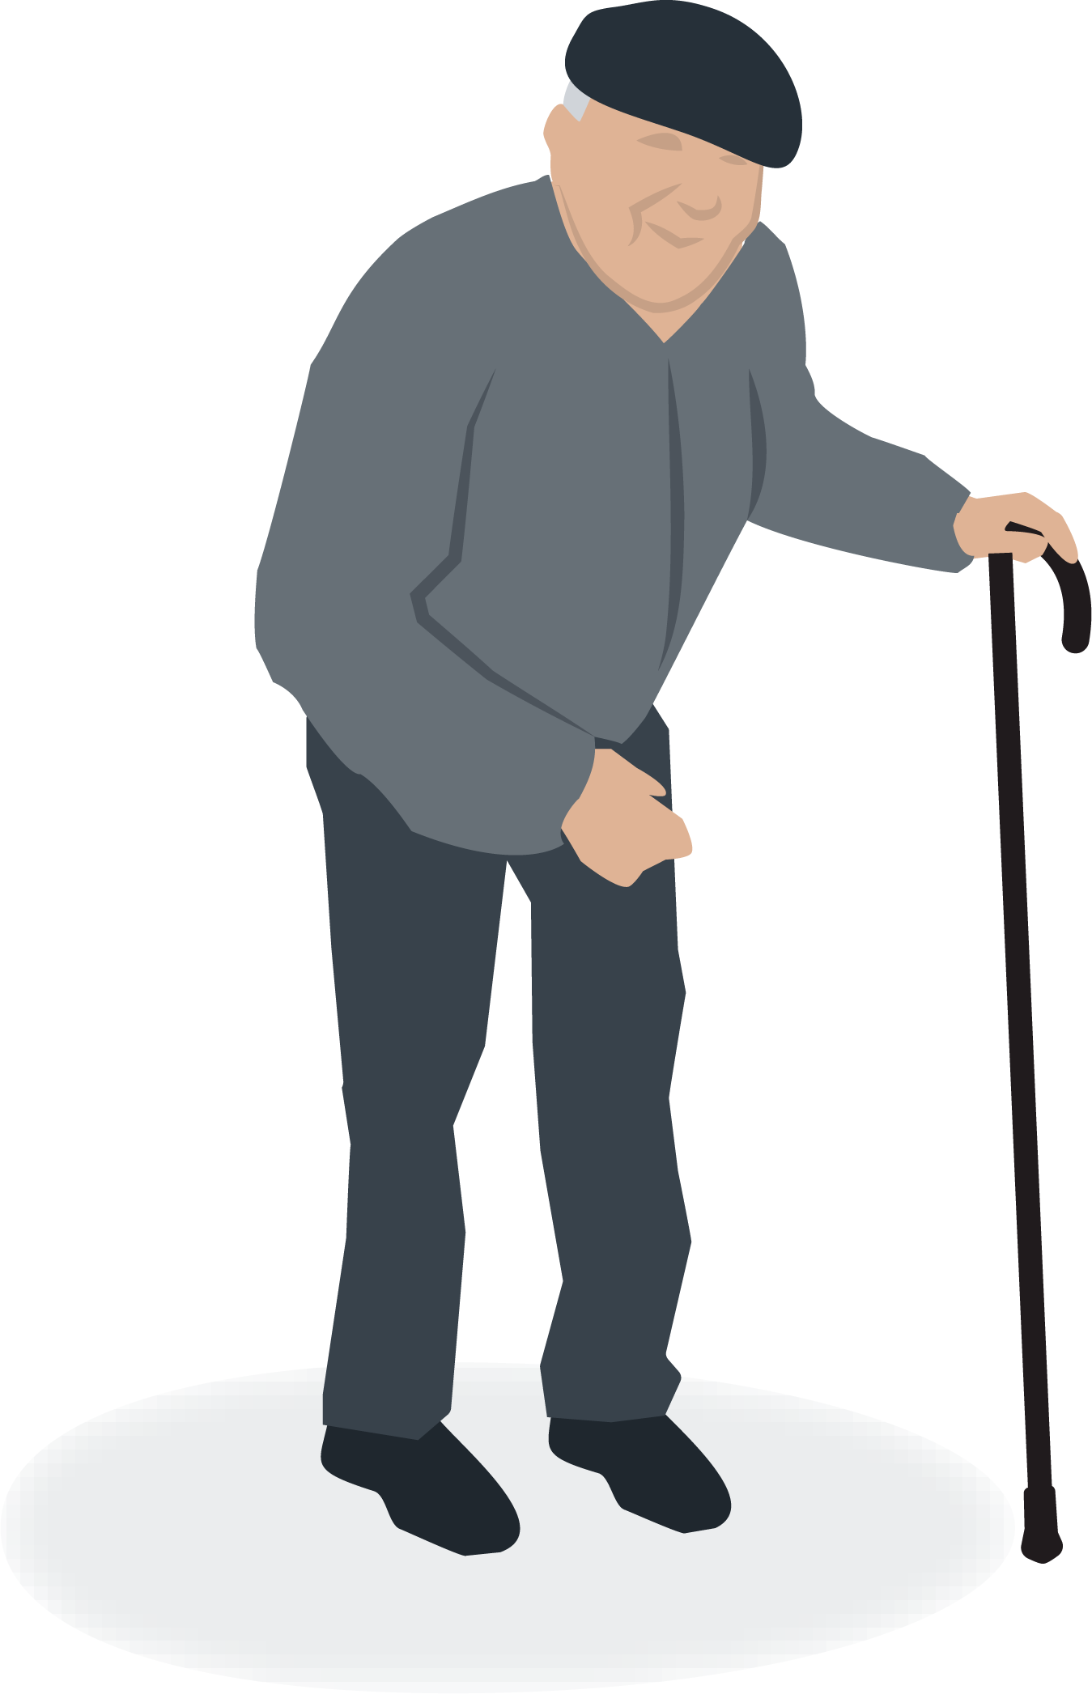
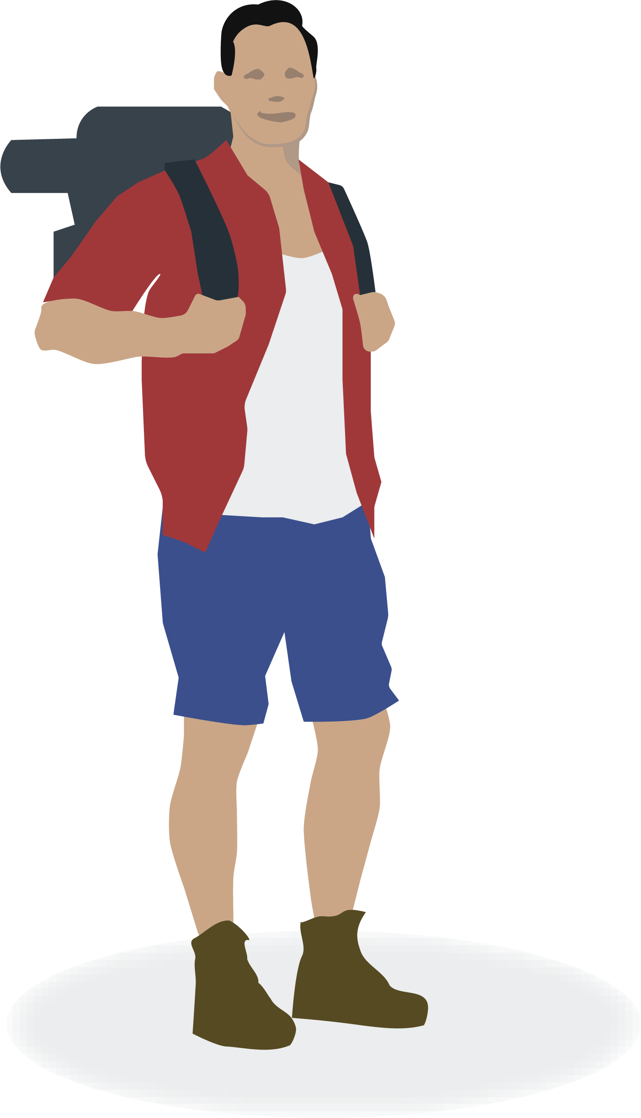
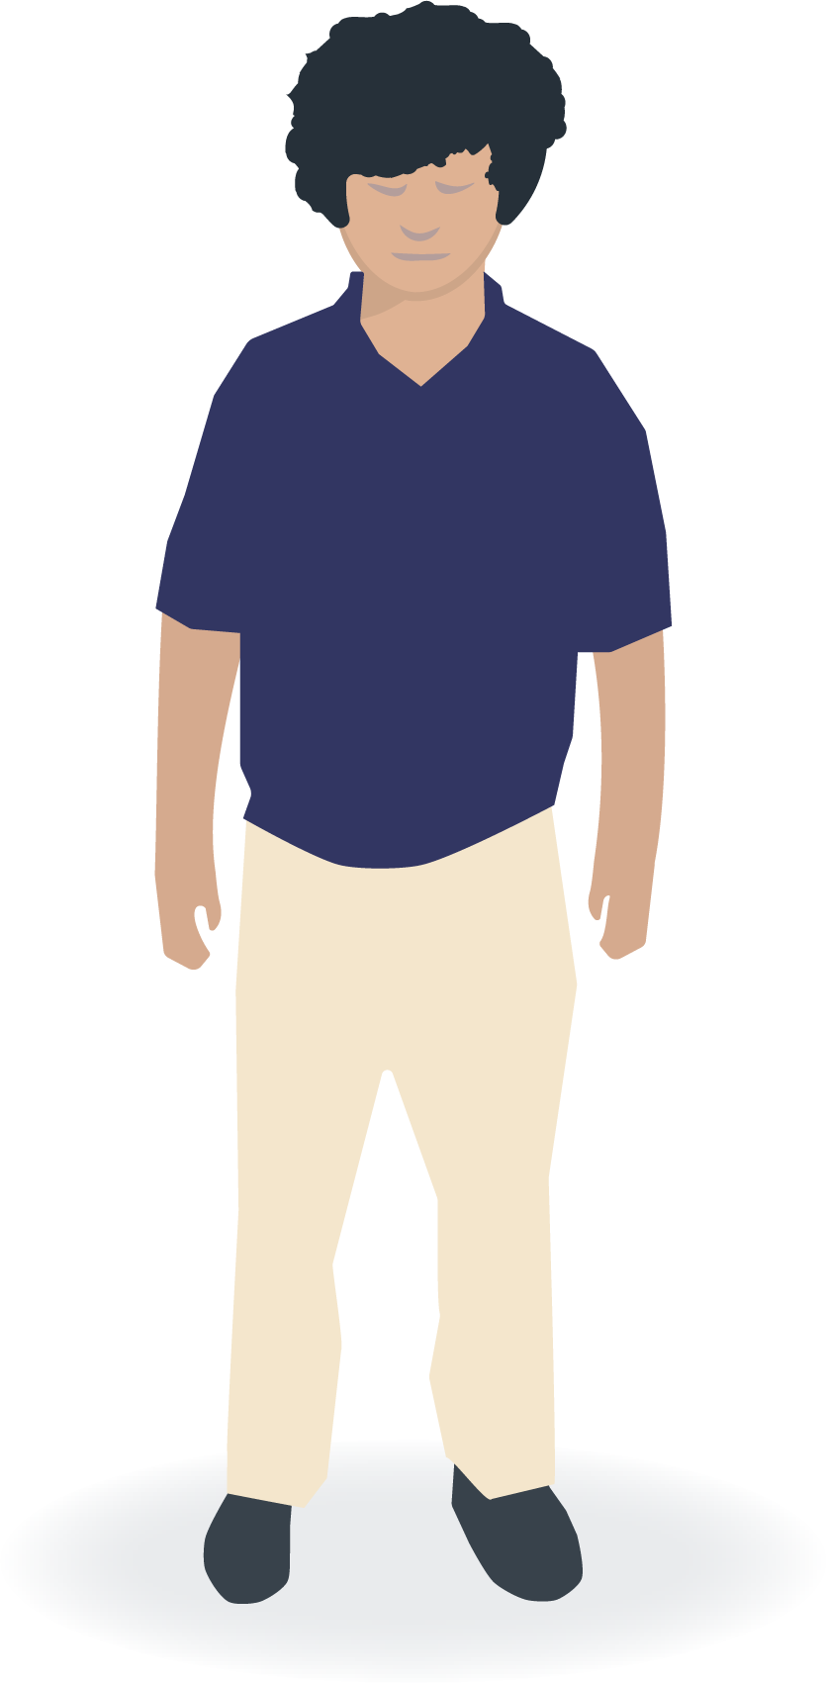
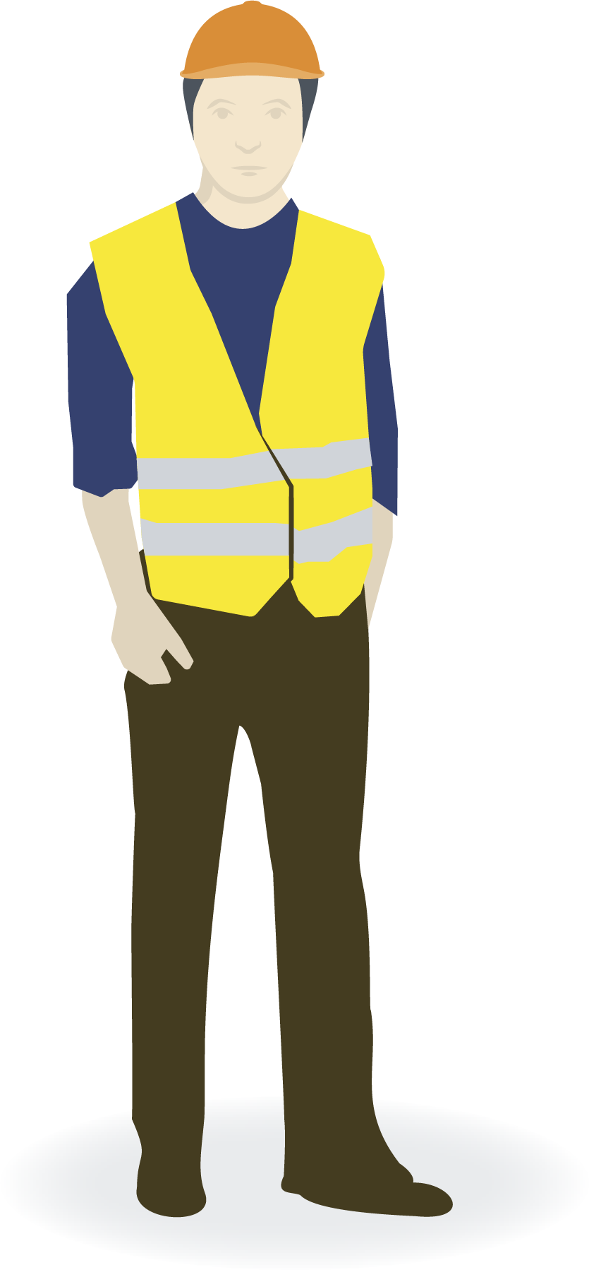
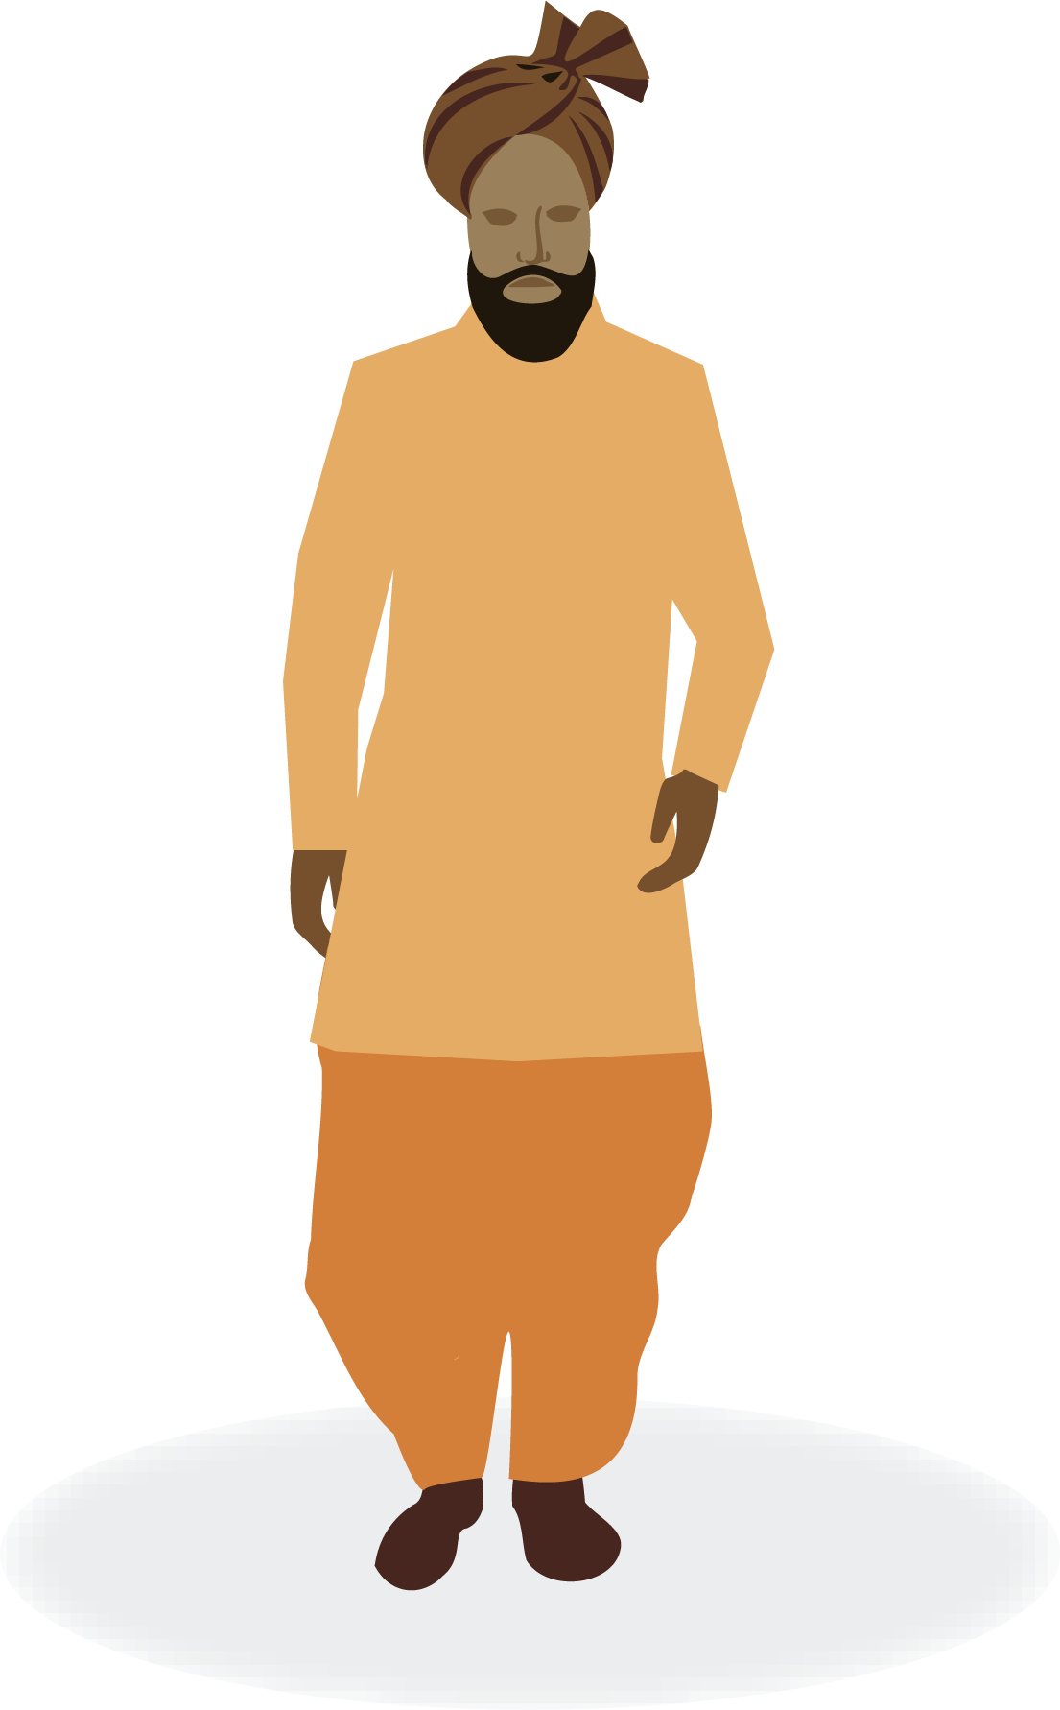
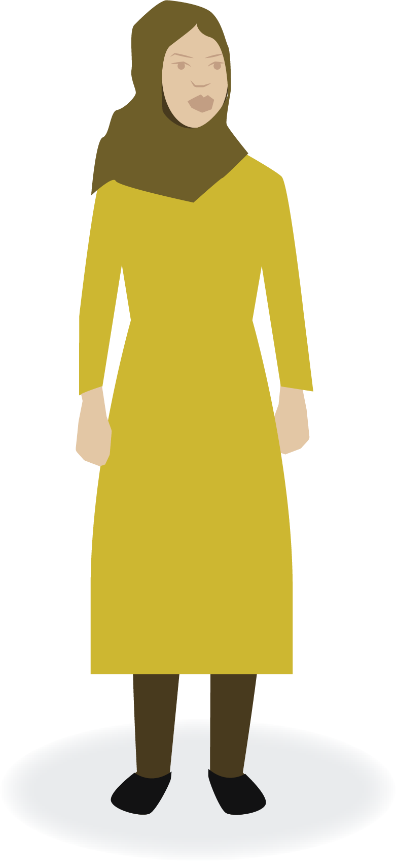
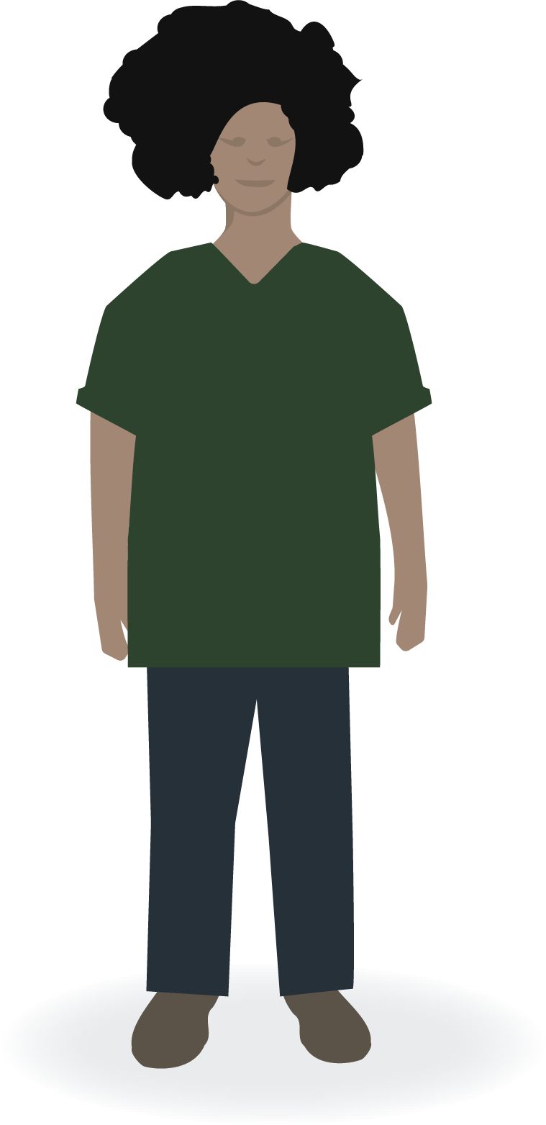
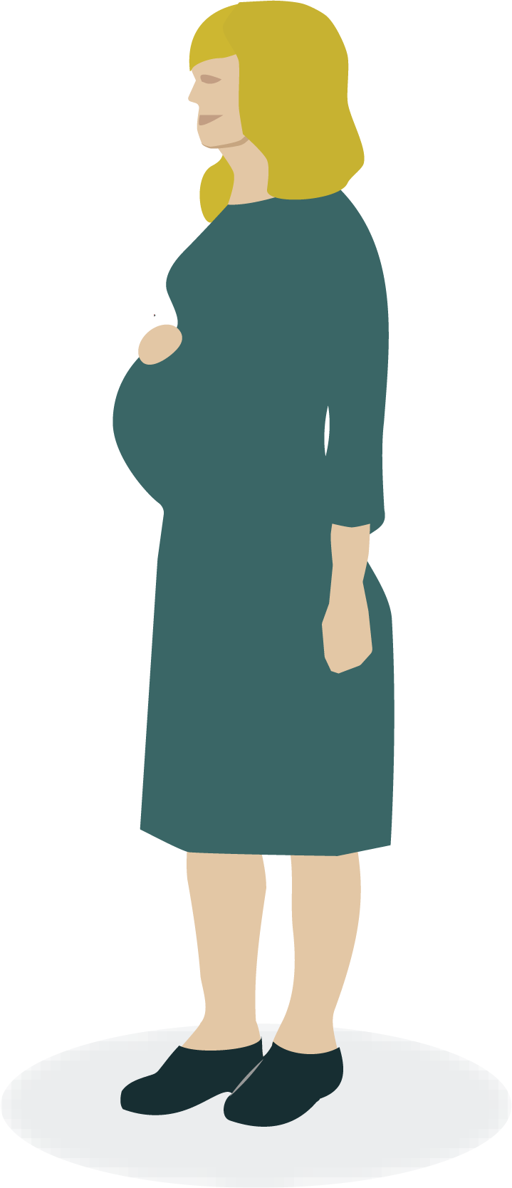
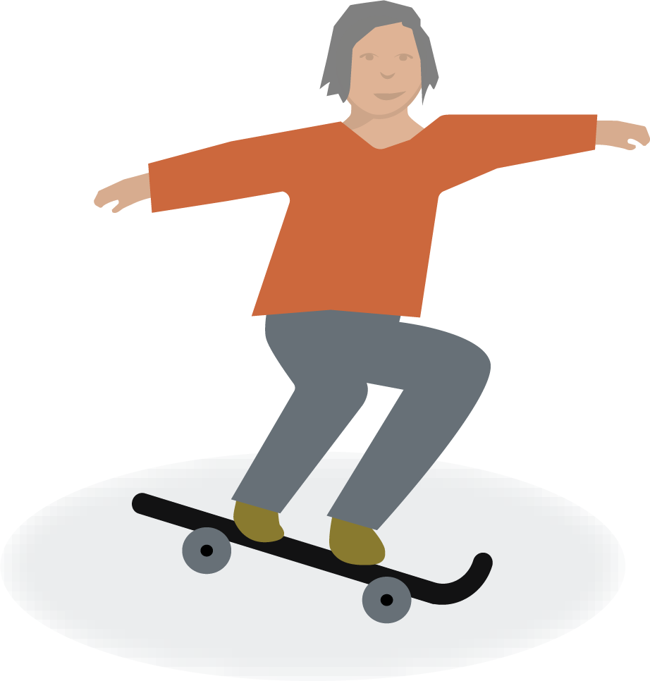
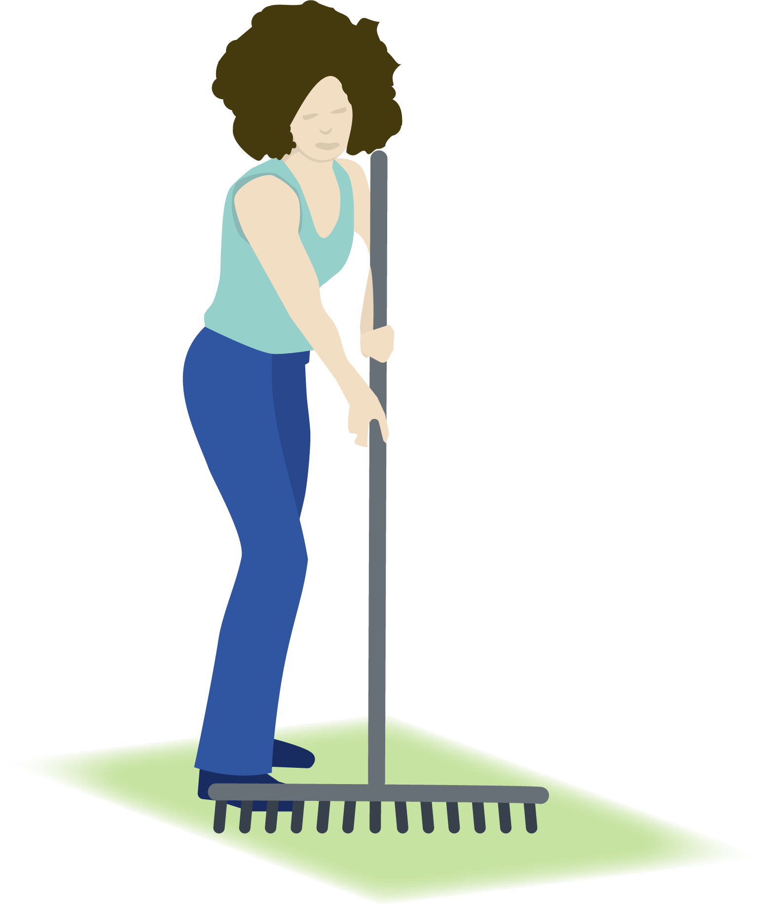
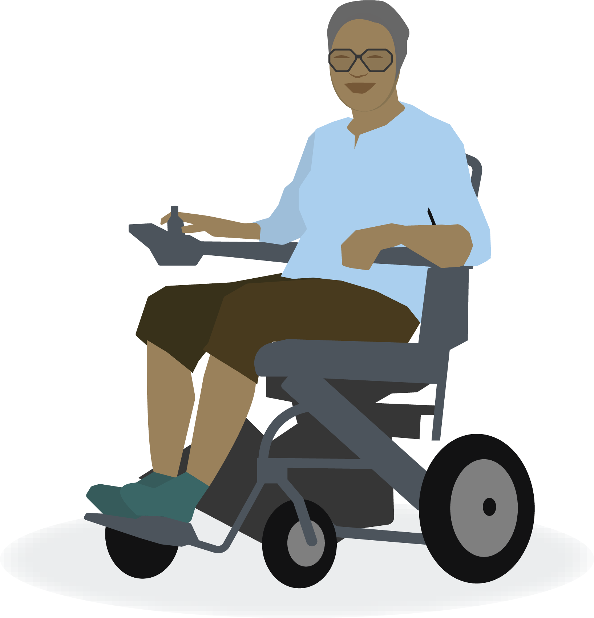
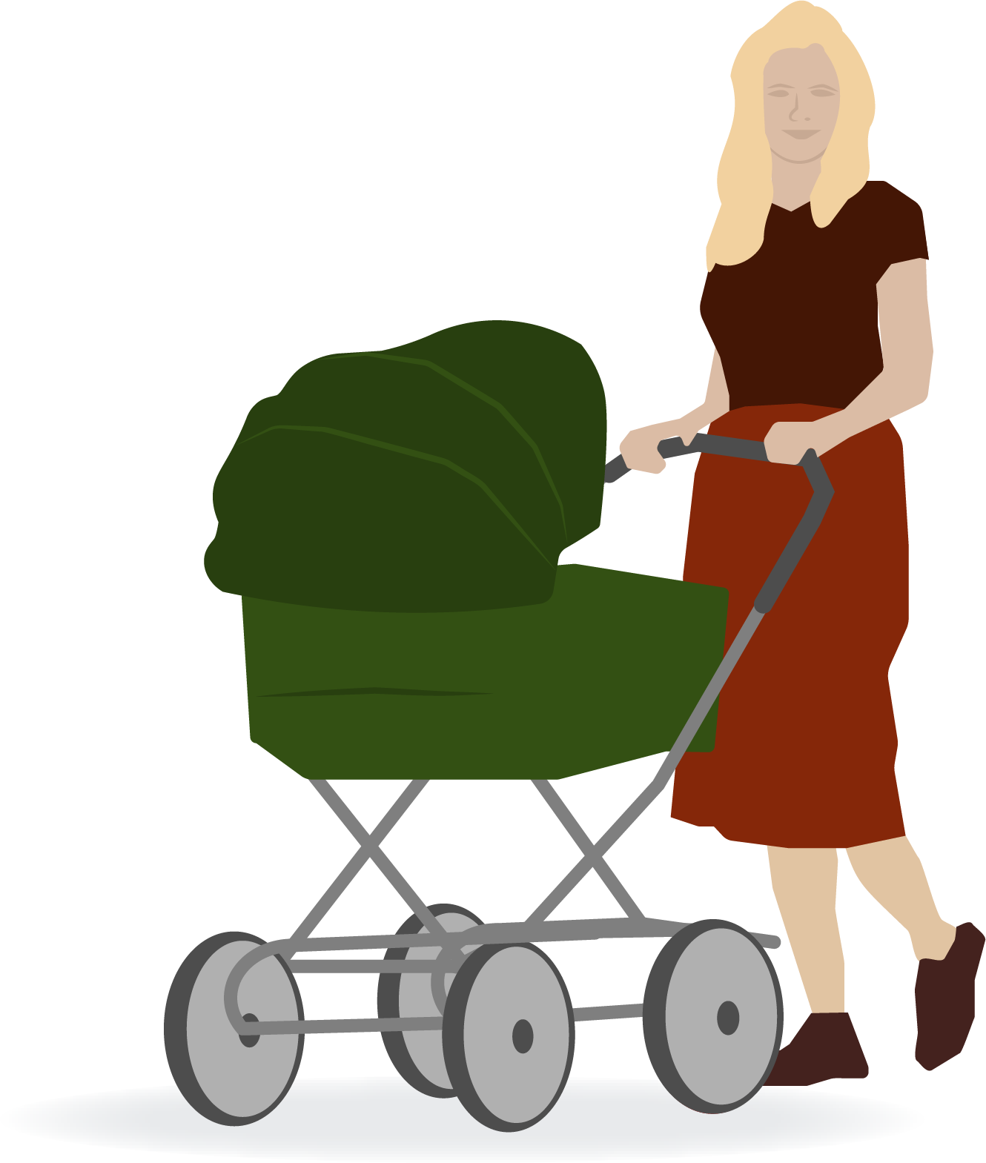
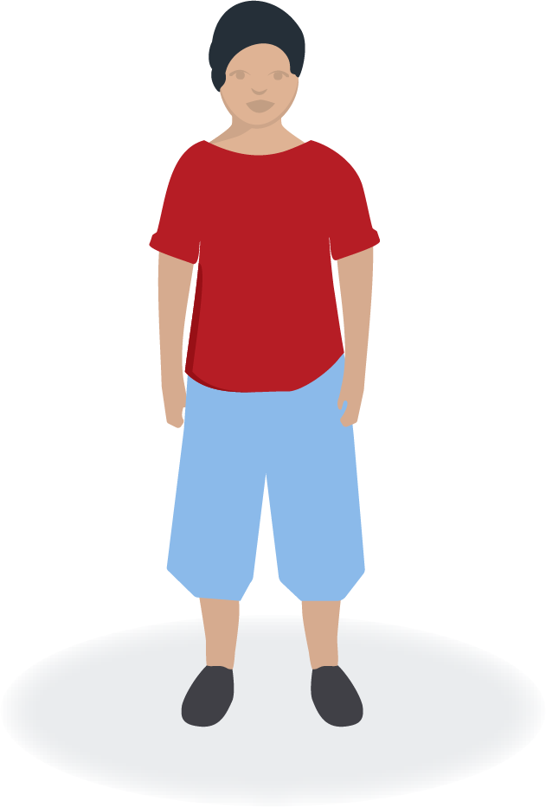
Notes:
Figures/persons

Slide 20
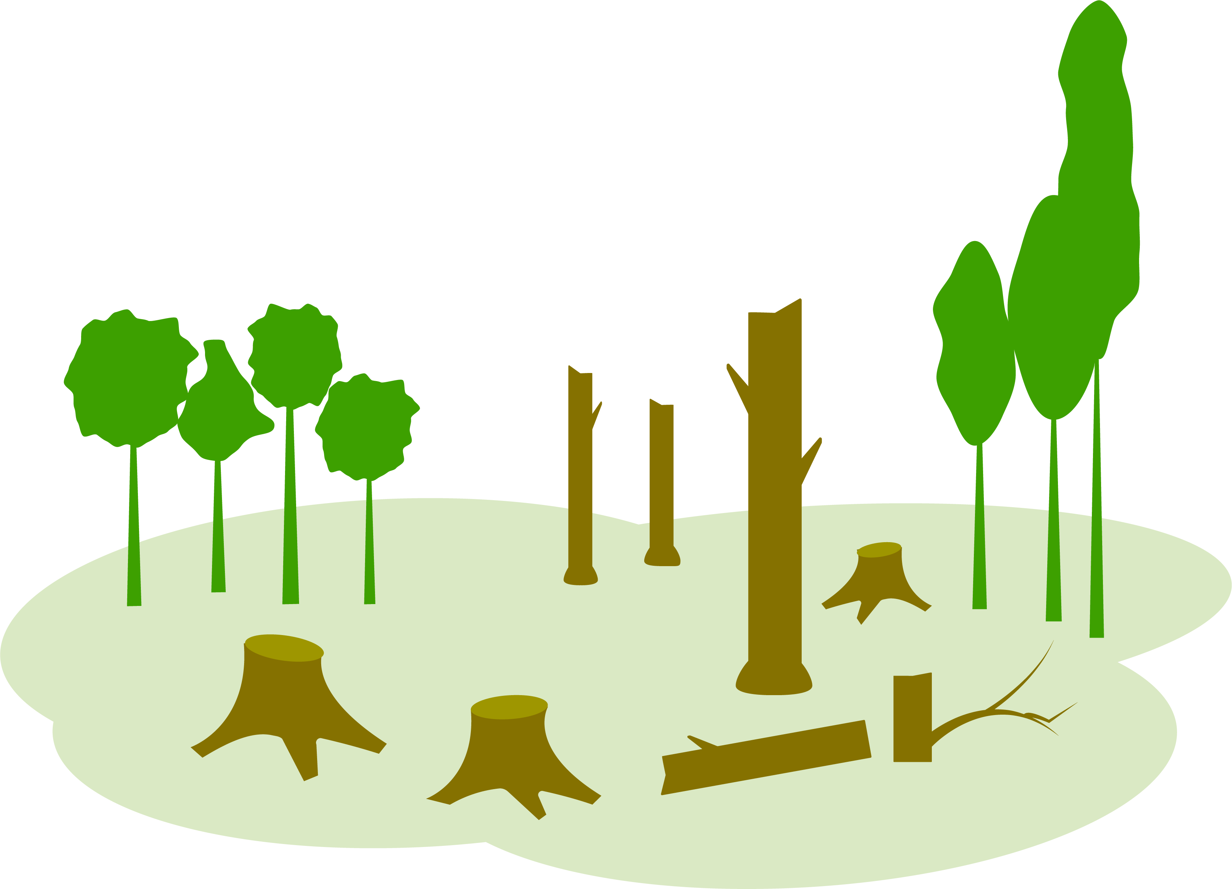
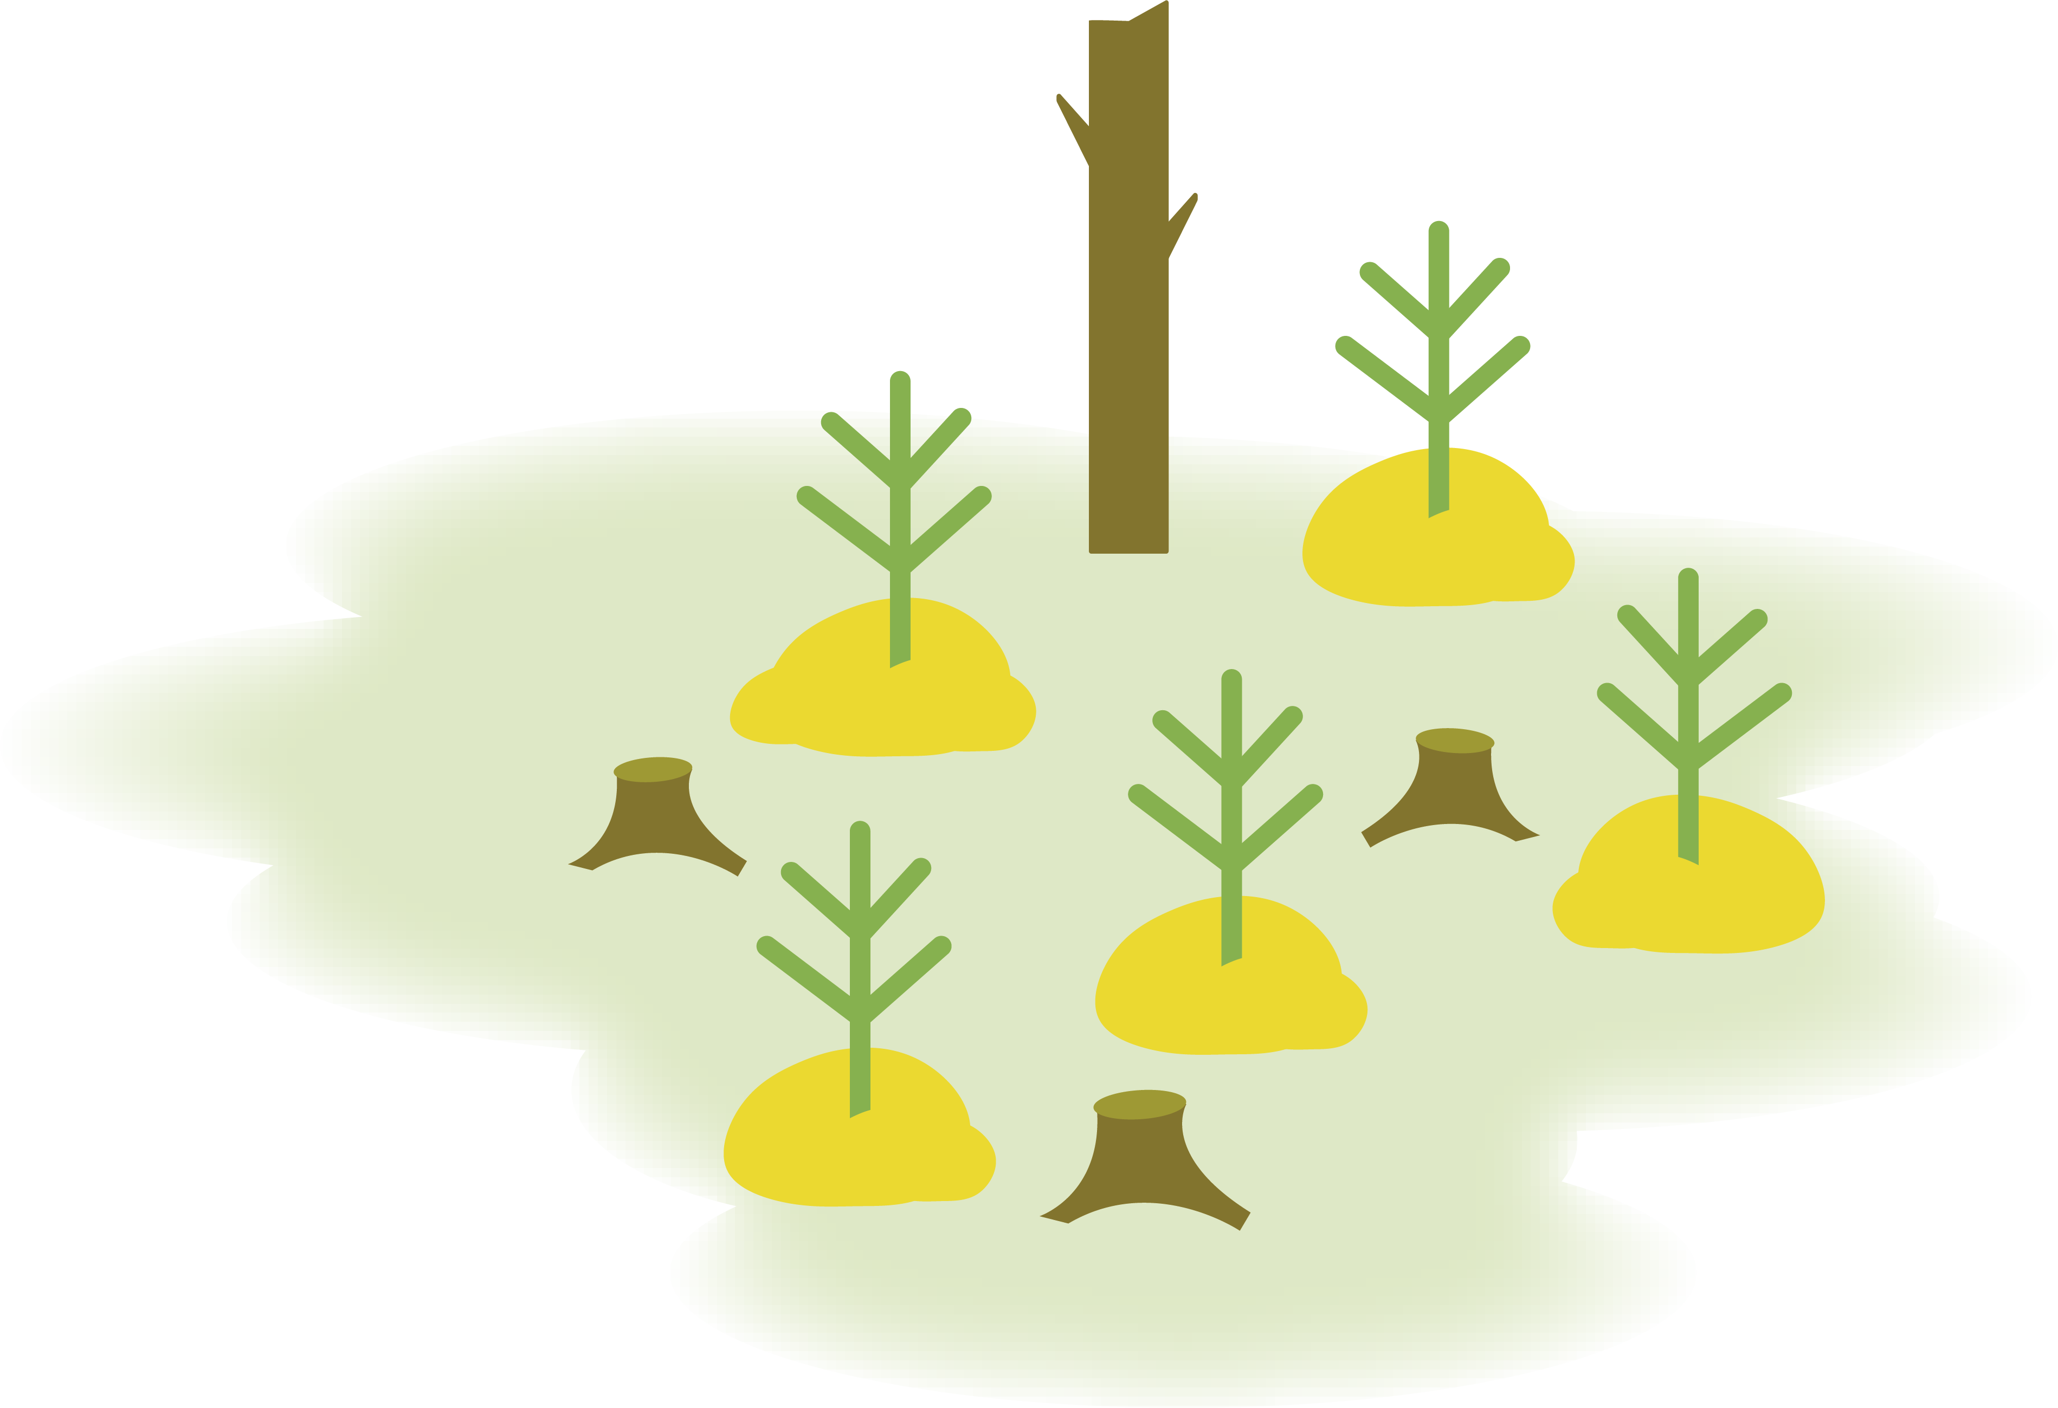
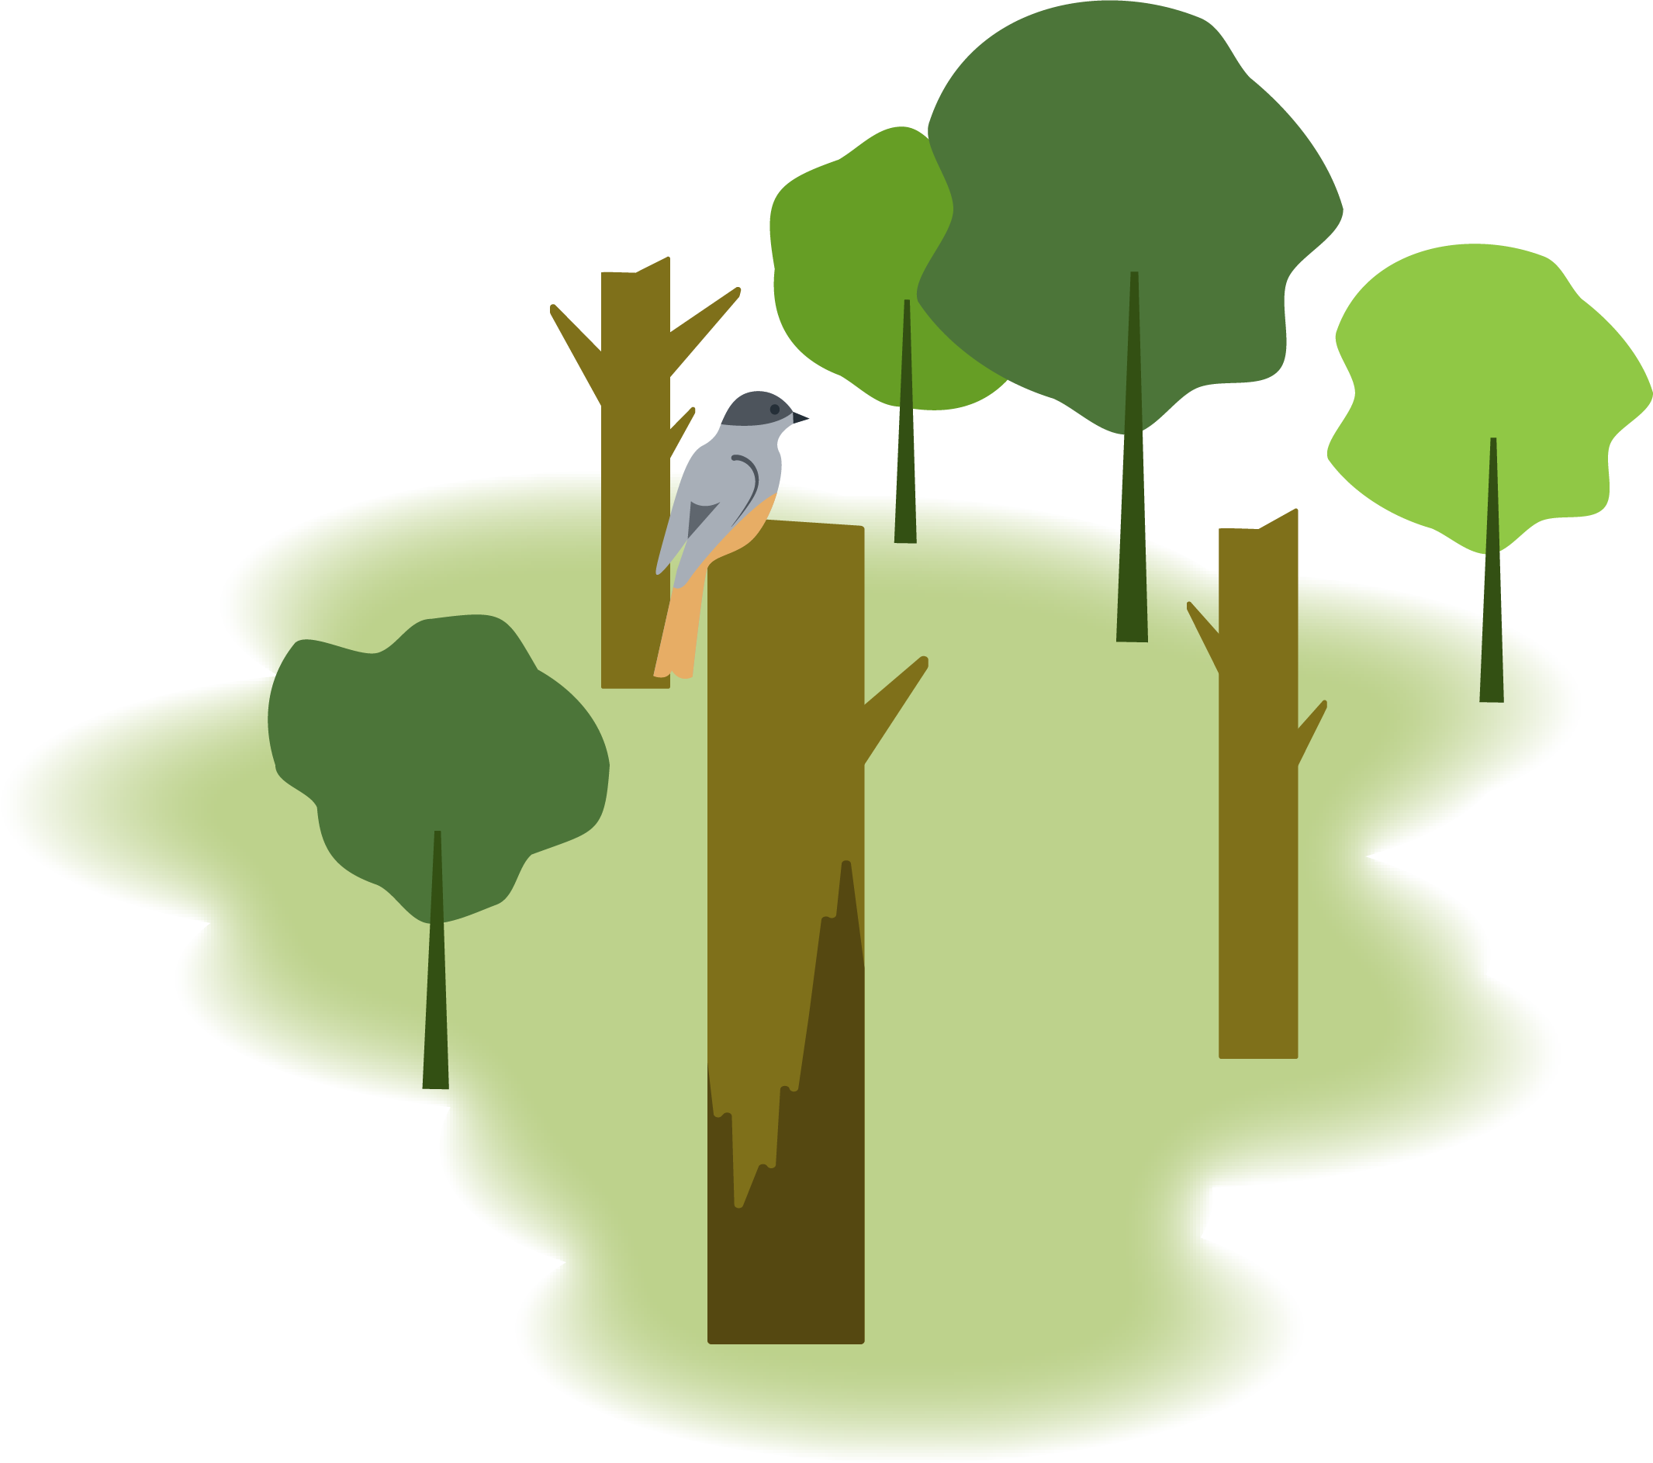
Notes:
Leafy tree

Slide 21
Notes:
Pine, mixed forest

Slide 22
Notes:
Buildings

Slide 23
Notes:
Buildings continued

Slide 24
Notes:
Various pictures

Slide 25
Notes:
Watercourse

